Slide 1
Business updates will begin at 8:30am.If you’re joining us now, feel free to chat amongst the group, check some email, or refill that coffee cup ☺

Slide 2
Improving Access to Work for Transgender Individuals Presented by Heidi Lucas, MS, LPC, AADC, CCSOTS
October 12th, 2021

Slide 3
Board of Directors – 2021
President: Jesse Sites, SHRM-SCP
President Elect: Courtney Carroll, SHRM-CP, GCDF
Treasurer: Wanda Bonfili (open in 2022)
Secretary: Lesley Hower, PHR, SHRM-CP (open in 2022)
Past President & Certification Chair: Harvey Ashworth, SPHR, SHRM-SCP
College Relations Chair: Pat Hubbard
Communications Chair: Morgan Gower
Membership Chair: Sabby Aldaya Lickey, SHRM-SCP
Workforce Readiness Chair: Open
Legislative Chair: Raylea Harvey, CEBs
Programming Co-Chair: Hadley Ward, PHR, SHRM-CP (open in 2022)
Programming Co-Chair: Jessica McIntosh, aPHR

Slide 4
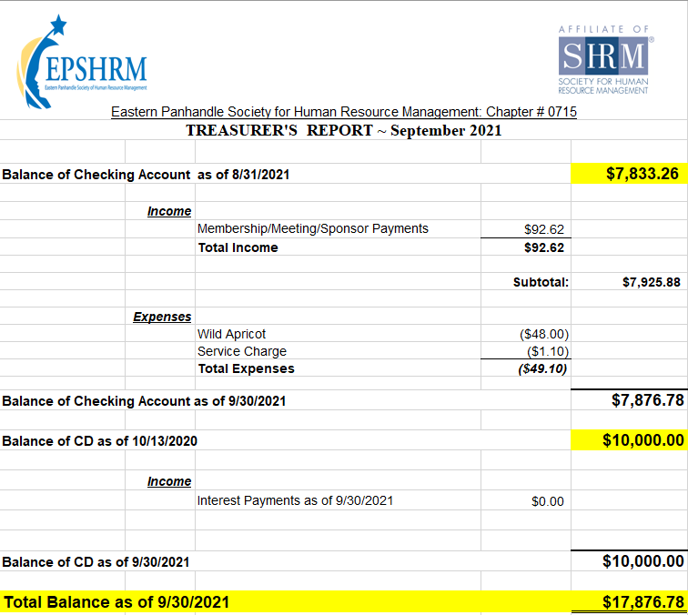
Treasurer’s Report

Slide 5
October Legislative Updates
Medicare Part D Notices: TOMORROW https://www.shrm.org/resourcesandtools/hr-topics/benefits/pages/deadline-nears-for-2020-medicare-part-d-coverage-notices.aspx
Guidance on COVID-19 Paid Leave Tax Credits: https://www.cupahr.org/blog/irs-issues-employer-guidance-on-covid-19-paid-leave-tax-credits/
EEO-1 Reporting Deadline October 25: https://www.paproviders.org/new-eeo-1-filing-deadline-reports-due-october-25-2021/
Trending Topics: https://www.shrm.org/ResourcesAndTools/tools-and-samples/exreq/Pages/Trending-Topics.aspx

Slide 6
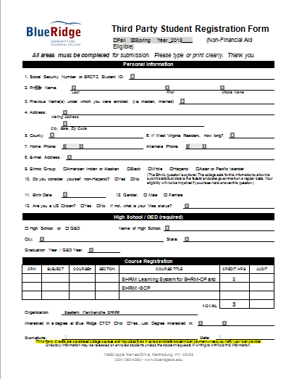

Slide 7
Upcoming Meetings
November 10th – HR Technology & Analytics Part 2 presented by Erica Young
December – Winter Social

Slide 8
Notes:
We will be sending a Programming survey to all members the week of October 18th. It has 15 “rate the importance of” type questions and 1 yes or no question. 16 total and it will take 3 minutes or less to complete. We really need their input on what they want to see for Programming in 2022.

Slide 10
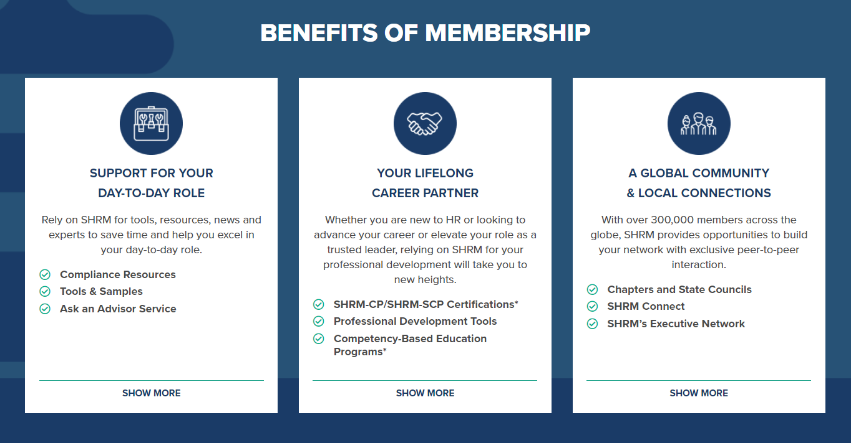

Slide 11
Notes:
About how you can bring about Organizational change. SHRM CEO Johnny C. Taylor and CEO of the Velvet Suite and Founder of the She-Suite Melissa Dawn Simpkins.

Slide 12
Notes:
The pandemic has upended everything about the workplace, but far and away the biggest challenge facing leaders isn’t technology, innovation, or even leadership: It’s engendering a culture that readily finds, develops, and engages the right talent to thrive now and in the future.
Informed by more than 70 years of SHRM experience and expertise and propelled by extensive original research, RESET delivers a candid and forward-thinking vision for leaders to reimagine their company cultures in a time of global upheaval and presents data-driven strategies to make the necessary foundational reset of all things work.

Slide 13
Notes:
Register by October 15 to take advantage of a special SHRM22 alumni rate.

Slide 14
Improving Access to Work for Transgender Individuals Presented by Heidi Lucas, MS, LPC, AADC, CCSOTS
Notes:
Heidi Lucas is a Licensed Professional Counselor practicing in Martinsburg, West Virginia. She graduated from West Virginia University with a Masters of Science in Rehabilitation Counseling. She has been working as a counselor for 23 years and specializes in working with people who have borderline personality disorder, trauma and/or substance misuse issues. Other credentials that she holds include Advanced Alcohol and Drug Counselor and Clinically Certified Sex Offender Treatment Specialist. Heidi is the Associate Director of Substance Abuse / Adult Services at Shenandoah Community Health where she has worked for the last 11 years. Her hobbies include crochet, painting and playing with her dogs, Jake and Bea.

