Slide 1
OSHA Enforcement Update: Trump’s Deregulatory
Agenda and Top 5 OSHA Issues in 2019 and Beyond
September 11, 2019
Dan C. Deacon, Esq.
© 2019 Conn Maciel Carey LLP All Rights Reserved Attorney Advertising www.connmaciel.com

Slide 2
Daniel C. Deacon ddeacon@connmaciel.com / 202.909.2738
Daniel C. Deacon is an Associate at Conn Maciel Carey in both the OSHA • Workplace Safety Practice Group and the Labor and Employment Group:
Represents employers during inspections and investigations conducted by the federal and state OSHA
Advises and counsels employers in responding to notices of employee safety complaints and OSHA citations
Represents and advises employers in all aspects of the employer-employee relationship including wage/hour disputes and claims of discrimination
Reviews and revises employee handbooks and workplace policies and procedures
© 2017 Conn Maciel Carey LLP All Rights Reserved Attorney Advertising www.connmaciel.com
© 2019 Conn Maciel Carey LLP All Rights Reserved Attorney Advertising www.connmaciel.com

Slide 3
Agenda
Top 5 OSHA Issues for 2019 and Beyond
Past is prologue: OSHA’s 2018 in review
New political landscape at OSHA
Looking Forward: Continuation of Obama-Era Policies
Status and future of OSHA’s deregulation agenda
Significant OSHA cases in 2019/2020
© 2019 Conn Maciel Carey LLP All Rights Reserved Attorney Advertising www.connmaciel.com
Notes:
Changed “issues” to “developments”

Slide 4
Past is Prologue: OSHA 2018 in Review
© 2019 Conn Maciel Carey LLP All Rights Reserved Attorney Advertising www.connmaciel.com

Slide 5
Enforcement Expectations
Expectation from Trump/Acosta OSHA has been a scaling back of enforcement-heavy philosophy and balancing with compliance assistance
Revising enforcement policies that tend to inflate civil penalties
Retiring many of the 9 National and 150 Regional and Local Enforcement Emphasis Programs
© 2019 Conn Maciel Carey LLP All Rights Reserved Attorney Advertising www.connmaciel.com
Notes:
<number>

Slide 6
Enforcement Reality
OSHA continues to implement the same number of enforcement emphasis programs as at the end of the Obama Administration:
150 Local and Regional Emphasis Programs
9 National Emphasis Programs (includes a new Chem/Ref PSM NEP)
Announced significant new Site-Specific Targeting Program
National Emphasis Programs:
Combustible Dust
Federal Agencies
Hazardous Machinery
Hexavalent Chromium
Lead
Primary Metal Industries
Chem/Ref PSM NEP
Shipbreaking
Trenching and Excavation
© 2019 Conn Maciel Carey LLP All Rights Reserved Attorney Advertising www.connmaciel.com
Notes:
<number>
10/23/2018

Slide 7
Fed OSHA Inspections
© 2019 Conn Maciel Carey LLP All Rights Reserved Attorney Advertising www.connmaciel.com

Slide 8
Violations Issued
© 2019 Conn Maciel Carey LLP All Rights Reserved Attorney Advertising www.connmaciel.com

Slide 9
Percentage of “In Compliance” Inspections
© 2019 Conn Maciel Carey LLP All Rights Reserved Attorney Advertising www.connmaciel.com

Slide 10
Average Penalty Per Serious Violation
© 2019 Conn Maciel Carey LLP All Rights Reserved Attorney Advertising www.connmaciel.com

Slide 11
$100K+ Penalty Cases
Obama Admin = Average of 165/year
Trump Admin = Average of 193/year
© 2019 Conn Maciel Carey LLP All Rights Reserved Attorney Advertising www.connmaciel.com

Slide 12
New Political Landscape
© 2019 Conn Maciel Carey LLP All Rights Reserved Attorney Advertising www.connmaciel.com
Notes:
<number>

Slide 13
House Oversight
Jan. 2019 – House of Reps controlled by Dems (235 D v. 199 R)
House Committee on Education & Labor (particularly the Workforce Protection Subcommittee), exercises oversight of OSHA – now controlled by Democrats
Now chaired by Rep. Bobby Scott (D-VA)
Plans for extensive OSHA-related oversight hearings:
Implementation of De-Regulatory Agenda
Publication of Injury & Illness Data
Perceived decrease in enforcement activity
Compel OSHA to develop emergency Workplace Violence rule
© 2019 Conn Maciel Carey LLP All Rights Reserved Attorney Advertising www.connmaciel.com

Slide 14
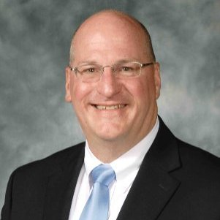
Will Trump Ever Get an Assistant Secretary of Labor for OSHA?
Still no Assistant Secretary of Labor
for OSHA
Longest ever vacancy for the top job
In 2018, Scott Mugno was re-nominated
and cleared by the Senate HELP Committee
Sat for a full year waiting for a full
Senate confirmation vote
Vote never happened – nomination returned to the White House
Withdrew nomination on May 14, 2019
Withdrew Nomination
Scott A. Mugno
Former VP of Safety at FedEx Ground
© 2019 Conn Maciel Carey LLP All Rights Reserved Attorney Advertising www.connmaciel.com

Slide 15
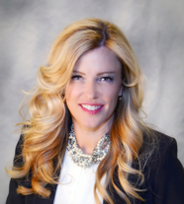
Shift in Balance of Political Power at OSHRC
Heather L.
MacDougall
Chairwoman
Trump-appointee
Cynthia L. Attwood
Commissioner
Obama-appointee
James J. Sullivan, Jr.
Commissioner
Trump-appointee
© 2019 Conn Maciel Carey LLP All Rights Reserved Attorney Advertising www.connmaciel.com

Slide 16
More Change at OSHRC
Heather L.
MacDougall
Chairwoman
Announced Resignation
(out April ‘19)
Cynthia L.
Attwood
Commissioner
Term Expired end of March 2019 (seeking re-appointment)
James J. Sullivan, Jr.
Commissioner
Current Chairman
© 2019 Conn Maciel Carey LLP All Rights Reserved Attorney Advertising www.connmaciel.com

Slide 17
Looking Forward: Continuation of Obama-Era Policies
© 2019 Conn Maciel Carey LLP All Rights Reserved Attorney Advertising www.connmaciel.com
Notes:
<number>

Slide 18
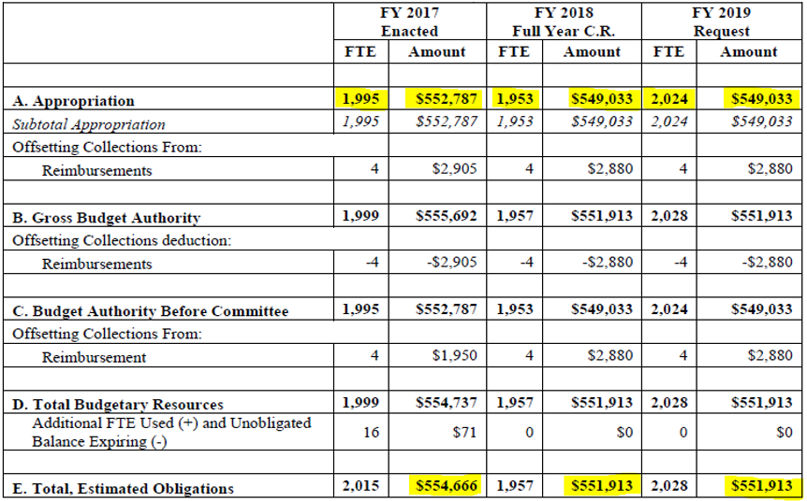
OSHA’s Budget
Last fall, OSHA got a new budget for FY2019 (October 2018 – September 2019) - $557,787,000
$5M increase over FY18
$9M more than Pres. Trump requested
Allocates $103M to OSHA for State OSH Programs (a $2M increase over FY18 – 1st increase since FY14)
$300,000 proposed increase in FY2020 Proposed Budget
Add 33 CSHOs and 5 whistleblower investigators
Greater allocation of budget towards enforcement ($3.8 million)
© 2019 Conn Maciel Carey LLP All Rights Reserved Attorney Advertising www.connmaciel.com
Notes:
<number>

Slide 19
Civil Penalties Rise… Again
Characterization | Historical Max | Aug. 2016 (80% Catch-up) | Jan. 2017 (Annual Bump) | Jan. 2018 (Annual Bump) | Jan. 2019 (Annual Bump – 2.5%)
Other-than-Serious | $7,000 | $12,471 | $12,675 | $12,934 | $13,260
Serious | $7,000 | $12,471 | $12,675 | $12,934 | $13,260
Willful | $70,000 | $124,709 | $126,750 | $129,336 | $132,598
Repeat | $70,000 | $124,709 | $126,750 | $129,336 | $132,598
Failure to Abate | $7,000 per day | $12,471 per day | $12,675 per day | $12,934 per day | $13,260 per day
© 2019 Conn Maciel Carey LLP All Rights Reserved Attorney Advertising www.connmaciel.com

Slide 20
Focus on Repeat Violations
 | 2002 | 2005 | 2008 | 2011 | 2013 | 2015 | 2016 | 2017 | 2018
Serious | 58,845 | 61,018 | 67,052 | 62,115 | 56,661 | 47,934 | 42,984 | 36,802 | 36,645
Repeat | 1,867 2.4% | 2,350 2.7% | 2,817 3.2% | 3,229 3.7% | 3,193 4.0% | 3,088 4.7% | 3,146 5.3% | 2,771 5.5% | 2,593 5.1%
Willful | 331 | 747 | 517 | 594 | 319 | 527 | 524 | 319 | 341
© 2019 Conn Maciel Carey LLP All Rights Reserved Attorney Advertising www.connmaciel.com

Slide 21
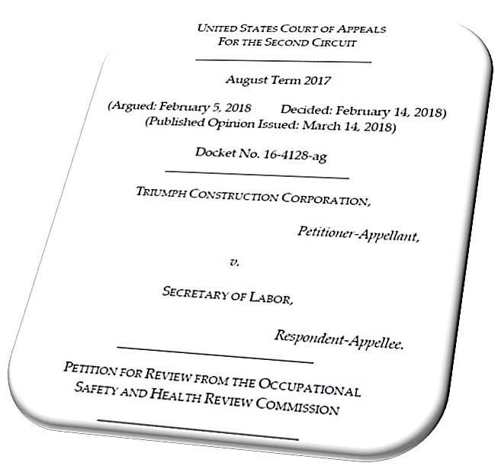
Unlimited Look Back
Triumph Construction v. Sec. of Labor – 2nd Circuit (February 2018)
Earlier versions of OSHA’s Field Operations Manual set 3 year look-back “policy” (i.e., OSHA looked back 3 years for past violations to serve as basis for a Repeat)
Obama’s OSHA expanded lookback to 5 years
In Triumph Construction, the 2nd Cir. held that OSHA is not bound by any express look-back policy b/c neither the OSH Act nor any OSHA regulation creates any look-back limit
© 2019 Conn Maciel Carey LLP All Rights Reserved Attorney Advertising www.connmaciel.com
Notes:
<number>

Slide 22
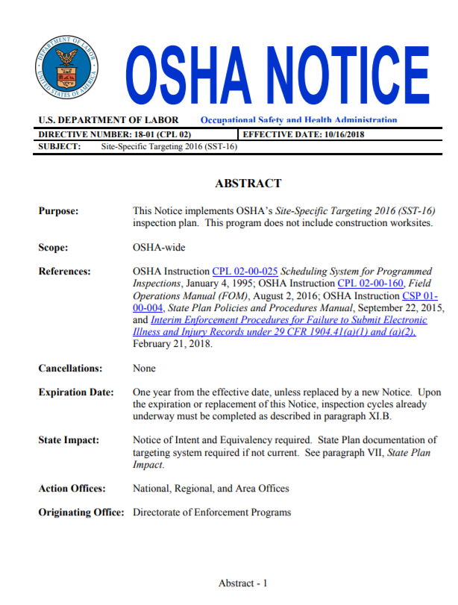
Site-Specific Targeting Inspection Plan
Oct. 16, 2018 - OSHA published its Site-Specific Targeting 2016 (SST-16) inspection plan
(Not So New) Enforcement Tool
Outlines OSHA’s strategy for
Targeting establishments for
inspection based on 300A injury
data collected under new E-Recordkeeping Rule
© 2019 Conn Maciel Carey LLP All Rights Reserved Attorney Advertising www.connmaciel.com

Slide 23
Who is Subject to SST-16 Inspections?
SST-16 selects establishments for inspection based on CY16 300A injury data
Establishments covered by SST-16 include:
Establishments w/ DART rate above currently unpublished threshold
NOTE - different DART rate trigger for manufacturing and non-manufacturing establishments
Random set of establishments OSHA believes were required to submit 2016 300A injury data under E-Recordkeeping Rule but did not
Random sample of establishments w/ unusually low-injury rates (for quality control purposes and to identify possible under-recording)
© 2019 Conn Maciel Carey LLP All Rights Reserved Attorney Advertising www.connmaciel.com

Slide 24
Scope of SST
Inspections will be comprehensive in scope
Coordinated with NEPs – i.e. if an establishment that is covered by a NEP and happens to be selected for inspection under SST-16 Plan, the SST and NEP inspections will run concurrently (classified separately)
Targeted establishments will be deleted from list if:
No longer in business
Received a comprehensive safety/health inspection w/in 36 months of creating current inspection cycle list;
VPP or SHARP participant
Public sector employer (federal, state, or local gov.)
© 2019 Conn Maciel Carey LLP All Rights Reserved Attorney Advertising www.connmaciel.com

Slide 25
Expanding Use of General Duty Clause
OSHA has been expanding the use the General Duty Clause to cite employers, focusing on:
Ergonomics
Workplace Violence
Heat Stress
Chemical Exposures below PEL
© 2019 Conn Maciel Carey LLP All Rights Reserved Attorney Advertising www.connmaciel.com

Slide 26
OSHA Enforcement of Silica Rule
Most likely to cite manufacturers for risk-assessment issues
Of 42 Silica citations issued by Fed OSHA or State Plans as of Jan. 4, 2019, 38% are for not meeting assessment requirements
Other common citations - lack of a written exposure control plan and training workers on avoiding inhalation
Most fines were low
62% w/ proposed fined $500 or less (even though Trump’s OSHA has left the rule intact, enforcement is lax)
Most inspections based on employee complaints
© 2019 Conn Maciel Carey LLP All Rights Reserved Attorney Advertising www.connmaciel.com

Slide 27
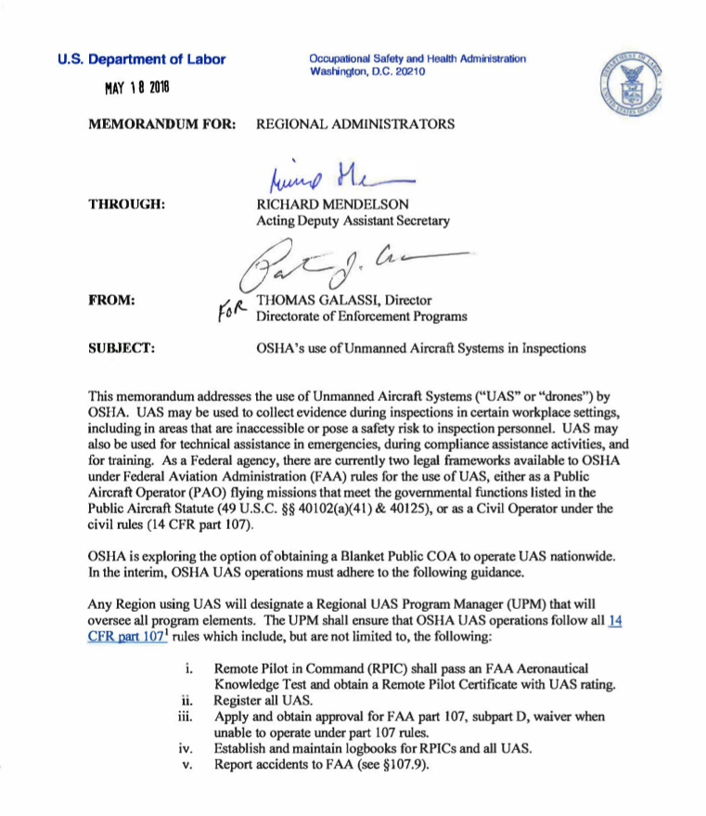
Inspection by Drone
May 2018 Memo: OSHA may use Drones during inspections to collect evidence, including areas that are inaccessible or dangerous for inspectors
Also used for technical assistance in an emergency, training, or compliance assistance
Operation must comply w/ FAA
OSHA to obtain prior employer consent
To ensure safety / cooperation of affected individuals, OSHA must notify on-site personnel of aerial inspection pre-launch
© 2019 Conn Maciel Carey LLP All Rights Reserved Attorney Advertising www.connmaciel.com

Slide 28
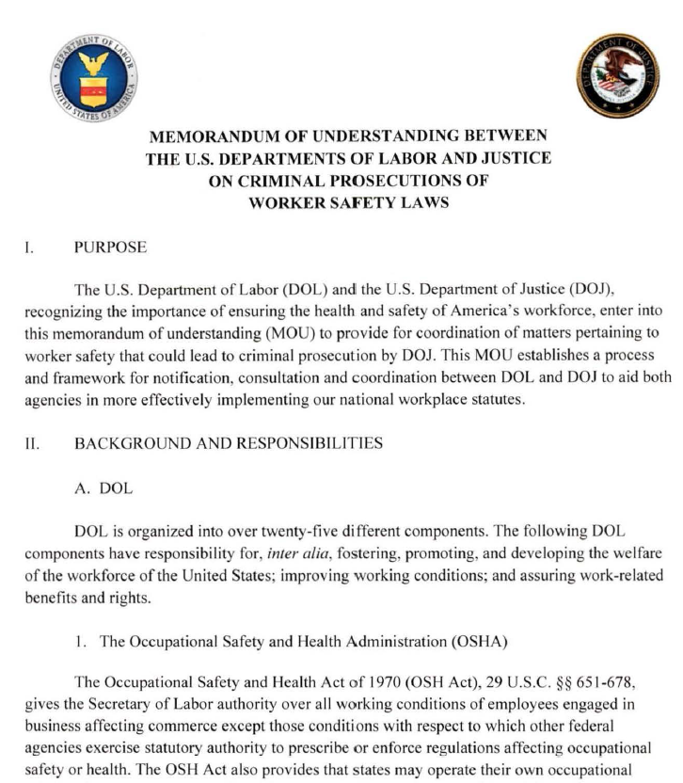
Criminal Prosecution – Status Quo
DOJ Continues Obama-Era Worker Safety Criminal Policies
2 DOJ Memos by Dept. Attorney General Sally Yates
Yates #1: Individual Accountability for Corp. Wrongdoing (Sept. 2015)
Yates #2: Use environmental laws w/ stronger enforcement teeth to prosecute worker safety crimes
June 18, 2019: Yates 1 and 2 remain Dept. of Justice policy
© 2019 Conn Maciel Carey LLP All Rights Reserved Attorney Advertising www.connmaciel.com

Slide 29
The Future of OSHA Deregulation
© 2019 Conn Maciel Carey LLP All Rights Reserved Attorney Advertising www.connmaciel.com
Notes:
<number>

Slide 30
“Deconstruction of Administrative State”
Candidate Trump on Campaign Trail:
Get the federal government
out of your workplace
Give more jurisdiction to States
Ease regulatory burden
on Economy
Repeal rules recently
promulgated by Obama Admin.
“Deconstruction of the administrative state.... If you look at these cabinet appointees, they were selected for a reason and that is the deconstruction. The way the progressive left runs, is if they can’t get it passed, they’re just going to put in some sort of regulation in an agency. That’s all going to be deconstructed . . . .”
© 2019 Conn Maciel Carey LLP All Rights Reserved Attorney Advertising www.connmaciel.com

Slide 31
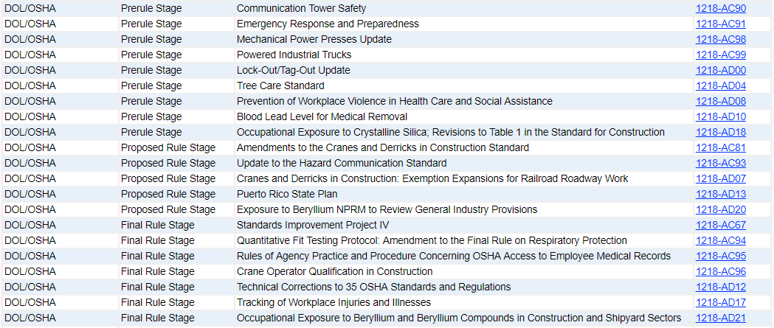
Trump’s Spring 2019 Regulatory / Deregulatory Agenda
Published May 2019
ID agency rulemaking priorities
Indicates status and priority of current rulemakings
ID new/cancelled rulemakings
Updates status of regulatory trading
© 2019 Conn Maciel Carey LLP All Rights Reserved Attorney Advertising www.connmaciel.com
Notes:
<number>

Slide 32
Rollback of Major Existing OSHA Rules?
E-Recordkeeping Rule
Final Rule Published
Beryllium Standard
Final Rule Stage (Gen. Industry); Final Rule Stage (Constr. & Shipyard)
HazCom Standard
Proposed Rule Stage
Lockout/Tagout
Prerule Stage (Updates); Final Rule (SIP IV)
Silica Rule
Prerule Stage
© 2019 Conn Maciel Carey LLP All Rights Reserved Attorney Advertising www.connmaciel.com
Notes:
<number>

Slide 33
Trump Changing Course on Electronic Recordkeeping?
OSHA issued a Notice of Proposed Rulemaking on July 30, 2018 with two proposed changes:
Eliminate requirement for large establishments (250+ employees) to annually submit 300 Logs and 301 Incident Reports; and
Require establishments to submit Employer Identification #
NPRM does NOT address publishing data, or anti-retaliation provisions (drug testing, safety incentives, executive compensation, etc.)
Final Amended Rule published Jan. 2019
© 2019 Conn Maciel Carey LLP All Rights Reserved Attorney Advertising www.connmaciel.com

Slide 34
More Updates to HazCom
2012 HazCom update aligned OSHA’s rule w/ GHS Rev. 3 (2009)
Since HazCom 2012, GHS up to Rev. 7 (2017)
OSHA working on more HazCom revisions:
Realign HazCom w/ more current GHS ver.
Address issues identified through 2 - 4 years implementing HazCom 2012
Not de-regulatory (would actually enhance current requirements)
BUT, OSHA since moved HazCom to its long-term action list
© 2019 Conn Maciel Carey LLP All Rights Reserved Attorney Advertising www.connmaciel.com
Notes:
<number>

Slide 35
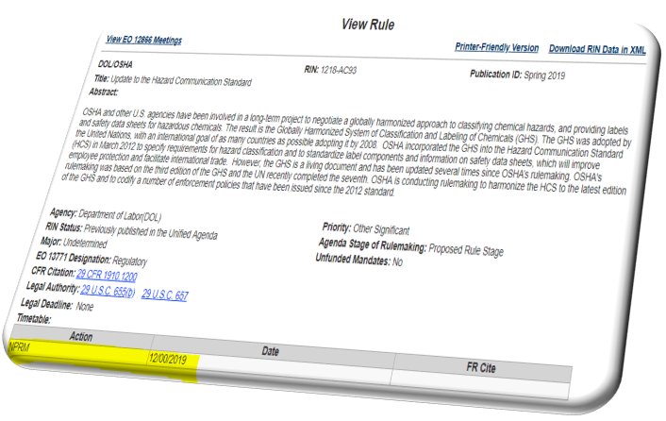
HazCom Updates
OSHA has been planning to further update HazCom since Fall 2014 when it first appeared in the Regulatory Agenda
No action was listed until the Fall 2016 (midnight Obama-era) Regulatory Agenda saying OSHA would issue a NPRM in Oct. 2017
Subsequent (Trump-era) Regulatory Agendas only listed the NPRM status as “TBA” until Spring 2018 Reg Agenda laid out a timeframe – Feb. 2019
No NPRM until Dec. 2019
© 2019 Conn Maciel Carey LLP All Rights Reserved Attorney Advertising www.connmaciel.com
Notes:
<number>

Slide 36
SIP IV – Rewriting LOTO
One rulemaking on Trump’s First Reg. Agenda was moved to the “Final Rule Stage” - Standards Improvement Project IV
Intent of SIP is to make non-controversial changes to confusing, conflicting, or outdated standards
SIP IV proposes to remove language “unexpected energization” from the LOTO standard
OSHA interpreted LOTO to apply if “employee could be injured if equipment is energized”
Would reverse GM-Delco decision that interprets “unexpected energization” to exempt LOTO if machine fore-warns movement
© 2019 Conn Maciel Carey LLP All Rights Reserved Attorney Advertising www.connmaciel.com
Notes:
<number>

Slide 37
SIP Phase IV Final Rule
SIP IV Final Rule published 5/13/19 w/out the LOTO change
But the decision not change may not be the last word on this:
“OSHA continues to believe … GMC Delco misconstrued the ‘unexpected’ language of the LOTO standard. However, OSHA also acknowledges the overwhelming opposition to this change [in SIP IV] and agrees w/ the many comments that cited complications due to technological advancements…. In light of the…comments, OSHA is not in a position at this time to make a final decision on this issue. As a result, the agency will not finalize its proposal to remove the word ‘unexpected’ from the control of hazardous energy standard but will further consider this issue in light of the overall standard.”
And then OSHA issued an RFI a week later re: potential changes to LOTO based on new energy control technology, which could open the door to also address “unexpected energization”
© 2019 Conn Maciel Carey LLP All Rights Reserved Attorney Advertising www.connmaciel.com

Slide 38
Significant OSHA Cases in 2019/2020
© 2019 Conn Maciel Carey LLP All Rights Reserved Attorney Advertising www.connmaciel.com
Notes:
<number>

Slide 39
Numerous E-recordkeeping Challenges
TEXO ABC/AGC v. DOL, (N.D. Tex. July 2016) – Industry challenge to anti-retaliation provisions of original rule
Nat’l Assn of Home Builders, (W.D. Okla. Jan. 2017) – data submission challenge
Both cases were stayed pending a Notice of Proposed Rulemaking promised by the Trump Administration that industry hoped would substantially revise the Rule
Stay likely to be lifted soon b/c NPRM does not address most of Industry’s concerns
Public Citizen v. DOL, (D.D.C. Jan. 2018) – Challenge to FOIA withholding
Trump’s OSHA sued for declining to publish already-collected injury data or share it in response to FOIA under FOIA exemption for active law enforcement investigations (i.e., using data to target under SST) and for confidential “commercial or financial information”
Public Citizen v. DOL, (DC Cir. Jan. 2019) – Challenge to Final Amended Rule removing requirement for large employers to submit 300 and 301 Level Data. Companion legal challenges by numerous states, also.
© 2019 Conn Maciel Carey LLP All Rights Reserved Attorney Advertising www.connmaciel.com

Slide 40
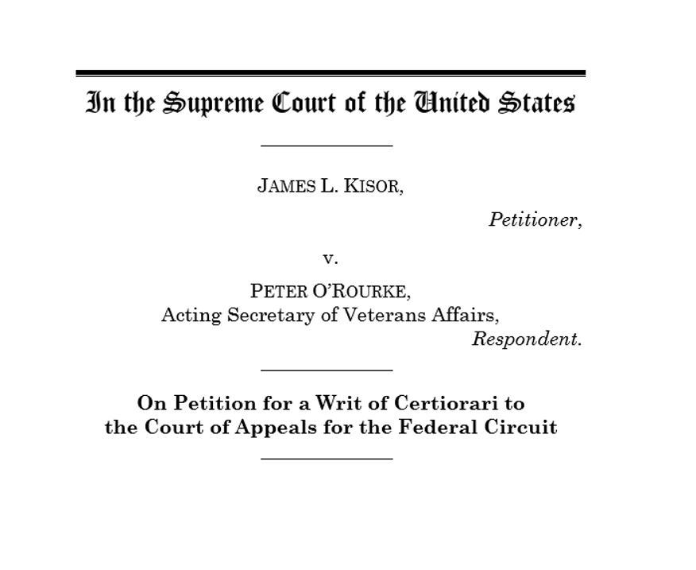
End of Agency Deference? No
In Dec. 2018, Sup. Ct. granted cert. in Kisor v. Wilkie
Kisor involves a veteran who was treated at the VA:
VA regs say “relevant” records to be considered in reopened cases – but “relevant” is not defined by VA
Auer deference – VA decides what “relevant” means
Can agency choose any non-arbitrary interpretation it wants, or can Judge decide the most reasonable?
June 26, 2019 plurality opinion
Decision reinforced “Auer” deference but expanded on limitations governing deference to agency interpretations of ambiguous regulations
© 2019 Conn Maciel Carey LLP All Rights Reserved Attorney Advertising www.connmaciel.com
Notes:
Courts may defer to an agency interpretation only if five criteria are satisfied:
Genuine ambiguity: Auer deference is limited to those circumstances where a “regulation is genuinely ambiguous.” To declare a regulation ambiguous, “a court must exhaust all the ‘traditional tools’ of construction.”
Reasonable construction: To warrant deference, the agency’s construction of the ambiguous regulation must be “reasonable.” The Court underscored that this is “a requirement an agency can fail.”
Proper authority: The agency construction “must be the agency’s ‘authoritative’ or ‘official’ position.” If the decision is “ad hoc,” it does not warrant deference. Likewise, if the interpretation stems from an actor who cannot “make authoritative policy in the relevant context,” no deference is appropriate. In particular, the Court identified that administrative law judges in the Department of Veterans’ Affairs—which number to about 100, issuing 80,000 decisions a year—likely are not sufficiently authoritative to warrant deference.
Substantive expertise: Deference is limited to those agency’s constructions that “in some way implicate its substantive expertise.” If the interpretative task is one that “fall[s] more naturally into a judge’s bailiwick,” then deference is not appropriate.
No surprises: The agency’s decision “must reflect ‘fair and considered judgment.'” For this reason, “convenient litigating position[s]” and “post hocrationalization[s]” do not trigger deference. Nor does an interpretation that “creates ‘unfair surprise’ to regulated parties.” This often occurs when an agency changes its position, or when a new agency rule imposes retroactive liability.
<number>

Slide 41
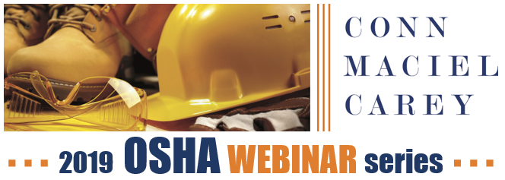

Slide 42
Save the Date
2nd Annual
Process Safety Summit
in Washington, DC
October 15-16, 2019

Slide 43
Check out our OSHA Blog:
www.OSHADefenseReport.com
© 2019 Conn Maciel Carey LLP All Rights Reserved Attorney Advertising www.connmaciel.com

Slide 44
QUESTIONS?
© 2019 Conn Maciel Carey LLP All Rights Reserved Attorney Advertising www.connmaciel.com

Slide 45
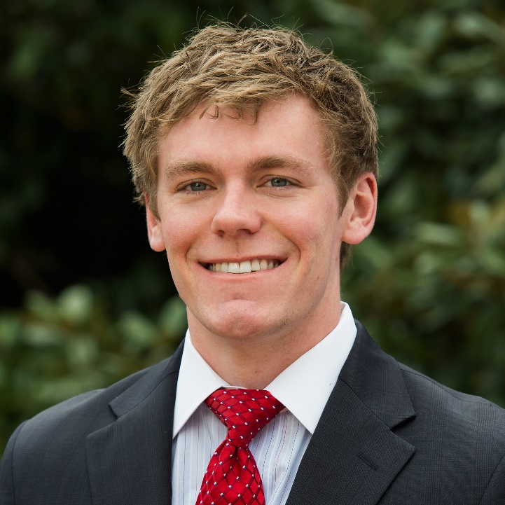
Contact Information
DAN DEACON
Associate, OSHA • Workplace Safety Group
Conn Maciel Carey LLP
Washington, D.C.
202.909.2738
ddeacon@connmaciel.com
© 2018 Conn Maciel Carey LLP All Rights Reserved Attorney Advertising www.connmaciel.com
© 2019 Conn Maciel Carey LLP All Rights Reserved Attorney Advertising www.connmaciel.com

