Slide 1
Business updates will begin at 8:30am.If you’re joining us now, feel free to chat amongst the group, check some email, or refill that coffee cup ☺

Slide 2
Talent Tech Trends Presented by Erica Young, MPS, SHRM-SCP
November 10th, 2021

Slide 3
Board of Directors – 2021
President: Jesse Sites, SHRM-SCP
President Elect: Courtney Carroll, SHRM-CP, GCDF
Treasurer: Wanda Bonfili (open in 2022)
Secretary: Lesley Hower, PHR, SHRM-CP
Past President & Certification Chair: Harvey Ashworth, SPHR, SHRM-SCP
College Relations Chair: Pat Hubbard
Communications Chair: Morgan Gower
Membership Chair: Sabby Aldaya Lickey, SHRM-SCP
Workforce Readiness Chair: Kim Moss
Legislative Chair: Raylea Harvey, CEBs
Programming Co-Chair: Hadley Ward, PHR, SHRM-CP
Programming Co-Chair: Jessica McIntosh, aPHR

Slide 4
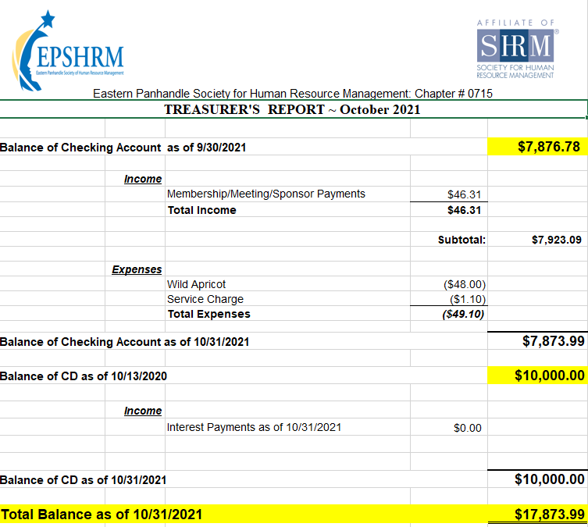
Treasurer’s Report

Slide 5
November Legislative Updates
Infrastructure Investment and Jobs Act: https://advocacy.shrm.org/wp-content/uploads/2021/08/SHRM-Summary_Infrastructure-Investment-and-Jobs-Act.pdf
OSHA Issues COVID-19 Workplace Vaccine-or-Testing Policy: https://www.shrm.org/ResourcesAndTools/legal-and-compliance/employment-law/Pages/OSHA-Issues-COVID-19-Workplace-Vaccine-and-Testing-ETS.aspx
UPDATES: https://www.shrm.org/ResourcesAndTools/tools-and-samples/how-to-guides/Pages/How-to-Comply-with-OSHA-COVID-19-Vaccination-Emergency-Temporary-Standard.aspx

Slide 6
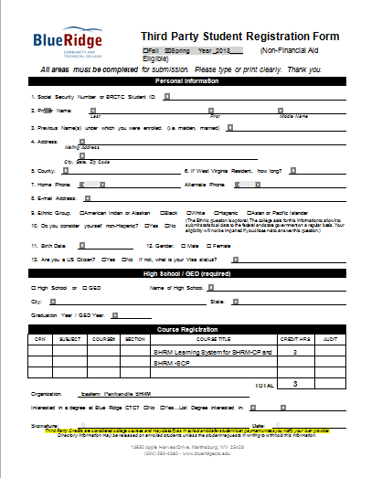

Slide 7
Notes:
We will be sending a Programming survey to all members the week of October 18th. It has 15 “rate the importance of” type questions and 1 yes or no question. 16 total and it will take 3 minutes or less to complete. We really need their input on what they want to see for Programming in 2022.

Slide 8
Upcoming Meetings
December – Winter Social
February – Work Style Tests and Assessments
March – Build Depth and Plan for Succession

Slide 10
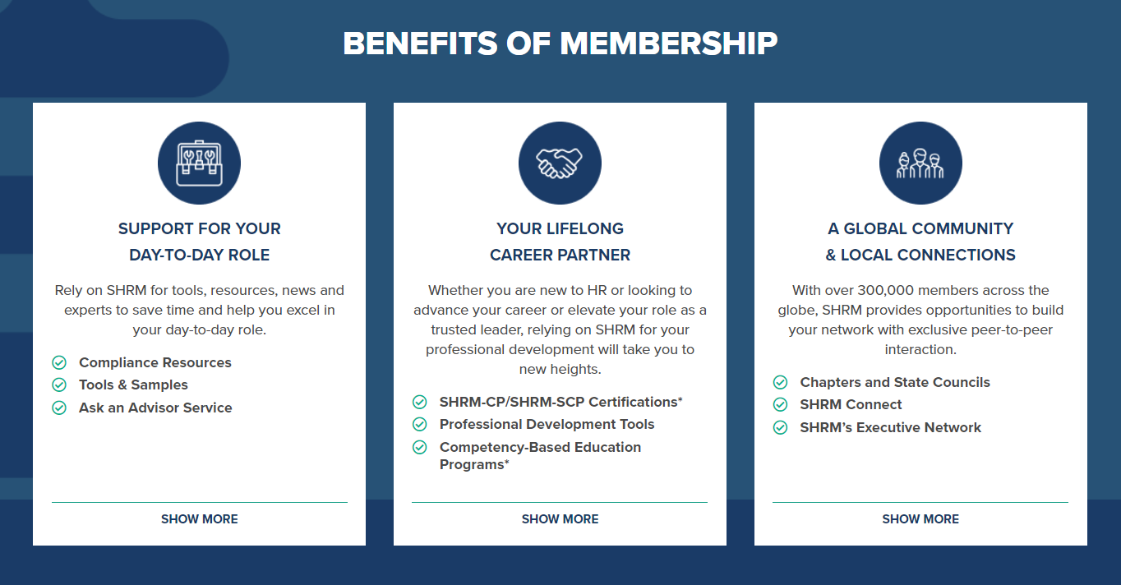

Slide 11
Notes:
About how you can bring about Organizational change. SHRM CEO Johnny C. Taylor and CEO of the Velvet Suite and Founder of the She-Suite Melissa Dawn Simpkins.

Slide 13
Notes:
The pandemic has upended everything about the workplace, but far and away the biggest challenge facing leaders isn’t technology, innovation, or even leadership: It’s engendering a culture that readily finds, develops, and engages the right talent to thrive now and in the future.
Informed by more than 70 years of SHRM experience and expertise and propelled by extensive original research, RESET delivers a candid and forward-thinking vision for leaders to reimagine their company cultures in a time of global upheaval and presents data-driven strategies to make the necessary foundational reset of all things work.

Slide 15
Talent Tech Trends Presented by Erica Young, MPS, SHRM-SCP
Notes:
Erica is proud to have started her career in Washington, DC by completing two terms of AmeriCorps service and managing volunteer and team talent. She then pivoted into organizational development and instructional design. Since joining SHRM, Erica has held three roles. She started off building research-based products, then moved onto the founding SHRMLabs team. SHRMLabs explores the intersections of work and technology. Because of her work on SHRMLabs, she came across hundreds of budding workplace technology solutions and speaks to the HR and talent community about talent tech trends. Now, Erica connects enterprise organizations with solutions that impact the people and the business.
Erica has a master’s degree in Industrial/Organizational Psychology, with a focus on instructional systems design. She earned her SHRM-SCP, is a co-host on the podcast, Career Compass, and consistently speaks as a SHRM Speaker’s Bureau speaker on workplace tech and the future of work. Outside of work, you can find Erica tending to her 200 houseplants, studying acting, and giving her cat, Suki, more attention than she wants.

