Slide 1
Speak for Yourself by Presented by Vicky Fields
November 10th, 2020

Slide 2
Board of Directors – 2020
President: Jesse Sites, SHRM-CP
President Elect: Courtney Carroll, SHRM-CP, GCDF
Treasurer: Wanda Bonfili
Secretary: Lesley Hower, PHR, SHRM-CP
Past President & Certification Chair: Harvey Ashworth, SPHR, SHRM-SCP
College Relations Chair: Pat Hubbard
Communications Chair: OPEN
Membership Chair: Sabby Aldaya Lickey, SHRM-SCP
Member Liaison: Hanna Kenney, SHRM-CP
Workforce Readiness Chair: OPEN
Legislative Chair: Raylea Harvey, CEBs
Programming Co-Chair: Hadley Ward, PHR, SHRM-CP
Programming Co-Chair: Jessica McIntosh, aPHR

Slide 3
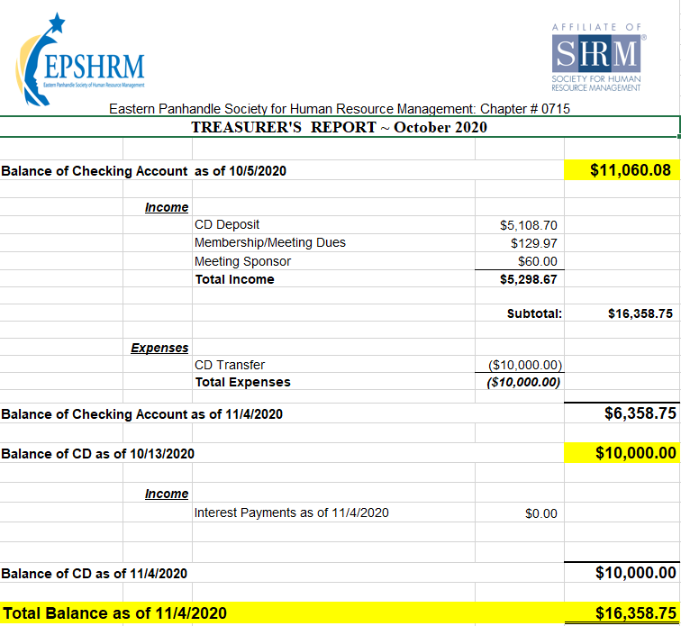
Treasurer’s Report

Slide 4
November Legislative Updates
COLA Increase for 2021: https://www.ssa.gov/news/press/releases/2020/#10-2020-1
IRS announces 401 (k), FSA contribution limits for 2021: https://hrexecutive.com/irs-announces-401k-fsa-contribution-limits-for-2021
Election updates and possible implications: https://www.law360.com/health/articles/1323963/5-key-areas-to-watch-as-bidencare-takes-shape

Slide 5
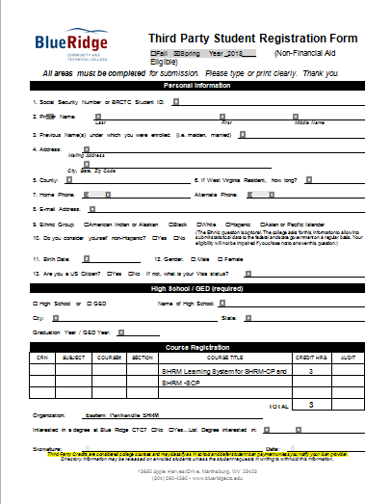

Slide 7
Upcoming Meetings
December – Erica Young: WorkTech Trends and Impact
Notes:
Over the past five years the need for workplace technology has exploded. And because of COVID-19, businesses are rethinking how they leverage technology to increase engagement, efficiency and organizational effectiveness.
As a result, we’re seeing businesses seek technology that make our workplaces more diverse and inclusive, and better prepared for remote work and business practice adjustments. Entrepreneurs have stepped in to create a wide array of technological solutions that contribute to the bottom line. This session will review how common workplace trends are impacting technology and how we can get ahead of the trends to proactively prepare our workplaces.
After attending this session, participants will be able to:
Describe how current workplace trends are creating needs for new workplace technology.
Identify how workplace technology could create positive change in their workplace.
Apply trends in emerging workplace technology to needs within their workplace.

Slide 10
Monthly Corporate Sponsor

Slide 11
Speak for Yourself Presented by Vicky Fields

