Slide 1
November 13th, 2019
Managing vs. Leadership
Presented by
Courtney Carroll & Samuel Taylor
Established 2007

Slide 2
Board of Directors – 2019
President: Harvey Ashworth, SPHR, SHRM-SCP
President Elect: Jesse Sites, SHRM-CP OPEN – Jan 1st 2020
Treasurer: Wanda Bonfili
Secretary: Lesley Hower, PHR, SHRM-CP
Past President & Certification Chair: Justin Ruble, SPHR, SHRM-SCP
College Relations Chair: Pat Hubbard
Communications Chair: OPEN - Jan. 1st 2020
Membership Chair: OPEN – Jan. 1st 2020
Member Liaison: Hanna Kenney, SHRM-CP
Workforce Readiness Chair: Courtney Carroll, SHRM-CP, GCDF
Legislative Chair: Raylea Harvey
Programming Co-Chair: Hadley Ward, PHR, SHRM-CP
Programming Co-Chair: Jessica McIntosh, aPHR
Social Media Chair- Lori Turner, SHRM-CP
Notes:
<number>

Slide 3
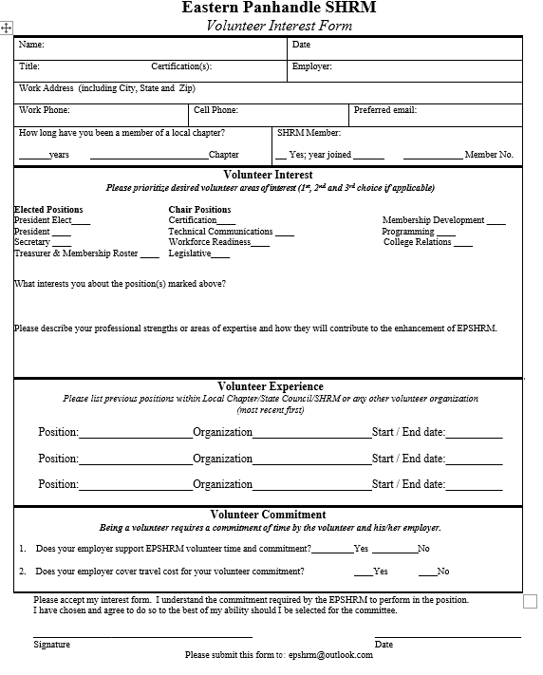

Slide 4
Volunteer Opportunities
President Elect – primary responsibilities:
build and enhance community relations
recruit sponsors and area partners to grow the chapter
advocate for SHRM national and the local chapter goals
fill in for chapter President as needed
attend local, regional and national events on behalf of the chapter
Communications Chair - primary responsibilities:
sets up online meeting and event registrations
works with partner organizations to share relevant communications (e.g.., Blue Ridge CTC's SHRM-CP/SCP prep course)
copyedits meeting presentation documents
updates ep.shrm.org website
takes/posts photos
Membership Chair - primary responsibilities:
maintains membership database
sends membership renewal notices
reconciles memberships once per month, prior to meetings
works with treasurer on event/meeting/membership payments

Slide 5
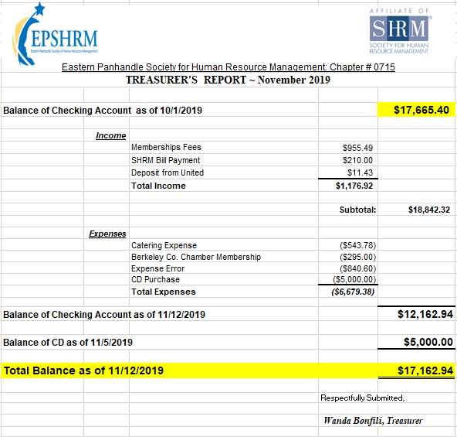

Slide 6
Nov Legislative Updates
Useful Resource for Employment Laws: https://www.employmentlawhandbook.com/
Final Regulations Update 401(k) Hardship Withdrawal Rules https://www.sgrlaw.com
NEW HRA REGULATIONS: More on the Employer Shared Responsibility Mandate https://www.erisapracticecenter.com
DOL ISSUES FINAL OVERTIME RULE: https://www.dol.gov
Notes:
3 in Maryland, 13 in PA, 3 in Virginia, 9 in WV- none
SAR due 9/30 for those who filed Welfare/Retirement 5500 by July 31st. All extended 5500 are due Oct 14th which makes SAR due Dec 14th
U.S. Citizenship and Immigration Services (USCIS) announced that employers should continue using the current version of Form I-9 even after the expiration date on the form of August 31, 2019 has passed. Latest version to date is July 17, 2017
Tax Payer Rights highlights
Independent Appeals Process
Innocent Spouse – De Novo Review For Equitable Liability
Modification Of Procedures For Issuance Of Third-Party Summons
Office of the National Taxpayer Advocate – Taxpayer Advocate Directives
Whistleblower Reforms
Cybersecurity and Identity Protection
<number>

Slide 7
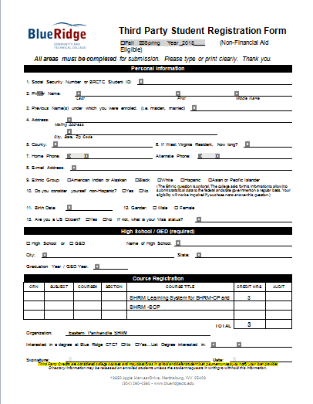

Slide 8
UPCOMING EVENTS
Thursday
December – 12th
Holiday Social @ Hollywood Casino
Epic Buffet

Slide 9
New Members & Introductions
Sept. Susan Lewis, Becky Nucelli
Oct. Kayla Barb, Morgan Gower
Christopher Karen, Karen Kisner,
Megan Haines
Nov. Christina Lee, Sherry Martin

Slide 10
Corporate Sponsor
Bowles Rice LLP
ATTORNEYS AT LAW
101 West Queen Street
Martinsburg, West Virginia, 25403

Slide 11
NEW FOR 2020
MEMBERSHIP RENEWALS
are moving to
January
for ALL Members

Slide 12
Membership Examples: With Nat. SHRM membership = $80 p/yr ($10 p/ mth cost) W/O Nat. SHRM membership = $95 p/yr ($11.88 p/mth cost)
Harvey – Due in Nov. 2019, pay for now for 2 months and the full year in January 2020.
Dennis – Due in Feb 2020, pays for the remaining 6 months in January 2020.
Direct questions about current membership renewal date to: JiJi, Wanda, Jesse, Harvey

Slide 13
Courtney Carroll, SHRM-CP, GCDF
COURTNEY- has over 10 years of training and development experience. Recently, she earned the CPLP credential, the highest certification in the talent development industry. She is also a SHRM-CP, a Global Career Development Facilitator, a Certified Career Services Provider, and Myers-Briggs certified. She has a Master’s Degree in College Student Development and Administration and a Master’s Degree in Management with a concentration in Human Resources. In her role as Training and Development Program Manager at American Public Education, Inc., Courtney develops and delivers a wide variety of professional development experiences for all employee levels, conducts New Employee Orientation bi-weekly, and facilitates individual career development sessions with employees looking to move up or across the organization. She lives in Inwood, WV with her dog, Chardonnay and her cat, Whiskey.

Slide 14
Samuel Taylor, CPC
Samuel - is a Financial Aid Services Manager at American Public University System and recently obtained his CPC, Certified Professional Coach and has a passion and talent for training. He also holds a Bachelor’s Degree in Biblical Studies, an undergraduate certificate in Music, and is currently enrolled in an undergraduate certificate for Instructional Design and Delivery. He appreciates opportunities to develop others and has delivered a variety of trainings to APUS and APEI employees. He lives in Hedgesville, WV with his wife, April, and two children, Isaiah and Lily, two dogs, Shelby and Tanger and one cat, Mimi.

