Slide 1
THE FAMILY AND MEDICAL LEAVE ACT:
Compliance Topics & Pitfalls for HR Professionals
J. Tyler Mayhew, Esq.
April 10, 2019

Slide 2
WORD OF CAUTION
These materials are presented with the understanding that the information provided is not legal advice. Due to the rapidly changing nature of the law, information contained in this presentation may become outdated or interpreted differently by a court. Anyone using information contained in this presentation should always research original sources of authority and update this information to ensure accuracy when dealing with a specific matter. No person should act or rely upon the information contained in this presentation without seeking the advice of an attorney.

Slide 3
Another Word of Caution
The FMLA contains special rules applicable to school employees and airline flight crew employees
  -The special school rules only apply to employees of public and private primary and secondary schools – not colleges, trade schools, preschools
This presentation does not address the school / airline rules!

Slide 4
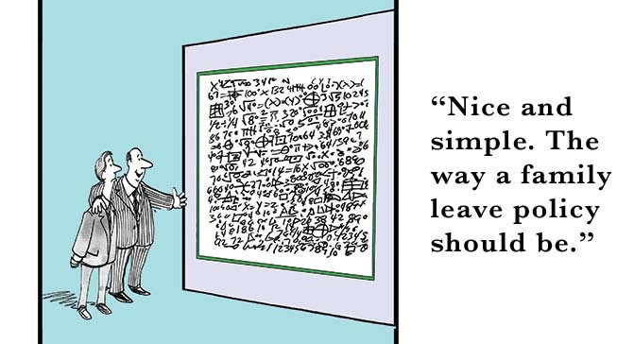
THE FAMILY AND MEDICAL LEAVE ACT OF 1993

Slide 5
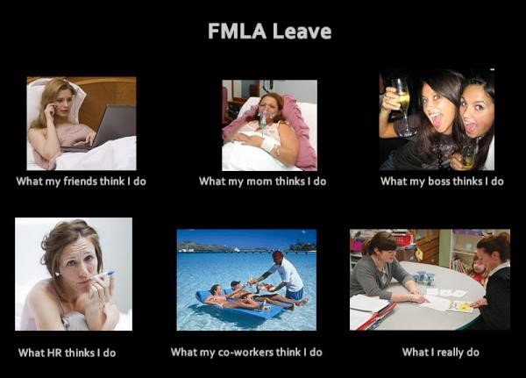
The FMLA: A Visual Summary

Slide 6
Introduction
Enacted in 1993, with military leave provisions added in 2009
Requires a covered employer to provide an eligible employee with job-protected, unpaid leave for up to 12 workweeks during a 12-month period for certain family and medical reasons (or up to 26 workweeks if leave is to care for a covered servicemember)
Requires employer to return employee to the same or an equivalent job (in terms of pay, benefits, other terms & conditions) upon return from leave
Requires employer to maintain employee’s group health benefits during FMLA leave
The FMLA is the “floor” for purposes of employee leave protections:
-The Americans with Disabilities Act may require additional unpaid leave as a reasonable accommodation
-State and local laws may require greater leave protections (paid leave, longer unpaid leave, etc.)
-Employers may voluntarily provide additional leave benefits or paid leave

Slide 7
Coverage and Eligibility
A covered employer is:
a private employer that employs 50 or more employees during 20 or more workweeks in the current or preceding calendar year;
a public agency (including a local, state, or federal government agency), regardless of the number of employees; or
a public or private elementary or secondary school, regardless of the number of employees
An eligible employee is an employee of a covered employer who:
has been employed by the employer for at least 12 months;
has been employed for at least 1,250 hours of service during the 12-month period immediately preceding the commencement of leave; and
works at a worksite where 50 or more employees are employed within 75 miles

Slide 8
SCENARIO #1: Coverage & Eligibility
Big Construction Company (“BCC”) is headquartered in Atlanta, Georgia and employs 45 employees at that location. BCC also has a satellite office in London, England that employs 5 employees. BCC opens a mobile office at a construction site in Charlotte, North Carolina and hires 45 local construction workers for the job. BCC also sends 5 employees from Atlanta to Charlotte to oversee the project.
Is BCC a covered employer?
If BCC is a covered employer, does it have eligible employees?

Slide 9
SCENARIO #1: Answer
Is BCC a covered employer?
  It depends on the length of the project in Charlotte. BCC’s employees in London are not counted toward the 50-employee threshold. If the Charlotte project lasts at least 20 calendar workweeks, then BCC would become a covered employer for the remainder of the calendar year and for the following calendar year.
If BCC is a covered employer, does it have eligible employees?
  No. BCC does not employ 50 or more people within 75 miles of either of its U.S. worksites. Although there are 50 employees working in Charlotte, the 5 employees sent from Atlanta continue to have BCC’s headquarters in Atlanta as their worksite.

Slide 10
Coverage and Eligibility:
Joint Employers
A joint employment relationship exists if two or more businesses exercise some control over an employee’s work or working conditions
  -Totality of the circumstances, but temp agencies are generally joint employers
  -Both employers count joint employees to determine coverage and eligibility
Primary employer provides FMLA rights to employee
  -Primary employer hires/fires, assigns/places, pays, provides benefits
  -Temp agencies are generally the primary employer

Slide 11
Qualifying Reasons for FMLA Leave
Birth of the employee’s child and bonding with the newborn;
Placement of an adopted/foster child with the employee and bonding with the newly-placed child;
Care for a spouse, son, daughter, or parent with a serious health condition;
Employee is unable to perform the functions of the position due to a serious health condition;
Qualifying exigency due to spouse, son, daughter, or parent’s active duty status;
Care for a covered servicemember with a serious injury or illness

Slide 12
Leave Entitlements Summary
Qualifying Reason | Leave Entitlement per 12-Month Period | Intermittent or Reduced Schedule Leave?
1. Birth of a child | 12 workweeks | If employer and employee agree, or mother has serious health condition
2. Adoption or foster placement of a child | 12 workweeks | If employer and employee agree, or child has serious health condition
3. Care for family member’s serious health condition | 12 workweeks | Yes, if medically necessary
4. Due to employee’s own serious health condition | 12 workweeks | Yes, if medically necessary
5. Due to a servicemember’s qualifying exigency | 12 workweeks | Yes
6. Care for a servicemember’s serious injury or illness | 26 workweeks | Yes, if medically necessary

Slide 13
What is a “Serious Health Condition”?
An illness, injury, impairment, or physical/mental condition:
  -that involves “inpatient care”; or
  -requires “continuing treatment by a health care provider”
  -common ailments (cold, flu, etc.) do not qualify unless complications arise
“Inpatient care”: overnight stay in a hospital or other medical care facility
  -What is an overnight stay? Not defined
  -One court says that stay must be a substantial period and from one calendar day to the next (14 hours inpatient all on the same day was not overnight)

Slide 14
What is “Continuing Treatment by a Health Care Provider”?
Incapacity of three or more full, consecutive calendar days, plus:
    -Two or more in-person treatments by HCP within 30 days (1st treatment within 7 days)
    -One in-person treatment by HCP, plus regimen of continuing treatment under HCP’s supervision (medication)
Prenatal care, or any period of incapacity due to pregnancy
Any period of incapacity for a chronic condition:
    -Periodic visits (at least twice a year) for treatment by HCP
    -Condition continues over an extended period of time (including recurring episodes of condition)
    -May cause episodic rather than continuing incapacity (asthma, diabetes, epilepsy, etc.)
Permanent or long-term conditions for which treatment is not effective (Alzheimer’s, terminal illness)
Any absence to receive multiple treatments for surgery after an accident, or for a condition that would cause incapacity of 3 or more calendar days without treatment (chemotherapy for cancer)

Slide 15
SCENARIO #2: Serious Health Condition
Jill begins feeling ill on Thursday. Overnight her condition deteriorates and she is too weak to work on Friday. Jill calls in sick and a family member takes her to urgent care, where she is diagnosed with the flu and severe dehydration. The doctor also conducts a blood test, revealing low white blood cell and platelet counts. Jill is administered intravenous fluids, directed to take over-the-counter medications and get bed rest, and ordered to return two days later for re-evaluation. Jill returns to the doctor on Sunday, and a second blood test reveals normal blood cell and platelet counts. On Monday, Jill feels better and returns to work.
Is Jill’s sick day on Friday eligible for FMLA leave?

Slide 16
SCENARIO #2: Answer
Is Jill’s sick day on Friday eligible for FMLA leave?
  Yes. Although the regulations state that the flu is not “ordinarily” a serious health condition unless complications arise, Jill’s condition still meets the regulatory definition. Jill was incapacitated for three, full consecutive calendar days and visited a health care provider on two occasions for treatment. The second visit constituted “treatment” because it was to determine if a serious health condition existed and to evaluate it.
What if Jill was not ordered to return for a follow-up on Sunday?
  Jill’s absence would not be FMLA-eligible. Although Jill met the period of incapacity, she did not receive continuing treatment. She only visited a health care provider on one occasion for treatment, and the regulations state that taking over-the-counter medication and bed rest are not, by themselves, a regimen of continuing treatment under the FMLA
Would Jill be eligible for FMLA if the doctor prescribed her Tamiflu on Friday and did not order her to return for follow-up on Sunday?
  Yes. Jill meets the period of incapacity, she visited a health care provider once for treatment, and she received a regimen of continuing treatment with a prescription antiviral medication.

Slide 17
Calculating the 12-Month Period
Employer may choose any of the following 12-month periods:
The calendar year;
Any fixed 12-month period (such as a fiscal year);
The 12-month period measured forward from when employee first takes leave
    -Military caregiver leave always uses this method
A “rolling” 12-month period measured backward from when employee takes leave
    -Most difficult to track, but only method that prevents employees from stacking leave
If employer fails to choose, most generous method to employee will be applied
Employer may change by: (1) giving 60 days notice, and (2) during transition, employees receive 12 weeks under whichever method gives greatest protection

Slide 18
Intermittent or Reduced Schedule Leave
Only required when “medically necessary” or for a qualifying exigency – employer may require certification
  -“Medically necessary” means a medical need for leave that can be best accommodated through intermittent leave or a reduced schedule
  -If employer requests certification of qualifying exigency, employee must state the frequency/duration of the qualifying exigency
Employee on intermittent leave must make a reasonable effort to schedule planned treatments to not disrupt company operations
Employer may define leave increments but must be one hour or less
Employer may also transfer employee to alternate position with equivalent pay & benefits for which employee is qualified and which better accommodates employee
  -Only if the intermittent leave is for foreseeable reasons (scheduled medical treatments)
  -Cannot transfer employee to position that might be considered retaliation for taking leave (worse schedule/commute)

Slide 19
Administering Intermittent Leave
An employee’s actual workweek is the basis of leave entitlement
Employees with variable schedules: how much leave?
  -Weekly average of hours scheduled over the previous 12 months
What about salaried-exempt employees?
  -Parties must agree in writing on the amount of hours worked per workweek
  -May deduct for hours of leave taken without losing exemption under FLSA

Slide 20
Employee Notice Requirements
Employee must provide notice of the need for leave and sufficient facts for employer to determine that FMLA leave is needed, the start date, and the duration
  -First time: not required to request “FMLA leave” or even mention the FMLA
  -Subsequent times for same qualifying reason: must specifically reference the qualifying reason for leave or the need for FMLA leave
  -Must respond to employer’s questions designed to determine if leave is FMLA-qualifying
Timing of notice: foreseeable vs. unforeseeable
  -Foreseeable: must provide 30 days notice, or notice “as soon as practicable”
  -Employer can require employee to explain failure to give timely notice of foreseeable leave
  -Unforeseeable: as soon as practicable
  -Qualifying exigency: as soon as practicable, regardless of how far in advance
Employer may require employee to follow company call-in policies for unforeseeable leave

Slide 21
Employer Notice Requirements
The Department of Labor has approved posters and forms:
  Poster: https://www.dol.gov/whd/fmla/posters.htm
  Forms: https://www.dol.gov/whd/fmla/forms.htm
General Notice (“Poster”): Publication WH1420
  -Post in a prominent place, even if no eligible employees
  -If eligible employees, also distribute in handbook or directly to new hires
Eligibility Notice / Rights & Responsibilities Notice: Form WH-381
  -Within 5 business days of employee request for FMLA leave or employer determines that leave may qualify
  -Provide a new notice whenever eligibility or information in notice changes
  -R&R must include information on company policies for call-in, periodic status reports, intent to return to work
Designation Notice: Form WH-382
  -Within 5 business days of employer determining if leave is for an FMLA-qualifying reason
  -Provide a new notice within 5 business days if the information changes
  -Must include fitness-for-duty requirements

Slide 22
Certification Requirements
Serious Health Condition, Qualifying Exigency, or Serious Injury / Illness of Servicemember
Notify employee in writing when leave requested or within 5 business days
  -May request certification at a later time if employer has reason to question leave/duration
  -Notice must inform employee of consequences of failure to respond
Employee must provide “complete and sufficient” certification within 15 calendar days
  -Complete: all entries on the certification form answered
  -Sufficient: the information is not vague, ambiguous, or non-responsive
  -Employee must cure deficiency in certification, upon written notice, within 7 calendar days
Failure to return certification at all is a failure to certify
May require a new certification annually if reason for leave extends beyond a single year

Slide 23
Form of Certification
The Department of Labor has approved forms:
  Forms: https://www.dol.gov/whd/fmla/forms.htm
  Serious Health Condition: Form WH-380-E (employee) or WH-380-F (family member)
  Qualifying Exigency: Form WH-384
  Serious Injury or Illness of Servicemember: Form WH-385 or WH-385-V (veteran)
For military caregiver leave, employee may instead provide an invitational travel order or authorization (ITO/ITA), or a document showing that a covered veteran is enrolled in the VA’s Program of Comprehensive Assistance for Family Caregivers

Slide 24
Authentication & Clarification of Certification
Employer may contact health care provider (HCP) to authenticate/clarify
  -Authentication: confirm that information was completed/authorized by HCP
  -Clarification: understand handwriting, meaning of response
  -Employer cannot request more information from HCP
Employee is require to clarify certification, but is not required to allow employer to directly contact HCP to obtain clarification
  -Even if employee authorizes, HCP will need a HIPAA-compliant release

Slide 25
Challenging Suspect Certifications
Employer may seek a second opinion if it doubts validity of certification
  -Employer selects HCP, cannot be regularly employed by employer
Employer may require a third, binding opinion if first and second differ
  -Parties jointly select HCP, must cooperate in making selection
Employer pays costs of second/third opinions, including employee travel
No second or third opinions for military caregiver leave if certification:
  -is from an HCP for DOD, the VA, or TRICARE (network or non-network) OR
  -is an ITO/ITA, or veteran enrollment in VA assistance program
No second or third opinions of certification for qualifying exigency

Slide 26
Recertifications
Basic Timing Rules:
  May always recertify every 6 months in connection with absence
  If certification indicates a leave duration longer than 30 days, must wait until that time period expires
  Cannot recertify more often than every 30 days in connection with absence
Important Exception → Employer may request recertification in less than 30 days if:
  -Employee requests extension of approved leave;
  -Circumstances of leave have changed significantly (duration/frequency of absences, nature/severity of illnesses, complications); or
  -Employer receives information that casts doubt on employees stated reason for leave or the continuing validity of the medical certification
Employer may provide HCP with a record of employee’s absence pattern and ask if the serious health condition / need for leave is consistent with the pattern
No recertification of qualifying exigency / military caregiver leave, and no second or third opinions of recertifications

Slide 27
Certification Rules Summary
Qualifying Reason | Certification Allowed? | Second or Third Opinions Allowed? | Recertification Allowed?
1. Birth of a child | Only if mother has serious health condition
2. Adoption or foster placement of a child | Only if child has serious health condition
3. Care for family member’s serious health condition | Yes, and documentation of family relationship | Yes | Yes
4. Due to employee’s own serious health condition | Yes | Yes | Yes
5. Due to a servicemember’s qualifying exigency | Yes, of military duty, family relationship, exigency facts | No | No
6. Care for a servicemember’s serious injury or illness | Yes, of military duty, family relationship, medical facts | Yes, unless ITO/ITA or HCP is from DOD/VA/TRICARE | No

Slide 28
Compensation & Benefits During Leave
Employer may require paid leave to run concurrent with unpaid FMLA leave
  -Employee is required to follow company policies/procedures for obtaining paid leave benefit
  -Leave for disability/workers’ comp runs concurrent but employer cannot also substitute paid leave unless parties agree to supplement benefits
Employer must maintain group health insurance benefits
  -Employee must pay normal share of premiums
  -Changes in coverage that occur during leave also apply to employee
  -Employer may recoup its share of premium payments if employee does not return to work
Employee does not lose accrued “fringe benefits,” but employer may have policy that employee does not accrue additional benefits during leave
  -Employee not entitled to production/attendance bonuses unless other employees on leave/vacation would receive benefit

Slide 29
Intent to Return to Work
Employer may have a non-discriminatory policy requiring an employee to periodically report on his/her leave status and intent to return to work
Employer’s obligations under the FMLA end if employee unequivocally states that he or she will not return to work at the end of leave
  -Obligations continue if employee “expresses desire” to return to work
If circumstances change during leave, employee may return to work early with 2 business days notice to employer
  -Employee cannot be forced to take more FMLA leave than necessary

Slide 30
Fitness-for-Duty Certifications
Employer may have a non-discriminatory policy requiring an employee to provide a fitness-for-duty certification before returning to work
  -May provide employee with list of essential job functions, require HCP to address employee’s ability to perform those functions
  -Fitness for duty must be job-related, limited to condition requiring leave
Intermittent leave: only once every 30 days, employee must pose risk of harm
No second or third opinions of fitness-for-duty certification

Slide 31
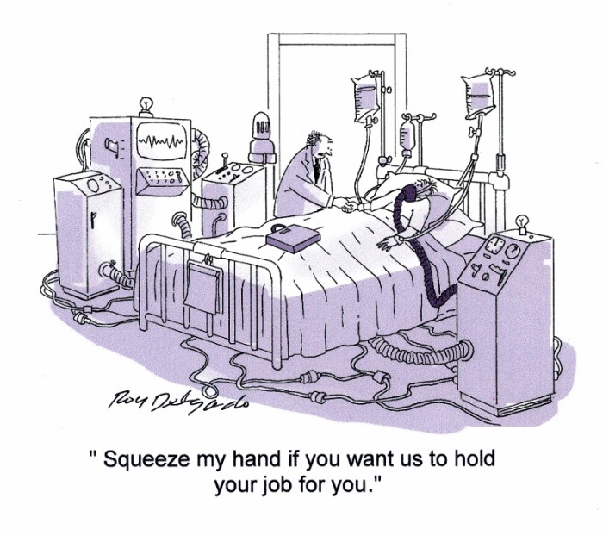
Reinstatement Rights Following Leave
Same or “equivalent” job, even if employee has been replaced or job restructured
An “equivalent position” is virtually identical in terms of pay, benefits, and working conditions
  -duties, authority, work schedule, location, etc.
  -includes duration: position is not equivalent if subject to layoff and old position is not
Employee must be given a reasonable to requalify for the position (i.e., renew a license, take a class, etc.)

Slide 32
Exceptions to Reinstatement
No greater right to reinstatement than if employee had not used FMLA leave
  -Employee would have been fired, laid off, shift reduced, etc. anyway
Employee unable to perform essential job functions, or fails to return required fitness-for-duty certification
Employee fraudulently obtains FMLA leave or violates “moonlighting” policy
“Key Employees,” (top-10% salaried employee), if substantial/grievous economic injury
Important: Employer bears the burden of defending decision to not reinstate!

Slide 33
Recordkeeping Requirements
Must keep required records for at least 3 years
Covered employers must maintain basic payroll and employee identity info
If there are eligible employees, primary employer must also maintain:
  -dates FMLA leave is taken, hours taken if less than a full day
  -copies of all written notices, whether from employer or employee
  -documents describing employer leave & benefits policies
  -record of payments for employee benefits
  -records of any disputes over designation of leave
  -medical information (in a separate medical file)

Slide 34
Intersection the Americans With Disabilities Act
An employee requiring FMLA leave for a “serious health condition” may also be a “qualified individual with a disability” under the ADA
The ADA may require additional unpaid leave if it does not cause undue hardship, there is no other effective accommodation, and it will allow the employee to return to work at the end of the leave period
  -Indefinite leave is not a reasonable accommodation
  -“Light duty” or an alternative position for which employee is qualified, if employee cannot perform the essential functions of original job at the end of leave
Different reinstatement rights: ADA requires reinstatement to the same job unless undue hardship (as opposed to same or “equivalent” under FMLA)

Slide 35
SCENARIO #3: ADA Issues
Laura takes FMLA leave for a hip replacement. During her recovery, Laura develops an antibiotic-resistant infection and is unable to begin physical therapy. After twelve weeks, Laura’s infection has cleared but she has not regained sufficient strength or mobility to return to work. Laura’s physician will not clear her to return to work, but believes she will be able to return to work after an additional 90 days of physical therapy. Laura requests an additional 90 days of leave to complete her recovery.
Is Laura’s employer required to extend her leave for an additional 90 days?

Slide 36
SCENARIO #3: Answer
Is Laura’s employer required to extend her leave for an additional 90 days?
  Yes, unless doing so would be an undue hardship. Granting Laura an additional 90 days of unpaid leave is a reasonable accommodation because her physician believes it will allow her to perform the essential functions of her job.
During her extended leave period, Laura begins treating with a psychiatrist for clinical depression. Although her physician clears her to return to work, Laura’s psychiatrist believes she cannot return to her position until her depression is controlled, and recommends re-evaluating her ability to work after an additional 90 days of therapy. Is Laura’s employer required to extend her unpaid leave for an additional 90 days?
  No. Although Laura is disabled due to her depression, there is no indication that granting her additional leave would allow her to return to work. Laura’s employer should explore whether there are other reasonable accommodations that would allow Laura to return to work while she continues her therapy (reduced schedule, modified job responsibilities, etc.), or if Laura is qualified to perform an alternate available position (either currently or at the end of the 90-day period).

Slide 37
Interference Claims
Elements: (1) employee entitled to an FMLA benefit, (2) employer failed to provide the benefit, and (3) employee suffered a harm as a result
Examples: failure to provide a required notice, incorrectly delaying or denying FMLA-qualifying leave, failing to properly reinstate employee
Employer intent is irrelevant to liability for interference

Slide 38

Retaliation Claims
Elements: (1) employee engaged in protected activity, (2) employer took adverse action against employee, and (3) causal connection
Liability if employee’s protected leave is a motivating factor in employer’s decision
“Cat’s Paw”: biased subordinate influences decisionmaker to retaliate against employee

Slide 39
Remedies for Violations of the FMLA
Damages:
  -lost wages, salary, benefits, other compensation
  -if none, then actual losses up to sum equal to 12 or 26 weeks worth of wages
  -interest, attorneys’ fees, other litigation costs
Liquidated Damages: additional sum equal to base damages
  -Court may reduce if employer acted in good faith, reasonably believed conduct did not violate FMLA
Equitable Relief: reinstatement, promotion, front pay, etc.
No general damages, no punitive damages
  -However, could be available if employee also has Title VII or ADA claim

Slide 40
Minimizing Liability for FMLA Claims
Address performance/attendance issues proactively, before FMLA leave comes into the picture
Properly train supervisors to:
    -Recognize employee requests for leave that may be FMLA-qualifying
    -Document reasons for employee absences
    -Avoid attempting to talk employees out of taking leave
    -Treat employees the same before and after leave, and avoid making biased comments
Provide required notices within the right timeframes, maintain proper records
Do not automatically terminate at the end of FMLA leave for a serious health condition – evaluate obligations under the ADA
Do not transfer employee to an inappropriate alternative position, or one slated for layoffs
Do not require the same amount of work during intermittent or reduced schedule leave
If laying off employee on or returning from leave, document the need for RIF, process for selecting employees, and do not retain lower-performing employees
If you suspect FMLA fraud, gather objective evidence and confront employee, allow employee to explain, before taking adverse employment action

Slide 41

ADDRESSING SUSPECTED FMLA ABUSE

Slide 42
Tips for Preventing or Addressing FMLA Leave Abuse
Create and enforce policies on attendance, absences, “moonlighting,” dishonesty
    -If employee on intermittent leave calls in “sick,” without more, treat as a non-FMLA absence
    -Obtain status reports from absent employees, details about why employee must be absent
    -Paid sick leave policies may require “proof of illness” so long as employer does not deny unpaid FMLA leave if employee fails to provide a doctor’s note
    -Investigate all suspected instances of dishonesty, and not just suspected FMLA abuse
Accurately track uses of FMLA leave, absences
Require complete, sufficient certifications, authenticate with HCP
    -Second or third opinions, if necessary and permitted
Require recertification of leave, particularly if intermittent leave use exceeds frequency/duration in certification or pattern of absences is suspect
    -Provide HCP with record of employee absence pattern
Monitor publicly-available social media posts
Use a private investigator to monitor employee activities during leave

Slide 43
SCENARIO #4: Suspected FMLA Abuse
Robert requests to use accrued PTO to take a family vacation the week of July 4th. Robert’s request is denied because another, more senior employee previously requested the week off. The first week of June, Robert requests FMLA leave to have foot surgery the first week of July.
May Robert’s employer deny his request for FMLA leave?
If Robert is granted FMLA leave, can his employer do anything to verify that his use of leave is legitimate?

Slide 44

SCENARIO #4: Answer
May Robert’s employer deny his request for FMLA leave?
  Probably not. The fact that Robert previously requested PTO is not relevant to whether he is entitled to leave for a serious health condition. Robert’s employer should request a certification, and may only deny leave if Robert fails or refuses to comply with the certification process.

Slide 45
SCENARIO #4: Answer (Cont’d)
If Robert is granted FMLA leave, can his employer do anything to verify that his use of leave is legitimate?
Yes. Robert’s employer should authenticate his medical certification, and if necessary obtain a second (or third) opinion. Robert’s employer may call him for a status report after the surgery, and may also monitor any publicly-available social media for evidence of fraud.

Slide 46
SCENARIO #5: Suspected FMLA Abuse
Robert’s employer approves his request to take FMLA leave to have foot surgery. The day after Robert was scheduled for surgery, a coworker complains that Robert lied to get out of work and is actually at the beach. An hour earlier, Robert posted a picture to his Instagram account showing him sitting next to a pool drinking beer.
What should Robert’s employer do?

Slide 47
SCENARIO #5: Answer
What should Robert’s employer do?
Robert’s Instagram post is sufficient information to suspect that he is fraudulently taking FMLA leave, but not conclusive. Robert could be recovering from surgery while sitting next to a pool. Robert’s employer should conduct an investigation, and then give Robert an opportunity to explain his conduct, before determining whether discipline is appropriate.

Slide 48
SCENARIO #6: Suspected FMLA Abuse
Bob requests and is approved for unforeseeable intermittent FMLA leave for migraines. Bob’s health care provider certifies that he will miss work two to six days per month. Bob begins calling off work every Monday with a migraine.
Are there reasons to doubt the validity of Bob’s use of leave?
What should Bob’s employer do?

Slide 49
SCENARIO #6: Answer
Are there reasons to doubt the validity of Bob’s use of leave?
  Yes. Although the amount of leave that Bob is taking is consistent with his certification, the timing is suspect. Bob’s use of leave every Monday to extend his weekend indicates that his use of leave may not be legitimate.
What should Bob’s employer do?
  Bob’s employer should seek recertification from Bob’s health care provider, and include a record of Bob’s absences. Bob’s health care provider should be asked to address whether Bob’s use of leave every Monday is consistent with his condition, and if his migraines are limited to Mondays. Bob’s employer should also contact the health care provider to authenticate the recertification.

Slide 50
SCENARIO #7: Performance Problems
Bill has a poor performance record and is placed on a 6-month performance improvement plan at his last review. Bill is approaching the end of his improvement period and has not met his goals. Bill requests FMLA leave for anxiety attacks, and produces a certification that he needs leave for treatment of his condition.
Must Bill’s employer grant his request for FMLA leave?
May Bill be terminated at the end of his improvement period?

Slide 51
SCENARIO #7: Answer
Must Bill’s employer grant his request for FMLA leave?
  Yes. Bill has a serious health condition that makes him unable to perform the functions of his job.
May Bill be terminated at the end of his improvement period?
  Yes, unless Bill would not have been subject to termination. Although Bill is entitled to FMLA leave, he is not entitled to protection from termination for reasons unrelated to his request for leave. Bill could sue for retaliation but would probably lose.
What if Bill had consistently poor reviews over time and was never placed on an improvement plan or otherwise disciplined for his performance?
  Tougher question. If Bill’s employer had not previously attempted to address his performance problems, and then terminated him in close proximity to his request for leave, a jury could find that Bill’s request for FMLA leave was a motivating factor in his termination.

Slide 52
Questions?

Slide 53
THANK YOU!
J. Tyler Mayhew, Esq.
Bowles Rice LLP
tmayhew@bowlesrice.com
(304) 264-4209
101 South Queen Street
Martinsburg, West Virginia 25401

