Slide 1
Welcome!
The Three Rs of
Human Resources Management for Millennial Employees:
Recruit, Relate, and Retain

Slide 2
A custom one hour presentation for: Eastern Panhandle Society of Human Resource Management Regina Turner, President By:
Dr. Donald R. Hillman, MS/MBA/DM
Hillman Organizational Consulting, LLC
Shepherd University Business Professor
www.HillmanConsulting.org
(443) 802-3315

Slide 3
Background/Credentials for Dr. Hillman:
Professional:
30 years of management and consulting experience in for-profit, nonprofit, and government work
Specializes in employment training, employee performance, and human resources management
Academic:
Education: AA-Social Science; BA-Organizational Psychology from California State-Sacramento; MBA, MS in Human Resource Management, Doctorate of Management (D.Mgt.) from University of Maryland-University College
Phi Kappa Phi National Honor Society, Psi Chi-The National Honor Society in Psychology
Business Professor: Business Communications and Human Resources Management
Nationally recognized, published, peer reviewed, journal author with expertise in workplace generational differences
Most read article of 2014 (and fourth most read all-time) for the Journal of Workplace Behavioral Health (the national journal for Employee Assistance Programs): Hillman, D. (2014) Understanding multigenerational work-value conflict resolution
Peer reviewer for the International Journal of Human Resource Management
Peer reviewer for the International Journal of Innovation Management
Recent Publications:
Hillman, D. (2013) Applying Gilbert’s teleonomics to engineer worthy performance in generation y employees. Performance Improvement Journal, 52(10), 13-21. International Society for Performance Improvement-Wiley. DOI: 10.1002/pfi.21377. (peer reviewed)
Hillman, D. (2013) Understanding generational differences in the U.S. workplace: Implications for managing generationally-diverse employees. UMI/ProQuest, 1-173. (dissertation)
Hillman, D. (2013) The three Rs of managing millennial employees: Recruit, relate, retain. HR Professionals Magazine, 3(12), 21-23. Thompson HR Firm LLC (magazine)
Hillman, D. (2014) Understanding multigenerational work-value conflict resolution. Journal of Workplace Behavioral Health, 29(3), 1-28, Routledge-Taylor & Francis Group DOI: 10.1080/15555240.2014.933961 (peer reviewed)
Hillman, D. (2015) Routledge health & social care journals special collection: Most read articles of 2014. Understanding multigenerational work-value conflict resolution. Journal of Workplace Behavioral Health, Routledge-Taylor & Francis Group, http://bit.ly/health-social-care-most-read (peer reviewed)
Personal::
Baby Boomer married to a Baby Boomer, 1 Millennial daughter, 2 GenC grandkids, 1 Bepherd, 1 Havanese, Poor Golfer, Muscle Car Lover
Personal:

Slide 4
Agenda, 11/12/15
Time Slide(s) Topic
9:00-9:05 1-5 Welcome and Introductions
9:05-9:15 6-10 Why should my organization’s management care about generation gap issues?
9:15-9:25 11-13 Where did these Millennial people come from? Let’s get a little academic…
9:25-9:35 14-16 Why is this Millennial workplace generation so different?
9:35-9:45 17-19 OK, Dr. Don, how do we deal with these Millennial employees?
9:45-10:00 20 Summary and Questions

Slide 5
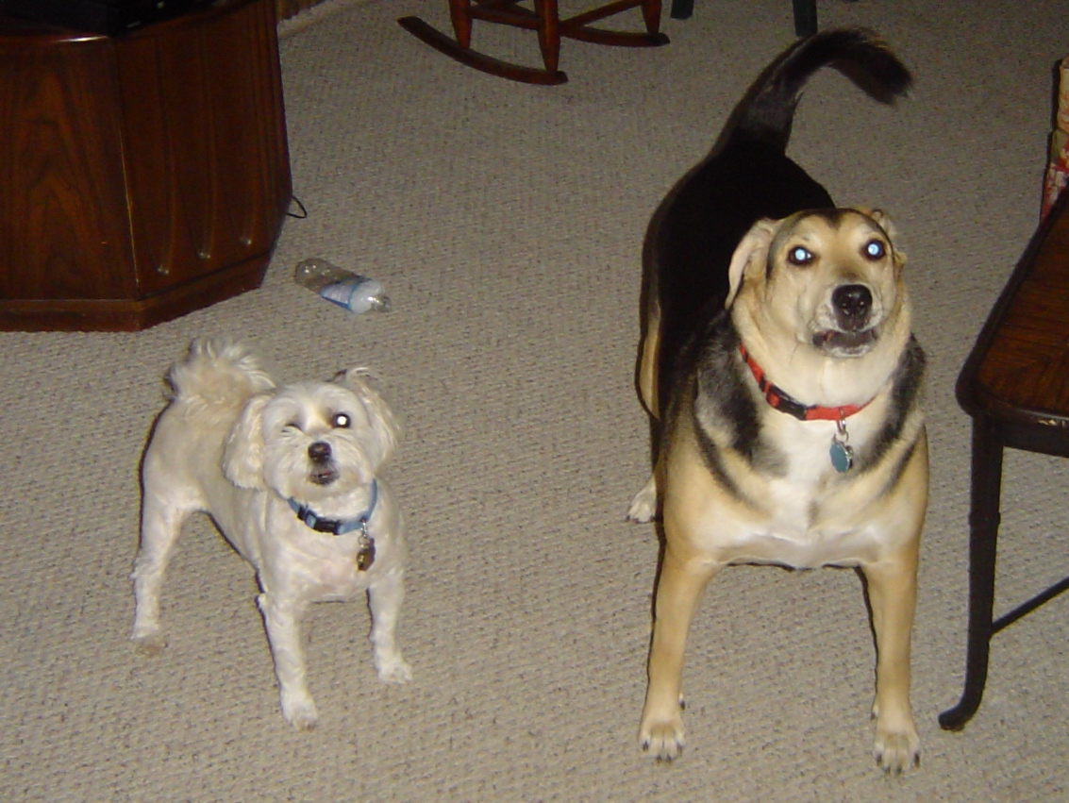
In case you were wondering what a Bepherd (half Beagle-half Shepherd) is, it is on the right. The Havanese is on the left. And, of course, the Havanese is the ruler of the roost.

Slide 6
What is a Generation?
Generational cohort: A generational cohort consists of an identifiable group that shares (a) birth years spanning about a 20 year range, (b) similar residence locations, and (c) similar schooling. This cohort is also shaped by historical or social life experiences at critical developmental stages (Smola & Sutton, 2002). One is known as a cusper, or to be on the cusp, of a generation when your birth year falls within four years of the generation cut-off years. For example, a person born in 1982 would technically be a Millennial but would display some Generation X values.

Slide 7
U.S. Workforce Current Generations and Work Values
Years Born | Moniker(s) | Core Values
1922-1946 | Traditionalists Veterans/Silents | Hard work, respect for authority, logic, discipline, dedication, sacrifice
1946-1964 | Baby Boomers | Optimism, personal gratification & growth, consensus building, equity
1964-1980 | Generation X | Diversity, techno literacy, work/life balance, informality, independence
1980-2000 | Generation Y Millennials Nexters | Optimism, civic duty, confidence, achievement, team oriented, diversity, work/life balance, person/organization fit

Slide 8
U.S. Workforce Proposed Generations
Years Born | Moniker(s) | Core Values
1922-1946 | Traditionalists Veterans/Silents | Hard work, respect for authority, logic, discipline, dedication, sacrifice
1946-1964 | Baby Boomers | Optimism, personal gratification & growth, consensus building, equity
1964-1980 | Generation X | Diversity, techno literacy, work/life balance, informality, independence
1980-2000 1990-2010 | Generation Y Millennials Nexters Generation C | Optimism, civic duty, confidence, achievement, team oriented, diversity, work/life balance, person/organization fit Constantly connected, socially driven, creation, curation, connection, and community, known as the YouTube Gen

Slide 9
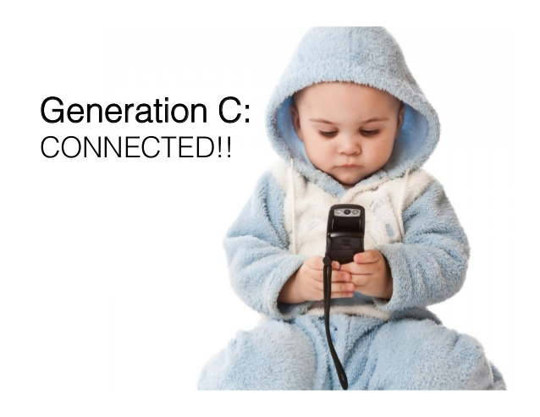
Remind you of anything? I suggest this new set of socially constant connected behaviors be coined: Bent Neck Syndrome-You heard it here first.

Slide 10
Importance of Clearly Understanding Millennial/GenC Workforce Entry to HR Management
There are numerous unreliable articles in the media and popular press about Millennial employees regarding their workplace behavior and how management should address these concerns.
There is a shortage of sound, academically based, generational differences research.
Management decisions based upon untruths concerning Millennial employees have created generational conflict problems.
Human resources professionals rely on management researchers to provide scholarly and convincing evidence for use in developing reliable systems and procedures.
Values-based conflict between workers of different generations results in lower productivity and is a growing problem in the U.S. workforce.
Baby Boomers are retiring at a rapid rate, creating a dynamic shift in the U.S. workforce as Millennial employees assume these jobs. This generational shift is believed to have created a clash of work values leading to conflict in the workplace.
To remain competitive in attracting qualified candidates, managers must understand Millennial work values in order to recruit, retain, and motivate to ensure organizational performance standards are met.

Slide 11
Wow! Who created this Millennial Generation? Let’s get a little academic…
Theoretical Foundation of Generational Workplace Value Differences
Origin of birth-year-cohort theory developed in the 1920s by Karl Mannheim known as the "Problem of Generations.“
Mannheim posited that individuals share a "social location" due to their year of birth and also a bond through common experiences.
Other sociologists have extended Mannheim's work finding the theory of "collective memories" which suggests shared memories of cultural and historical events create behaviors, preferences, and attitudes uniquely shared by each generation.
Birth-year-cohort theory versus Age-related life-stage theory
Some academic research has concluded that age-related stage of life is the cause of any differences that are seen between the generations.
Still more academic researchers have found that both age-related life-stage theorists and birth-year-cohort theorists make compelling arguments to support the notion that workplace-value differences are the result of a combination of the effects from each theory.
Generation Gap confusion; Know the real story and why it matters
Birth-year-cohort theory is overwhelmingly supported by empirical research including time lag and longitudinal studies with samples in the millions over the past 10-15 years. Age related theories have no such support. I.e. there are true differences between the generations but there are clearly individual differences within each generation. Don’t stereotype, but you can generalize for planning purposes.

Slide 12
Framework of Management Understanding of Work-Value Differences
in a Generationally Diverse Work Environment
Multigenerational
Work Environment
High Generational Work- Value Conflict
Age-Related
Life-Stage
Work-Value Differences
Communication, Leadership, Education
Birth-Year
Cohort
Informed
Management
Practice
Low
Generational Work-Value Conflict

Slide 13
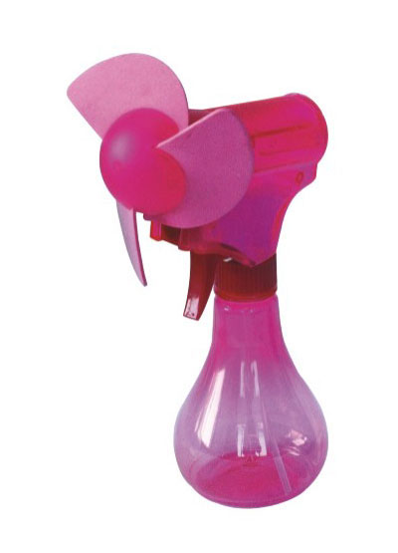
If you fall asleep I shall spray you with this specially designed water bottle with a battery operated fan to evenly distribute the H2O. HR question: Is this considered creating a hostile learning environment? Answer: Only if you perceive it to be.

Slide 14
Why is this Millennial workplace generation so different? Nature vs. Nurture, probably both…
Millennials compared to other generations
Research has found that the average Millennial employee will change jobs seven times and careers three to four times in a ten year period.
Researchers have also found that Millennial workers with higher levels of education are less likely to "job hop“ and that these employees have a thirst for knowledge and seek specialized training in their fields.
Millennial employee work values include: (a) work should be done on my terms, with flexible work hours; (b) work is for earning money to purchase things, there is no intrinsic value in work; (c) work should be fun, friendly, and personal; (d) work should involve creativity, variety, innovation, and diversity; and (e) management opportunity should be immediate.
Millennial employees want their work to be meaningful and contribute to a greater purpose. Additionally, they are less concerned about financial gain than other generations, and value corporate social responsibility.
A large empirical study found Millennials to have significant psychological and technological differences compared to other generations that relate to the impact psychological traits can have upon the workplace. For example, one of the behaviors concerns narcissism, which can be destructive to organizations. Managers who learn to understand these psychological differences will be more successful at supervising Millennial employees than those who ignore these disparities.
Millennials have been found to display significant levels of patriotism due to the impact of the terrorist attacks on the United States of September 11, 2001.

Slide 15
What to expect from the youngest to come: Generation C
The following research was based on younger Millennials now termed GenC-
Experience, support, and recommendations from others through social media are what Generation C uses to make decisions.
Generation C members are known as digital natives experiencing digital immersion.
Generation C has been found to be "hard wired" with some evidence that their brains are actually different from other generations. UCLA neuroscientist Gary Small found a significant difference in technological skills functioning that he has labeled the "brain gap" in a 2009 study. Small found Generation C to be more effective at using technology, multitasking, responding to visual stimulation, and filtering information, and were less effective at face-to-face communication and deciphering non-verbal cues.
One downfall to the fast-paced information gathering and technological savvy is the quality of the data gathered. Generation C is generally more concerned with retrieving information in the workplace quickly and not about the validity and accuracy of what they obtained.
HOT OFF THE PRESS! Just finished collecting data from a well distributed and targeted nationwide sample of GenC (ages 18-30) regarding human resources issues relating to the use of social media. Some early findings are:
Nearly 90% surveyed said they use social media sites daily and 30% said they use them hourly!
Close to 2/3 said they would consider using social media to find a job.
77% said they would stay longer on the job if they liked their employer and 80% said it was very important their employer care about them.
75% said that they would consider getting to know an employer BEFORE they start work for the company.

Slide 16
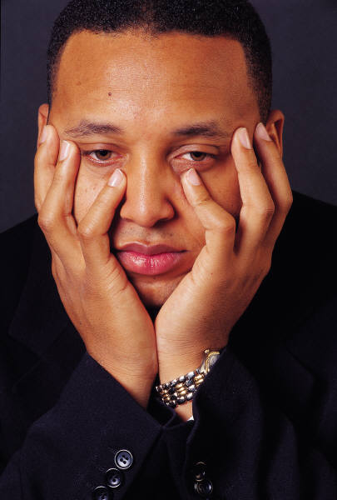
Will this old boomer Hillman ever finish? Man, my coffee is cold, I need to get to work, and I really need to check Facebook, geez…………..
Hey, I’m almost done, be happy you aren’t in one of my 3 hour workshops or college classes

Slide 17
OK, Dr. Don, how do we deal with these Millennial employees? Recommended Human Resources Strategies
Recruiting
Millennial employees have proven to be valuable workers due to their information technology skills, teamwork affinity, and concern for corporate social responsibility.
The organization that is successful at recruiting these employees must understand what the potential Millennial employee is seeking and where they are looking for jobs.
Include the following Millennial employee desired attributes prominently in recruitment advertising (especially social media) and employee screening. Your organization should be able to attract competent Millennial candidates:
Millennials are less concerned about financial gain than other generations, and value corporate social responsibility and a company's ethical standards.
Millennials are attracted to organizations that promote work/life balance including the need for being happy and having a strong family life as well as person-organization fit (especially regarding technology).
Many Millennial employees have a high team orientation and enjoy working in organizations that promote teamwork.
Millennial potential employees with higher education levels, such as graduate degrees, are more likely to have increased levels of organizational commitment as they value learning and seek promotion.

Slide 18
OK, Dr. Don, how do we deal with these Millennial employees? Recommended Human Resources Strategies
Relating
Human resources professionals and other organizational managers who understand generational work-value differences and implement generationally sensitive policies can expect increased employee productivity from Millennial staff members.
Scholarly research suggests that Millennial employees are extremely proficient at organizational tasks that require internet-based information collection and projects that require the ability to multitask.
By utilizing the following guidelines regarding the ability to positively relate to Millennial employees one should see an increase in organizational effectiveness and efficiency:
Provide Millennial employees with clear communication and expectations including clear direction, timely feedback (critical), structure, technology (social media and mobile devices), and company goals and objectives.
Adapt a leadership style that includes a team orientation, concern for corporate social responsibility, and is creative, supportive, and trustworthy. Millennial employees require leaders who will guide, coach, and provide fast on-line responses to their needs. Human resources professionals should also consider providing generational diversity training emphasizing listening and questioning skills so managers can fully comprehend the differences between the generations.
Use cross-generational work teams that promote shared work values for all generations such as assigning Millennial, Generation X, and Baby Boomer employees to a work team where all of the employees possess the skills required to solve a designated company problem. The company will benefit if the team members can form a cohesive unit through developing shared work values that create a higher degree of "value fit", ultimately leading to solving the assigned problem. Emergent leadership (possibly from Millennial employees) often will evolve from members within such a work group.
Designate mentors for Millennial employees. Research indicates that 75% of Millennial workers enjoy working with Baby Boomers, and that nearly 60% turned to Baby Boomers for mentoring advice. Millennial employees favor personal relationships and personal attention from superiors significantly more than other generations.

Slide 19
OK, Dr. Don, how do we deal with these Millennial employees? Recommended Human Resources Strategies
Retaining
Research has found that the average Millennial employee changes jobs often. Researchers also know that better educated Millennial workers stay with their companies longer.
Millennial employees look for training and educational opportunities at work. This may be due to the fact that Millennial employees have a considerably lower level of knowledge regarding reading, math, history, and civics upon high school graduation than previous generations. Human resources professionals should consider making a thorough assessment of Millennial basic education levels including specific needs for meeting organizational objectives.
HR professionals that seek to recruit, relate, and then retain Millennial employees on a long term basis should consider implementing the following research-based protocols:
Provide individual career planning that includes educational needs. Millennial employees are typically very interested in cross-training and prefer to move laterally in an organization initially to increase their skills base.
Implement technologically based learning that incorporates sensitivity to the Millennial employee learning style which requires a focus on digital literacy, immediate feedback, and a technologically-based teaching strategy. The Millennial learning orientation involves operating at "twitch" speed (much faster than conventional). They typically learn more effectively with an "on the job" action approach.
Create a nurturing workplace for Millennial employees where they can learn and grow within a supportive environment. This will enhance the success of achieving the organization's mission. A key element to this approach is to provide generational diversity workshops promoting shared work values to members of all the generations. Managers in a generationally-diverse work environment will find that education and training of all employees to avoid judgment of others based upon generational perceptions can mitigate workplace conflict. Millennial employees have been found to thrive in supportive work environments that offer state-of-the-art technology, flexible scheduling, recognition programs, increased career-development opportunities, and more decision-making autonomy.

Slide 20
Summary
Human resources professionals must provide their organizations with "the truth" behind managing Millennial (aka Generation Y or C) employees. The successful company of the future will adapt the structure and design of the organization as needed to recruit, relate, and retain the largest, and most technologically capable, generation in the U.S. workforce.
Any Questions?

