Slide 1
Business updates will begin at 8:30am.If you’re joining us now, feel free to chat amongst the group, check some email, or refill that coffee cup ☺

Slide 2
Understanding Myers-Briggs & How it is Useful Presented by Karen Sadler-Bower, CPTD, MA Ed.
February 10th, 2021

Slide 3
Board of Directors – 2021
President: Jesse Sites, SHRM-SCP
President Elect: Courtney Carroll, SHRM-CP, GCDF
Treasurer: Wanda Bonfili
Secretary: Lesley Hower, PHR, SHRM-CP
Past President & Certification Chair: Harvey Ashworth, SPHR, SHRM-SCP
College Relations Chair: Pat Hubbard
Communications Chair: OPEN
Membership Chair: Sabby Aldaya Lickey, SHRM-SCP
Member Liaison: Hanna Kenney, SHRM-CP
Workforce Readiness Chair: OPEN
Legislative Chair: Raylea Harvey, CEBs
Programming Co-Chair: Hadley Ward, PHR, SHRM-CP
Programming Co-Chair: Jessica McIntosh, aPHR

Slide 4
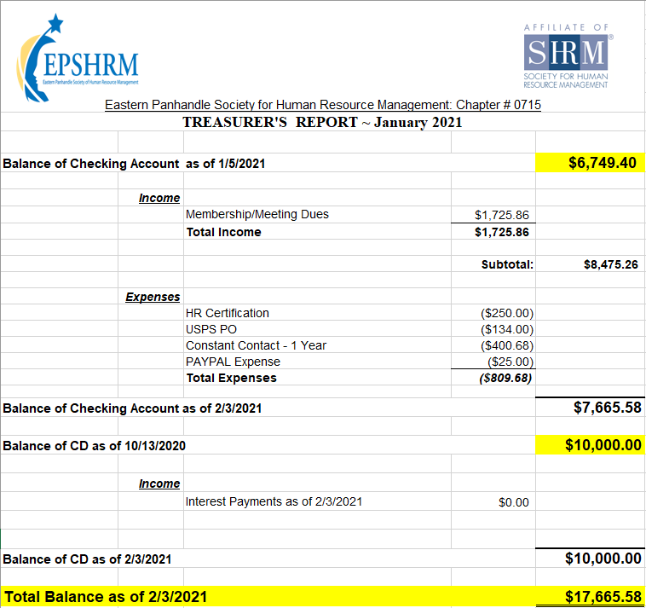
Treasurer’s Report

Slide 5
February Legislative Updates
Travel Restriction coming IN to the US: https://www.natlawreview.com/article/negative-covid-19-test-or-proof-recovery-covid-19-required-all-air-passengers
Can you reward Employees who get the COVID 19 Vaccine: https://blog.shrm.org/blog/before-you-reward-employees-for-getting-the-covid-19-vaccine-read-this-it-m?utm_source=marketo&utm_medium=email&utm_campaign=editorial~Compensation%20and%20Benefits~NL_2021-1-28_Compensation-and-Benefits&linktext=Worker-Who-Left-to-Evaluate-Spouses-Condition-Loses-FMLA
W-2s May Need to Be Corrected Due to FFCRA https://www.shrm.org/resourcesandtools/legal-and-compliance/employment-law/pages/ffcra-w2s.aspx?utm_source=marketo&utm_medium=email&utm_campaign=editorial~HR%20Week~NL_2021-2-1_HR-Week&linktext=W-2s-May-Need-to-Be-Corrected-Due-to-the-FFCRA&mkt_tok

Slide 6
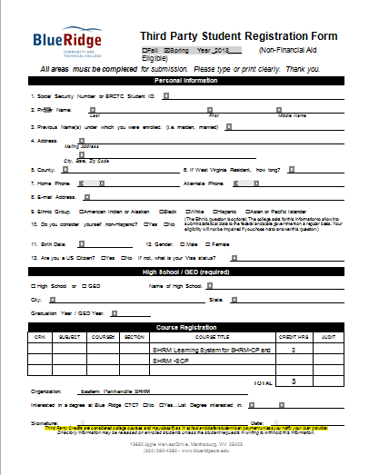

Slide 7
Upcoming Meetings
March – Talent Development presented by Wendy Anson
April – Communication/Leadership presented by Sarah Fletcher
May – Leadership Conference
November – HR Technology & Analytics Part 2 presented by Erica Young
Notes:
Sarah Chick Fil A Leadership Director

Slide 8
Notes:
February: Covered interesting topics such as some must know information for HR in 2021, the role benefit programs specifically student debt repayment programs have in workforce development and rebuilding the economy, discussions surrounding the COVID vaccine and what it means for the workplace.

Slide 9
Notes:
Beginning this year, through a three-year Department of Labor grant, SHRM Foundation’s Human Resource Registered Apprenticeship Program (HR RAP) will help you develop apprentices for the HR Specialist role through a “learn and earn" experience. Apprentices will be prepared to earn the SHRM-Certified Professional credential, giving them the skills they need to deliver results to your organization and an opportunity to progress in an established career path.

Slide 11
Understanding Myers-Briggs & How it is Useful Presented by Karen Sadler-Bower, CPTD, MA Ed.
February 10th, 2021

