Slide 1
WorkTech Trends & Impact Presented by Erica Young, MPS, SHRM-SCP
December 8th, 2020

Slide 2
Board of Directors – 2020
President: Jesse Sites, SHRM-CP
President Elect: Courtney Carroll, SHRM-CP, GCDF
Treasurer: Wanda Bonfili
Secretary: Lesley Hower, PHR, SHRM-CP
Past President & Certification Chair: Harvey Ashworth, SPHR, SHRM-SCP
College Relations Chair: Pat Hubbard
Communications Chair: OPEN
Membership Chair: Sabby Aldaya Lickey, SHRM-SCP
Member Liaison: Hanna Kenney, SHRM-CP
Workforce Readiness Chair: OPEN
Legislative Chair: Raylea Harvey, CEBs
Programming Co-Chair: Hadley Ward, PHR, SHRM-CP
Programming Co-Chair: Jessica McIntosh, aPHR

Slide 3
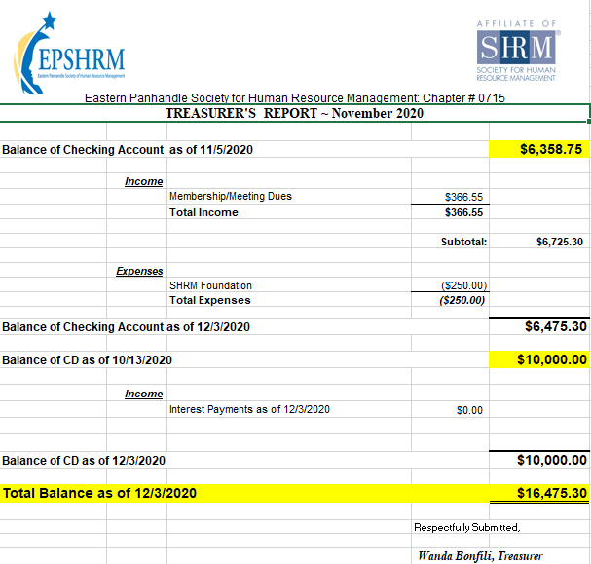
Treasurer’s Report

Slide 4
December Legislative Updates
Families First Coronavirus Response Act (FFCRA): https://www.dol.gov/agencies/whd/pandemic/ffcra-employer-paid-leave
Advanced Payment for Employer Credit: https://www.irs.gov/forms-pubs/about-form-7200
Temporary I-9 Policies Related to COVID-19: https://www.uscis.gov/i-9-central/temporary-policies-related-covid-19
New Rule's COBRA: https://www.shrm.org/ResourcesAndTools/hr-topics/benefits/Pages/DOL-temporarily-extends-COBRA-deadlines-coronavirus.aspx or https://www.benefitnews.com/opinion/employers-and-benefits-administrators-must-prepare-for-a-cobra-avalanche

Slide 5
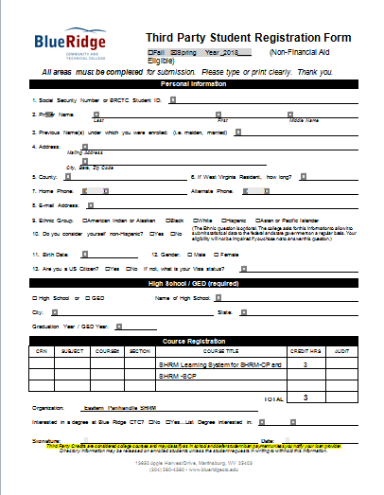

Slide 6
Upcoming Meetings
January – A Culture of Belonging: The Foundation for Diversity & Inclusion Strategies presented by Rebecca D. Mathias Stump

Slide 7
Notes:
December: Virtual hiring and onboarding have become the new normal for many employers in the age of COVID-19. Learning how to balance recruiting for key positions while potentially reducing employment in other areas is also critical. And for job seekers, learning to stand out in what has become a crowded market is a key skill when trying to grab the attention of interested employers. Join our two-part conversation on both aspects of the recruiting puzzle with Jeff Luttrell, Senior Director of Talent Management at Alorica, Kim Ades, President & Founder of Frame of Mind Coaching, and moderator Tony Lee, Director of Editorial at SHRM to equip yourself with new learnings to both recruit more effectively and stand out in the market in these challenging times.
January: As we embark on a brand new year, SHRM shares their top considerations for HR in 2021 to help build better workplaces and a better world during January’s episode of Tune in Tuesday!

Slide 9
WorkTech Trends & Impact Presented by Erica Young
Notes:
Erica is the Innovation Catalyst on the ParagonLabs team at SHRM, where she is responsible for building the first SHRM workplace innovation accelerator. In addition to the accelerator, ParagonLabs is also developing a virtual community and pitch competition on workplace innovation, along with a venture capital arm. Erica has a master’s degree in industrial- organizational psychology with a focus in instructional design. She also earned her SHRM-SCP certification in July 2020.
Before SHRM, Erica managed volunteer human capital and served as an AmeriCorps service member in Washington, DC for several years. She became passionate about improving access to and satisfaction with work when she taught computer literacy courses to low-income DC-residents. Erica is also a SHRM speaker, and a cohost on the SHRM podcast, Career Compass.
Outside of work, you can find Erica tending to her 200+ houseplants, frolicking outside, and giving her cat, Suki, more attention than she wants.

