Slide 1

CAREER READINESS
Forge Business Solutions, LLC
Frank Vitale – President and CEO

Slide 2


INTRODUCTION
Forge Business Solutions, LLC
Strategic Planning and Consulting Firm
Education, Healthcare, and Government
Frank Vitale, President & CEO
Lyndsey Moran

Slide 3
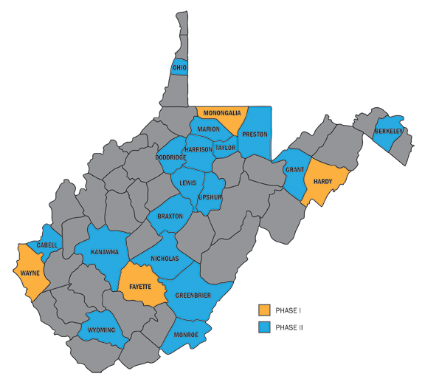
CAREER READINESS WV

Slide 4
PHASE 1 COUNTIES
Hardy County
Fayette County
Monongalia County
Wayne County

Slide 5
PHASE 2 COUNTIES
Berkeley County
Braxton County
Cabell County
Doddridge County
Grant County
Greenbrier County
Harrison County
Kanawha County
Lewis County
Mingo County
Mingo
Monroe County
Nicholas County
Ohio County
Preston County
Taylor County
Upshur County
Wyoming County

Slide 6
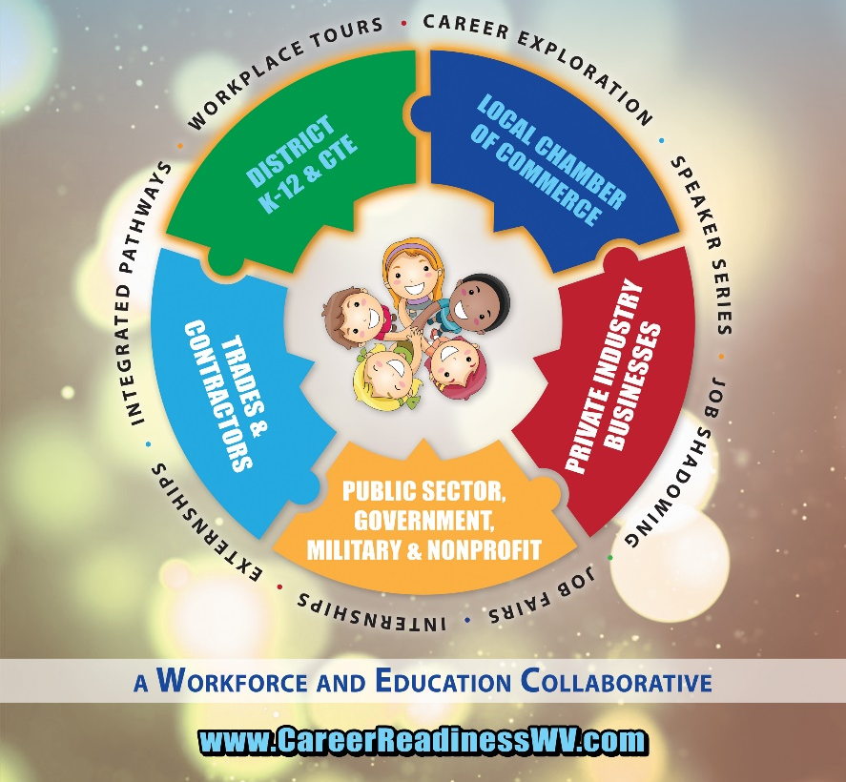
CAREER READINESS WV

Slide 7
PARTNERS
County Districts/ K-12 and CTE
Local Chambers of Commerce
Private Industry and Businesses
Public Sector, Government, Military, and Nonprofits
Trades & Contractors

Slide 8
OUTCOMES
Career Exploration
Workplace Tours
Speaker Series
Job Shadowing
Job Fairs
Internships
Integrated Pathways

Slide 9
PROCESS
Step 1: Leadership Meeting
Step 2: Stakeholder Engagement Meeting
Step 3: Research and Summary Report
Step 4: Strategic Rollout

Slide 10

LEADERSHIP MEETING
During the first phase of our process, we conduct a meeting with the local chamber of commerce executive, superintendent of schools, and CTE senior representatives.

Slide 11

STAKEHOLDER MEETING
Based upon the goals of the initiative and the leadership meeting, we conduct a stakeholder engagement meeting with chamber members, local educators, community and business leaders, local elected officials, and interested students.

Slide 12
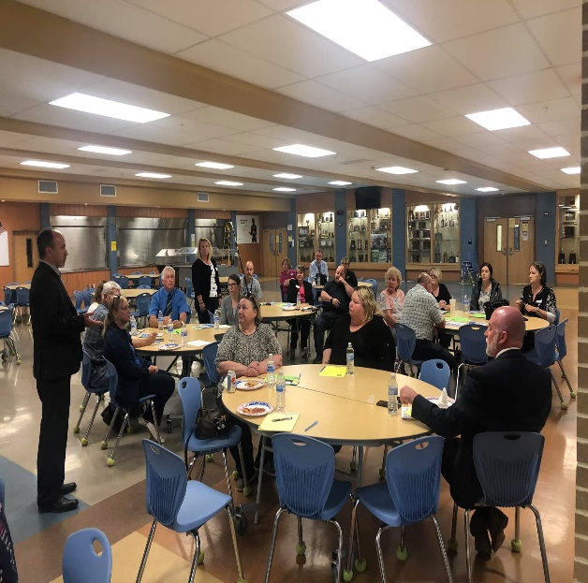
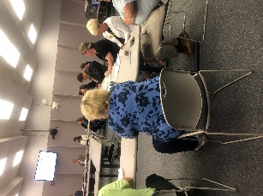
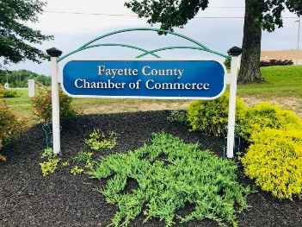
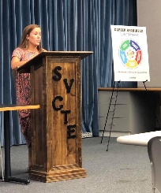
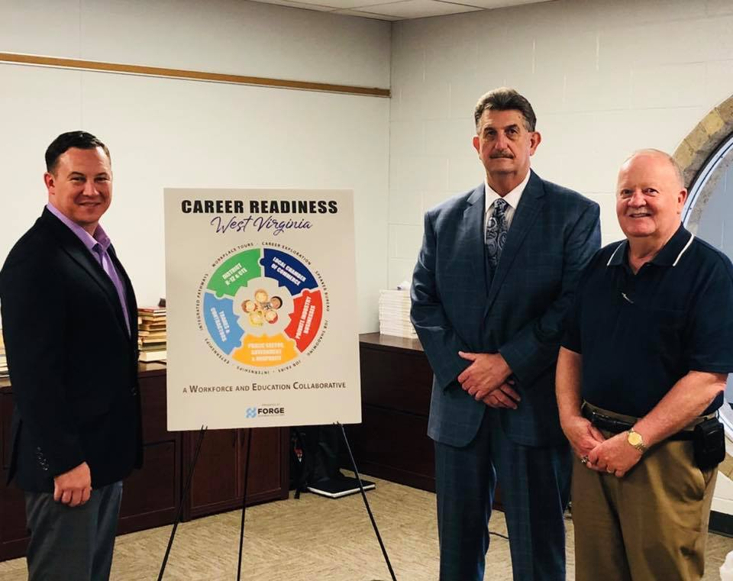
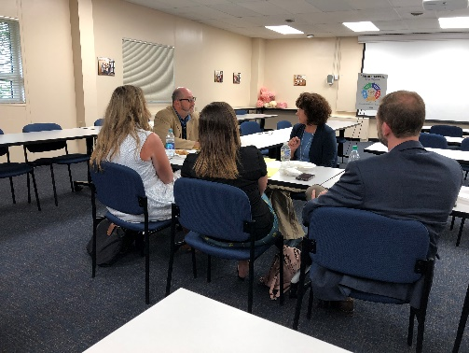
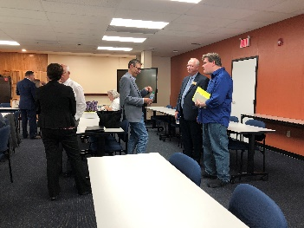
STAKEHOLDER MEETING

Slide 13


RESEARCH AND SUMMARY REPORT
Following each Stakeholder meeting, the Forge team conducts research on local, state and national economies and workforce development.
The summary report includes recommendations and feedback collected from each stakeholder meeting.
The summary report may be used as a tool by each county for Career Readiness and workforce development.

Slide 14

STRATEGIC ROLLOUT
Top Employers
Future of Occupations
Important Qualities of Job Applicants
Local Industry Trends
Current Engagement
Recommendations

Slide 15
CRWV REACH
21 Counties Involved with CRWV
Combined Populations: 978,325
  52% of State Population
Combined Student Populations: 140,068
  53% of WV Student Population

Slide 16
WEST VIRGINIA TOP EMPLOYERS
WVU Medicine
Wal-Mart​
Charleston Area Medical Center​
Mountain Health Network
Kroger

Slide 17
RESOURCES
Bureau of Business and Economic Research; Dr. John Deskins
U.S. Small Business Administration
WV News
Forbes
Fortune
U.S. News and World Reports
National Intelligence Council
WV Executive
United States Department of Labor
Workforce WV
West Virginia Department of Education
United States Census Bureau
myStrategic Compass (WVDE)

Slide 18

IN THE NEWS
Moorefield Examiner: Businesses and Schools Work Together to Help Students
Williamson Daily News: Wayne County selected to join workforce development project
The Register-Herald: It takes a village
WV MetroNews: Frank Vitale on Career Opportunities
Dominion Post: Initiative aims at helping teens finding career paths
The State Journal: Chambers, school districts working to bolster career opportunities

Slide 19

QUESTIONS?
Contact:
info@forgebz.com
304.777.2248
Visit:
careereadinesswv.com

