Slide 1
Business updates will begin at 8:30am.If you’re joining us now, feel free to chat amongst the group, check some email, or refill that coffee cup ☺

Slide 2
Servanthood, and what it means to Be Remarkable! Presented by Sarah Fletcher
April 13th, 2021

Slide 3
Board of Directors – 2021
President: Jesse Sites, SHRM-SCP
President Elect: Courtney Carroll, SHRM-CP, GCDF
Treasurer: Wanda Bonfili
Secretary: Lesley Hower, PHR, SHRM-CP
Past President & Certification Chair: Harvey Ashworth, SPHR, SHRM-SCP
College Relations Chair: Pat Hubbard
Communications Chair: OPEN
Membership Chair: Sabby Aldaya Lickey, SHRM-SCP
Member Liaison: Hanna Kenney, SHRM-CP
Workforce Readiness Chair: Susan Lewis, SHRM-CP
Legislative Chair: Raylea Harvey, CEBs
Programming Co-Chair: Hadley Ward, PHR, SHRM-CP
Programming Co-Chair: Jessica McIntosh, aPHR

Slide 4
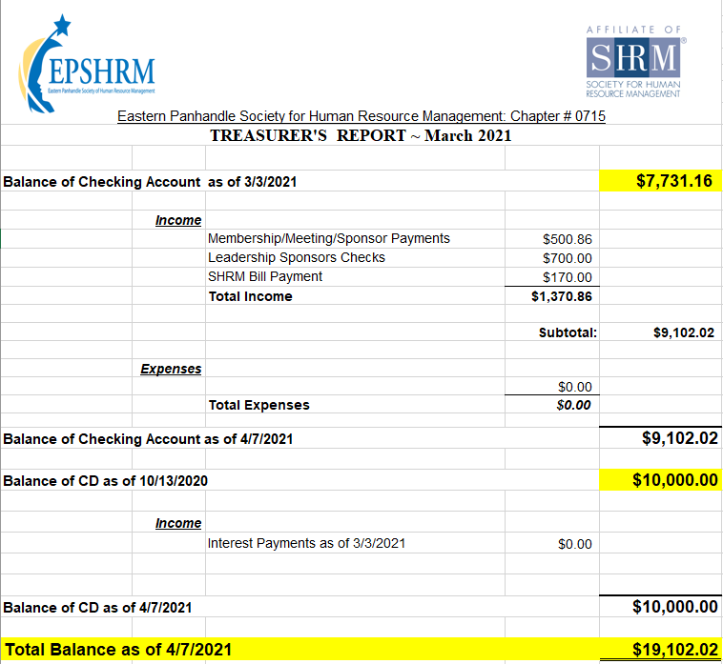
Treasurer’s Report

Slide 5
April Legislative Updates
The American Rescue Plan Act of 2021: https://www.shrm.org/ResourcesAndTools/hr-topics/benefits/Pages/new-COBRA-subsidy-requires-quick-action-by-plan-sponsors.aspx
Unemployment Insurance Fraud: U.S. Department of Labor Launches New Online Resource for Victims: https://www.natlawreview.com/article/unemployment-insurance-fraud-us-department-labor-launches-new-online-resource
OSHA Publishes New National Emphasis Program Targeting COVID-19 Enforcement: https://www.jacksonlewis.com/publication/osha-publishes-new-national-emphasis-program-targeting-covid-19-enforcement
EEO-1 Reporting Period (Apr 26 - Jul 19)

Slide 6
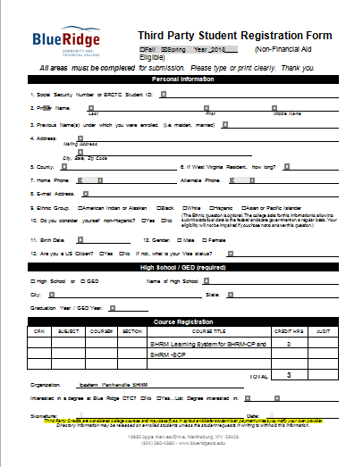

Slide 7
Upcoming Meetings
November – HR Technology & Analytics Part 2 presented by Erica Young
Notes:
Sarah Chick Fil A Leadership Director

Slide 12
Notes:
April, SHRM share updates about SHRM21, Second Chances Month, and an preview on the latest coming from their Together Forward@Work platform

Slide 16
Servanthood, and what it means to Be Remarkable! Presented by Sarah Fletcher
April 13th, 2021

