Slide 1
Business updates will begin at 8:30am.If you’re joining us now, feel free to chat amongst the group, check some email, or refill that coffee cup ☺

Slide 2
2020-2021 Legislative Update for the HR Professional Presented by J. Tyler Mayhew, Esq.
September 8th, 2021

Slide 3
Board of Directors – 2021
President: Jesse Sites, SHRM-SCP
President Elect: Courtney Carroll, SHRM-CP, GCDF
Treasurer: Wanda Bonfili (open in 2022)
Secretary: Lesley Hower, PHR, SHRM-CP (open in 2022)
Past President & Certification Chair: Harvey Ashworth, SPHR, SHRM-SCP
College Relations Chair: Pat Hubbard
Communications Chair: Morgan Gower
Membership Chair: Sabby Aldaya Lickey, SHRM-SCP
Workforce Readiness Chair: Open
Legislative Chair: Raylea Harvey, CEBs
Programming Co-Chair: Hadley Ward, PHR, SHRM-CP (open in 2022)
Programming Co-Chair: Jessica McIntosh, aPHR

Slide 4
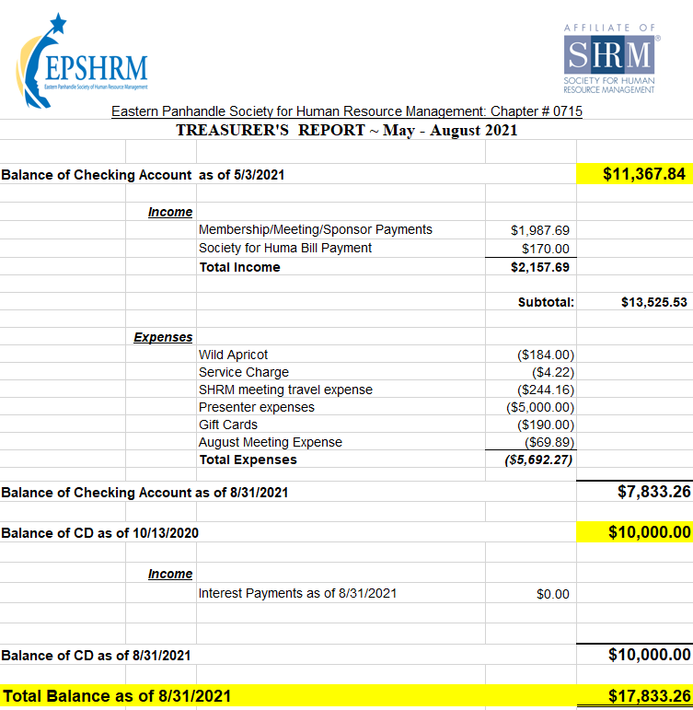
Treasurer’s Report

Slide 5
September Legislative Updates
Summary Annual Reporting (SAR) 60 days after 5500
Ends Sept 30 (as of right now): Do they require notices to be sent?
NO: Families First Coronavirus Response Act (FFCRA) due to American Rescue Plan Act (ARPA)
YES: COBRA Subsidy due to ARPA: https://www.shrm.org/ResourcesAndTools/hr-topics/benefits/Pages/deadline-approaches-for-COBRA-subsidy-final-notice.aspx
ICE Extends Form I-9 Remote Review Through End of 2021: https://www.shrm.org/ResourcesAndTools/hr-topics/talent-acquisition/Pages/ICE-Extends-Form-I9-Remote-Review-Through-End-of-2021.aspx
Vaccine refusal and unemployment:
https://www.shrm.org/resourcesandtools/legal-and-compliance/employment-law/pages/can-a-worker-who-was-fired-for-refusing-a-vaccine-collect-unemployment.aspx
https://www.huschblackwell.com/newsandinsights/50-state-update-on-pending-legislation-pertaining-to-employer-mandated-vaccinations#linktojump21

Slide 6
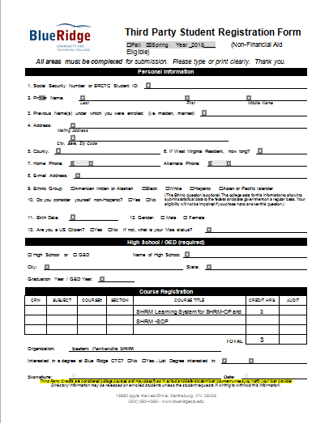

Slide 7
Upcoming Meetings
October 13th – Pending
November 10th – HR Technology & Analytics Part 2 presented by Erica Young
December – Winter Social

Slide 10
Notes:
Featuring a conversation between Laszlo Bock, former SVP of People Operations at Google and SHRM President & CEO, Johnny C. Taylor, Jr.

Slide 11
Notes:
The pandemic has upended everything about the workplace, but far and away the biggest challenge facing leaders isn’t technology, innovation, or even leadership: It’s engendering a culture that readily finds, develops, and engages the right talent to thrive now and in the future.
Informed by more than 70 years of SHRM experience and expertise and propelled by extensive original research, RESET delivers a candid and forward-thinking vision for leaders to reimagine their company cultures in a time of global upheaval and presents data-driven strategies to make the necessary foundational reset of all things work.
And if you purchase a copy of the book, you can enter yourself in a drawing to receive an all expenses paid VIP experience to SHRM’s Inclusion Conference in Austin, TX. Visit reset.shrm.org.

Slide 13
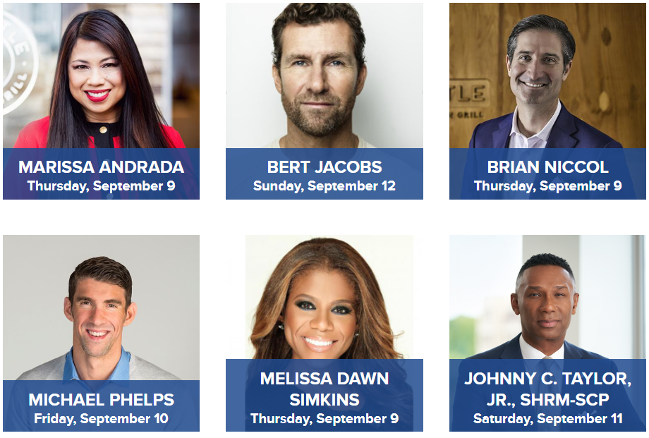
Notes:
Marissa Andrada
Chief Diversity, Inclusion and People Officer @ Chipotle
Bert Jacobs
Co-Founder
Life is Good
Brian Niccol
Chairman and Chief Executive Officer
Chipotle Mexican Grill
Michael Phelps
Record breaking Olympic Swimmer
Melissa Dawn Simkins
CEO, Velvet Suite | Founder, The She-Suite

Slide 14
HRCI Ethics Certificate
Since ethics plays an important role in the business community, HRCI is offering an ethics series certificate that can help support the social responsibility and success of your organization. This series can also be used towards meeting your one ethics recertification requirement.
The series includes ten ethics subjects, and you can earn 15 recertification credits for $259. Apply discount code FALL2021 during checkout for an additional 15% off the course. This code expires on September 30, 2021.
Notes:
All certificants must fulfill one ethics credit as part of the total 45/60 recertification credits requirement.

Slide 15
2020-2021 Legislative Update for the HR Professional Presented by J. Tyler Mayhew, Esq.

