Slide 1
September 11th, 2019
Comprehensive OSHA Enforcement Update: by Daniel Deacon, LLP
Established 2007

Slide 2
Board of Directors – 2019
President: Harvey Ashworth, SPHR, SHRM-SCP
President Elect: Jesse Sites, SHRM-CP
Treasurer: Wanda Bonfili
Secretary: Lesley Hower, PHR, SHRM-CP
Past President & Certification Chair: Justin Ruble, SPHR, SHRM-SCP
College Relations Chair: Pat Hubbard
Communications Chair: OPEN (JiJi to step down in Dec.)
Membership Chair: OPEN (JiJi to Step down in Dec.
Member Liaison: Hanna Kenney, SHRM-CP
Workforce Readiness Chair: Courtney Carroll, SHRM-CP, GCDF
Legislative Chair: Raylea Harvey
Programming Co-Chair: Hadley Ward, PHR, SHRM-CP
Programming Co-Chair: Jessica McIntosh, aPHR

Slide 3
Volunteer Opportunities
Communications Chair - primary responsibilities
sets up online meeting and event registrations
works with partner organizations to share relevant communications (e.g.., Blue Ridge CTC's SHRM-CP/SCP prep course)
copyedits meeting presentation documents
updates ep.shrm.org website
takes/posts photos
Membership Chair - primary responsibilities
maintains membership database
sends membership due notices
reconciles memberships once per month, prior to meetings
works with treasurer on event/meeting/membership payments

Slide 4
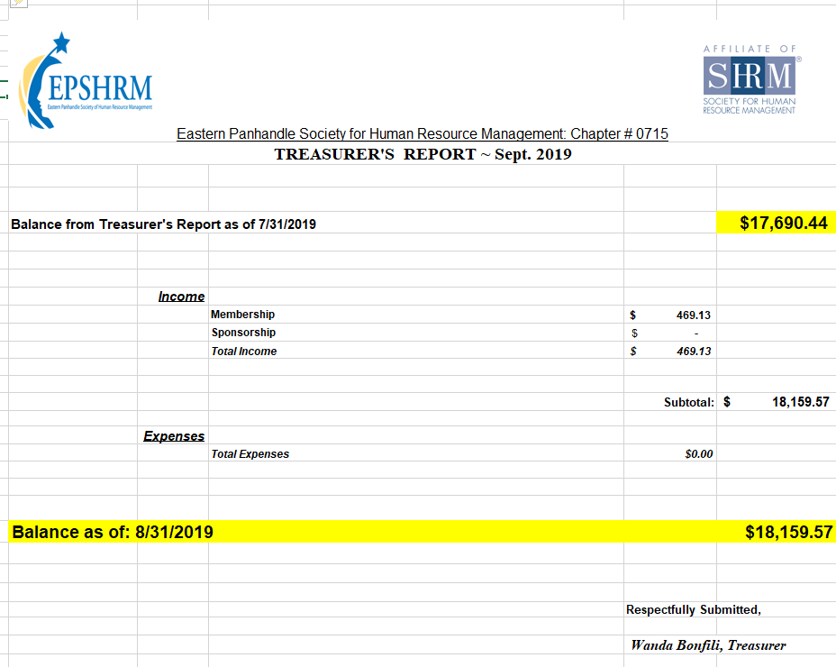

Slide 5
September Legislative Updates
33 States have enacted 51 laws addressing drug prices. 2019 on July 1st . https://www.forbes.com/sites/deanzerbe/2019/07/02/congress-expands-taxpayer-rights-with-taxpayer-first-act-of-2019/#3e207e261729
https://nashp.org/wp-content/uploads/2019/01/RxTracker-final-8.27.2019.pdf
Summary Annual Reporting (SAR) 60 days after 5500
I-9 Forms expired August 31st. https://www.apspayroll.com/blog/changes-coming-to-form-i9/
Congress Expands Taxpayer Rights With Taxpayer First Act of
Notes:
3 in Maryland, 13 in PA, 3 in Virginia, 9 in WV- none
SAR due 9/30 for those who filed Welfare/Retirement 5500 by July 31st. All extended 5500 are due Oct 14th which makes SAR due Dec 14th
U.S. Citizenship and Immigration Services (USCIS) announced that employers should continue using the current version of Form I-9 even after the expiration date on the form of August 31, 2019 has passed. Latest version to date is July 17, 2017
Tax Payer Rights highlights
Independent Appeals Process
Innocent Spouse – De Novo Review For Equitable Liability
Modification Of Procedures For Issuance Of Third-Party Summons
Office of the National Taxpayer Advocate – Taxpayer Advocate Directives
Whistleblower Reforms
Cybersecurity and Identity Protection
<number>

Slide 6
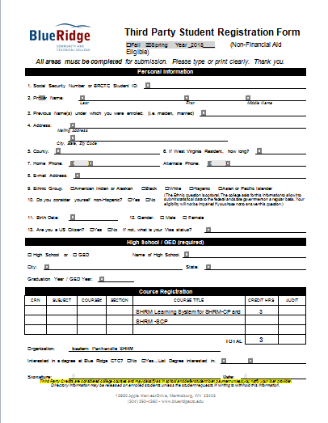

Slide 7
Upcoming Events
October – Diversity Techniques with Lisa Hammer
November – Mental Illness & Substance Abuse In the Workplace with Jan Nives & Dana DeJarnett
December- Holiday Social at Hollywood Casino
January- (Tentatively) Performance Management with Lisa Shuster

Slide 10
New Members & Introductions
Becky Nucilli
Susan Lewis

Slide 11
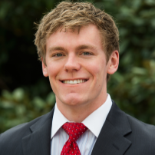
Comprehensive OSHA Enforcement Update: Review of Trump's Deregulatory Agenda and Top Five OSHA Issues in 2019
Presented by Daniel Deacon, LLP

Slide 12
Daniel C. Deacon, LLP
Daniel C. Deacon is an Associate in the Washington, D.C. office of Conn Maciel Carey LLP working in both Labor and Employment and OSHA practice groups.
He advises and represents employers on a wide range of employment-related issues, including wage and hour disputes, claims of discrimination and harassment, compliance with the Americans with Disabilities Act (ADA), the Affordable Care Act (ACA), and the Family and Medical Leave Act (FMLA).
He also helps employers develop and implement effective workplace policies and safety and health programs.
Additionally, Mr. Deacon represents and advises employers during inspections and investigations conducted by the federal Occupational Safety and Health Administration (OSHA) and state OSHA programs, responds to notices form OSHA about employee complaints of safety hazards, and represents employers in OSHA litigation, including citation contests and administrative hearings.
He also helps employers develop safety and health programs and policies, and conducts presentations on a variety of workplace safety topics.

