Slide 1
Influence with Integrity Presented by Hadley Ward
September 9th, 2020

Slide 2
Board of Directors – 2020
President: Jesse Sites, SHRM-CP
President Elect: OPEN
Treasurer: Wanda Bonfili
Secretary: Lesley Hower, PHR, SHRM-CP
Past President & Certification Chair: Harvey Ashworth, SPHR, SHRM-SCP
College Relations Chair: Pat Hubbard
Communications Chair: OPEN
Membership Chair: OPEN
Member Liaison: OPEN
Workforce Readiness Chair: Courtney Carroll, SHRM-CP, GCDF
Legislative Chair: Raylea Harvey
Programming Co-Chair: Hadley Ward, PHR, SHRM-CP
Programming Co-Chair: Jessica McIntosh, aPHR

Slide 3
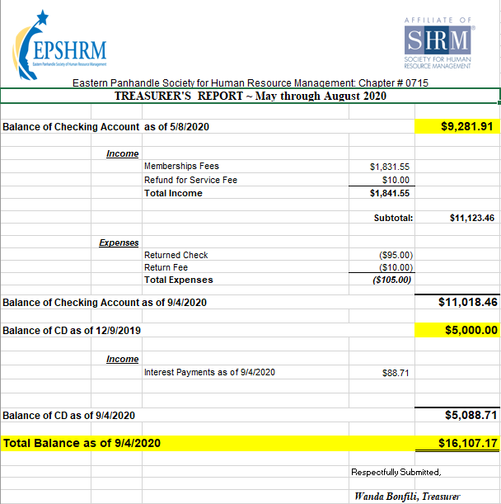
Treasurer’s Report

Slide 4
Legislative Updates
Labor Department Expands Fluctuating Workweek Overtime Rule: https://www.shrm.org/ResourcesAndTools/legal-and-compliance/employment-law/Pages/Labor-Department-Expands-Fluctuating-Workweek-Overtime-Rule.aspx
Summary Annual Reporting (SAR) 60 days after 5500
SHRM’s new 2020 Election Resource Center: https://elections.shrm.org/
New DOL FMLA Forms: https://www.shrm.org/ResourcesAndTools/legal-and-compliance/employment-law/Pages/guide-new-FMLA-forms.aspx
Worker Adjustment and Retraining Notification Act of 1988 WARN Act): https://www.dol.gov/agencies/eta/layoffs/warn
West Virginia CARES Act: https://grants.wv.gov/en/flexible-page?pageId=1424
Families First Coronavirus Response Act: Questions and Answers: https://www.dol.gov/agencies/whd/pandemic/ffcra-questions
Notes:
Synopsis:
Each month I try to report on Legal Rulings or Legislative Bills that have been signed into law that would impact the world of HR. I also like to provide resources that you can use on a day to day setting that will help navigate some of the complexities in our ever-changing world.
1. "The IRS will not grant an additional 30-day extension beyond this deadline," and if an employer submits a request for a 30-day extension to furnish these forms, "the IRS will not respond to that request since it is now moot," according to compliance firm Hub International. Even with the automatic extension, "the IRS specifically encouraged employers and other coverage providers to send the forms to employees and individuals as soon as possible."
2. Regular Rate: Under the Fair Labor Standards Act, non-exempt employees must receive one and one half times their regular rate of pay for all hours worked over forty in a work week. On December 16, 2019, the United States Department of Labor (“DOL”) released the final rule updating the regulations that govern how the regular rate is calculated. The new rule is intended to provide additional guidance and address certain types of compensation that have become more common since the regulations were initially implemented. The new rule took effect January 15, 2020.
3. SECURE Act:
Allow unaffiliated employees to offer their workers a 401(k) through a multiple employer plan (MEP), with eased compliance requirements compared to current MEPs.
Delay required retirement distributions from 401(k) plans to age 72, up from age 70 1/2.
Allow automatic-enrollment safe-harbor 401(k) plans to increase the cap on automatically raising payroll contributions
Create a 401(k) safe harbor from liability for offering in-plan annuities.
Reduce annual testing requirements on "frozen" defined-benefit pension plans closed to new hires.
SECURE Act Passage
The Setting Every Community Up for Retirement Enhancement (SECURE) Act, passed by the House in May, contains several compliance changes for 401(k)-type defined contribution plans and to defined-benefit pension plans. The SECURE Act would, among other changes:
Increase the business tax credit for plan startup costs to make setting up 401(k) plans more affordable for small businesses.
Allow unaffiliated employees to offer their workers a 401(k) through a multiple employer plan (MEP), with eased compliance requirements compared to current MEPs.
Delay required retirement distributions from 401(k) plans to age 72, up from age 70 1/2.
Allow automatic-enrollment safe-harbor 401(k) plans to increase the cap on automatically raising payroll contributions.
Create a 401(k) safe harbor from liability for offering in-plan annuities.
Reduce annual testing requirements on "frozen" defined-benefit pension plans closed to new hires.
Most of the SECURE Act's provisions won't take effect until January 2021.
"This legislation will help hard-working Americans prepare for a financially secure future by incentivizing small businesses to set up employer-sponsored retirement plans," said SHRM Chief of Staff Emily M. Dickens, who oversees SHRM Government Affairs.
"Among the many valuable elements of the SECURE Act is a measure that would address a glitch in the nondiscrimination rules affecting participants in frozen pension plans," said Lynn Dudley, senior vice president for global retirement and compensation policy at the American Benefits Council, which represents benefit plan sponsors. "Hundreds of thousands of participants could lose future pension benefits as of Jan. 1, 2020, without a legislative fix."

Slide 5
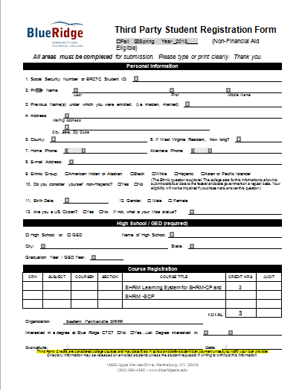

Slide 6
Upcoming Meetings
October – Katie Spriggs: How to Identify Domestic Violence and Human Trafficking in the Workplace
November – Vicky Fields: Public Speaking
December – Erica Young from the SHRM Bureau of Speakers (Process of finalizing)

Slide 8
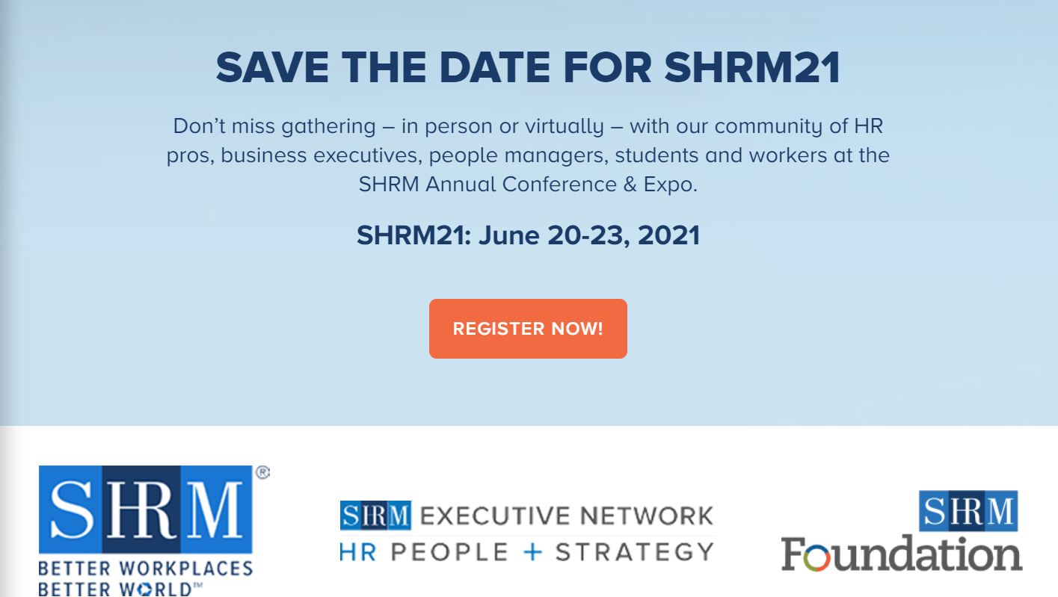

Slide 9
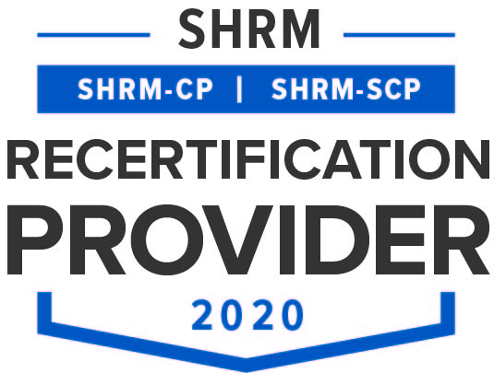
Influence with Integrity Presented by Hadley Ward
Hadley Ward has been a member and/or board member of the EPSHRM chapter for about 8 years. She has worked in HR for many years for healthcare, non-profit, higher education and travel organizations. Today, she joins us as a Certified Trainer with Libby Wagner and Associates to share the Influencing with Integrity model for communication and building trust.

