Slide 1
How to Identify Domestic Violence & Human Trafficking in the Workplace by Presented by Katie Spriggs, BSW
October 14th, 2020

Slide 2
Board of Directors – 2020
President: Jesse Sites, SHRM-CP
President Elect: OPEN
Treasurer: Wanda Bonfili
Secretary: Lesley Hower, PHR, SHRM-CP
Past President & Certification Chair: Harvey Ashworth, SPHR, SHRM-SCP
College Relations Chair: Pat Hubbard
Communications Chair: OPEN
Membership Chair: OPEN
Member Liaison: Hanna Kenney, SHRM-CP
Workforce Readiness Chair: Courtney Carroll, SHRM-CP, GCDF
Legislative Chair: Raylea Harvey
Programming Co-Chair: Hadley Ward, PHR, SHRM-CP
Programming Co-Chair: Jessica McIntosh, aPHR

Slide 3
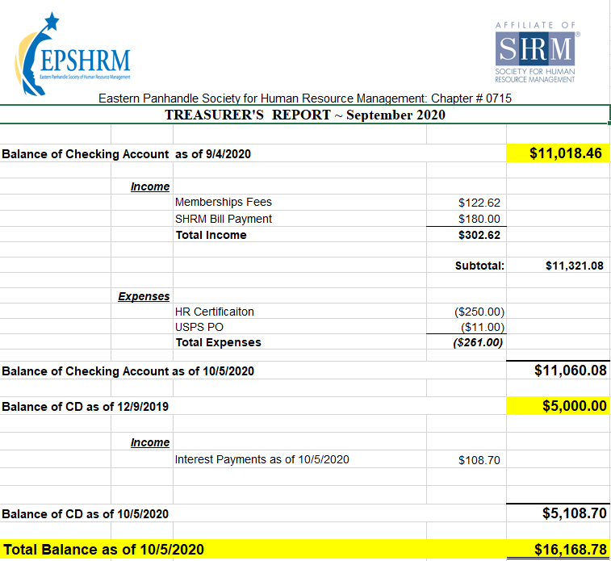
Treasurer’s Report

Slide 4
October Legislative Updates
Medicare Part D Notices: TODAY https://www.shrm.org/resourcesandtools/hr-topics/benefits/pages/deadline-nears-for-2020-medicare-part-d-coverage-notices.aspx
ACA 1095 C Deadline pushed to March 2: https://www.shrm.org/ResourcesAndTools/hr-topics/benefits/Pages/irs-extends-form-1095-distribution-deadline-to-march-2.aspx
IRS: Check tax withholdings now as the last quarter of 2020 begins: https://www.irs.gov/newsroom/irs-check-tax-withholdings-now-as-the-last-quarter-of-2020-begins

Slide 5
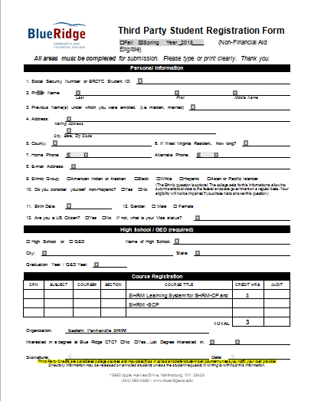

Slide 6
Upcoming Meetings
November – Vicky Fields: Public Speaking
December – Erica Young from the SHRM Bureau of Speakers

Slide 9
Monthly Corporate Sponsor

Slide 10
How to Identify Domestic Violence and Human Trafficking in the Workplace Presented by Katie Spriggs, BSW
Notes:
Katie is a graduate of Shepherd University with a bachelor’s degree in Social Work. Katie has worked in victim services for 7 years, with a focus on victims of domestic violence, sexual assault, human trafficking and stalking. She is a member of the WV human trafficking task force, is co-chair of their training committee and a steering committee member. Katie has trained medical professionals, law enforcement, military members and community members about intervention and prevention of human trafficking, domestic violence, and sexual assault. Katie has been with Eastern Panhandle Empowerment Center (EPEC) for 7 years and currently works as the Executive Director. EPEC is a dual program in the Eastern Panhandle of WV that serves victims of domestic violence, sexual assault, stalking and human trafficking. Katie co-facilitates the statewide WV coalition against domestic violence’s advocates aspiring for equity team. She is also a member of the Martinsburg Police Dept. Chief’s advisory panel and works closely with law enforcement and other first responders in the field.

