Slide 1
Diversity & Conflict in the Workplace by David B. Newman & Lisa Hammer
October 9th, 2019

Slide 2
Board of Directors – 2019
President: Harvey Ashworth, SPHR, SHRM-SCP
President Elect: Jesse Sites, SHRM-CP
Treasurer: Wanda Bonfili
Secretary: Lesley Hower, PHR, SHRM-CP
Past President & Certification Chair: Justin Ruble, SPHR, SHRM-SCP
College Relations Chair: Pat Hubbard
Communications Chair: OPEN
Membership Chair: OPEN
Member Liaison: Hanna Kenney, SHRM-CP
Workforce Readiness Chair: Courtney Carroll, SHRM-CP, GCDF
Legislative Chair: Raylea Harvey
Programming Co-Chair: Hadley Ward, PHR, SHRM-CP
Programming Co-Chair: Jessica McIntosh, aPHR

Slide 3
Volunteer Opportunities
Communications Chair - primary responsibilities
sets up online meeting and event registrations
works with partner organizations to share relevant communications (e.g.., Blue Ridge CTC's SHRM-CP/SCP prep course)
copyedits meeting presentation documents
updates ep.shrm.org website
takes/posts photos
Membership Chair - primary responsibilities
maintains membership database
sends membership due notices
reconciles memberships once per month, prior to meetings
works with treasurer on event/meeting/membership payments

Slide 4
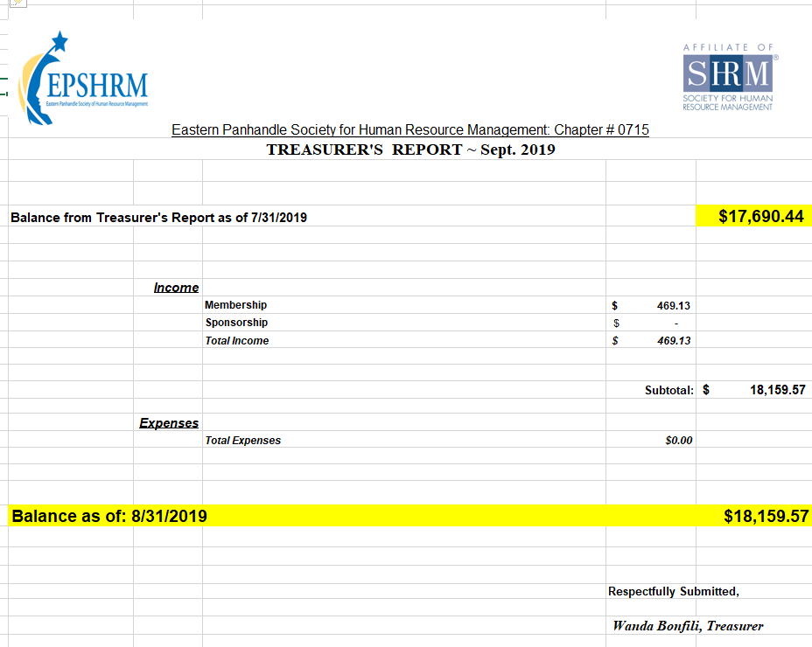
Treasurer’s Report

Slide 5
October Legislative Updates
Medicare Part D Notice October 14th
EEO-1 Component 2 deadline extended by EEOC; https://hrdailyadvisor.blr.com/2019/09/30/eeoc-extends-eeo-1-component-2-deadline/
DOL issues finalized overtime regulation; https://www.dol.gov/newsroom/releases/whd/whd20190924

Slide 6
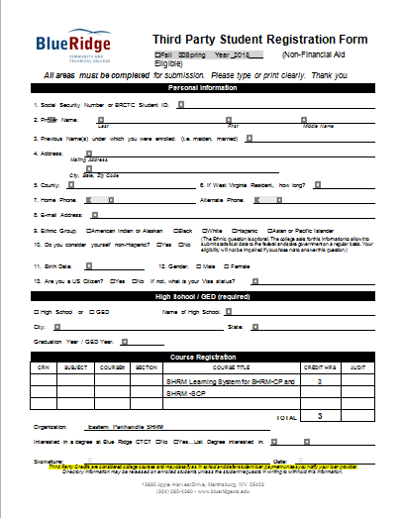

Slide 7
Upcoming Events
November – Mental Illness & Substance Abuse In the Workplace with Jan Nives & Dana DeJarnett
December- Holiday Social at Hollywood Casino
January- (Tentatively) Performance Management with Lisa Shuster

Slide 8
New Members & Introductions
Kayla Barb
Morgan Gower
Christopher Claudio
Karen Kisner
Megan Haines

Slide 9
Monthly Corporate Sponsor

Slide 10
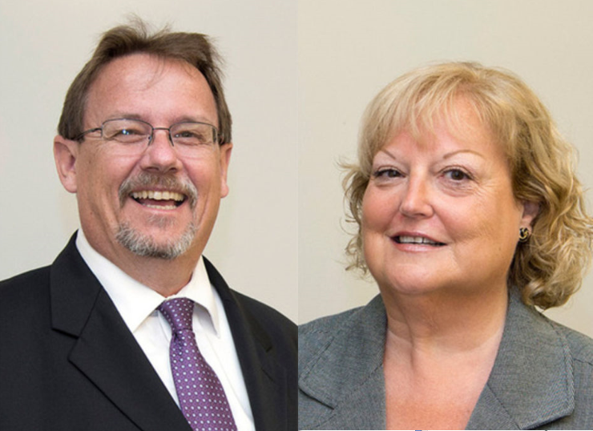
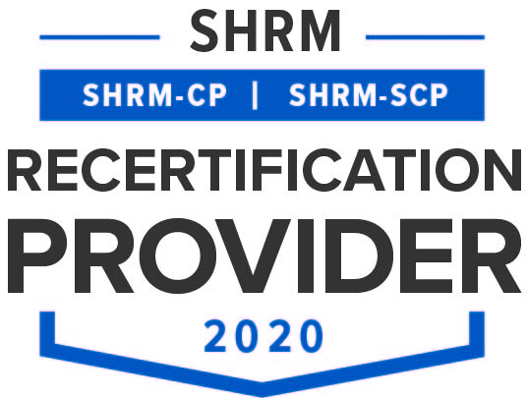
Diversity and Conflict in the Workplace Presented by David B. Newman & Lisa Hammer

Slide 11
David B. Newman, PMP, PMI-ACP, SPHR, ITIL
David B. Newman has over 30 years of experience and holds a Master’s degree in Technical Management from Johns Hopkins University. He has a diversified background in engineering and product development, is a certified trainer for leadership seminars, and loves to share his experience and extensive background with others. Project teams have excelled under his leadership as he has emphasized that the key to building a high-performance team is to integrate management skills with a collaborative philosophy to influence and motivate teams.
Audiences eagerly engage with David’s interactive presentation style. Through a mix of personal experience, hands-on activities and touches of PMBOK® Guide formality, David’s workshops are entertaining and educational. His passion and humor make his workshops fun while his focus on results drives attendees to reach for practical solutions to real challenges.
David has been selected to present multiple courses for PMI SeminarsWorld®, a series of professional seminars, which are held annually in various cities throughout the United States and internationally.

Slide 12
Lisa Hammer, PMP
Lisa Hammer has more than 30years of experience, specializing in project management and staff development for both large and small firms. She has managed the implementation of several multi-million-dollar programs, which included coordination of staff, consultants and subcontractors to achieve client goals while maintaining budget and cost controls across all activities. Her executive career has been highlighted by a broad range of qualifications, including proven leadership and analytical skills, collaboration with outside groups, along with a reputation for accountability, flexibility, and resourcefulness.
Lisa continues to be a Project Management practitioner, working with clients to improve their ability to execute against demanding deliverables in dynamic environments. Her client base includes many state and local agencies, non-profits and as well as public and private companies. Lisa understands that people who are satisfied with their employment experience are more engaged, which leads to improved quality, productivity and happiness. Her passion for professionalism shines through in her presentations on a wide range of project management topics. Using her broad and in-depth field experience she not only stands behind her training, she expects success!
Lisa has been selected to present multiple courses for PMI SeminarsWorld®, a series of professional seminars, which are held annually in various cities throughout the United States and internationally.

Slide 13
David B. Newman and Lisa Hammer are co-founders and principals of Leadership Techniques, LLC. Specializing in leadership and project management training and consulting, their public speaking experience has been expanded to include workshops at PMI’s SeminarsWorld®. While often asked to intervene in challenging scenarios, they always try to inject positivity and happiness into the environment and look to reduce stress for employees while driving results for all stakeholders.

