Slide 1
March 13th, 2019
The Communication Connection: Three Tools to Advance Your Company,
Your Cause or Yourself
Presented by Patti Sherwood
Established 2007

Slide 2
Board of Directors – 2019
President: Harvey Ashworth, SHRM-SCP
President Elect: Jesse Sites, SHRM-CP
Treasurer: Lori Turner, SHRM-CP - Now Available!
Secretary: Lesley Hower, PHR, SHRM-CP
Past President & Certification Chair: Justin Ruble, SPHR, SHRM-SCP
College Relations Chair: Pat Hubbard
Membership & Communications Chair: JiJi Russell, SHRM-CP
Member Liaison: Hanna Kenney, SHRM-CP
Workforce Readiness Chair: Courtney Carroll, SHRM-CP, GCDF
Legislative Chair: Raylea Harvey
Programming Co-Chair: Hadley Ward, PHR, SHRM-CP
Programming Co-Chair: Jessica McIntosh, aPHR

Slide 3
SAVE THE DATE

Slide 4
WELCOME NEW MEMBERS
Lee Bonebrake
Lisha Burks
Vickie Elliott
Chelsey Weaning

Slide 5
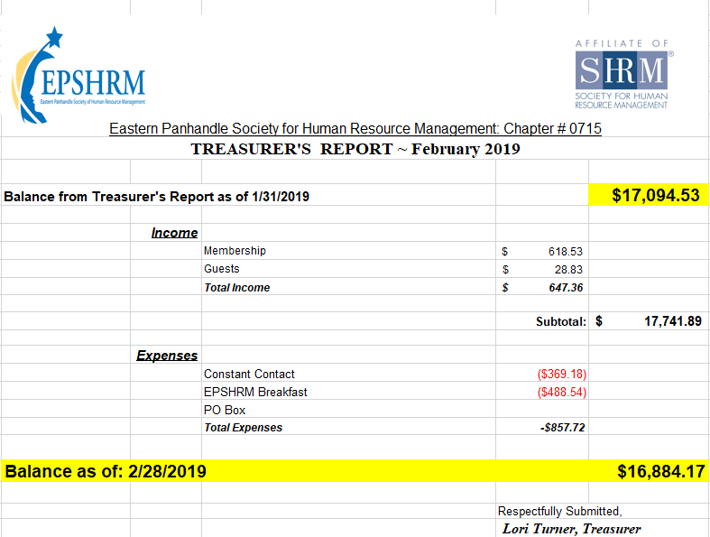

Slide 6
WorkForce Readiness – Events
Mock Interviews
give back & prepare the next generation
March 21st 8:00AM – 12:30 noon Martinsburg High School
March 22nd 8:00AM – 12:00 noon Hedgesville High School

Slide 8
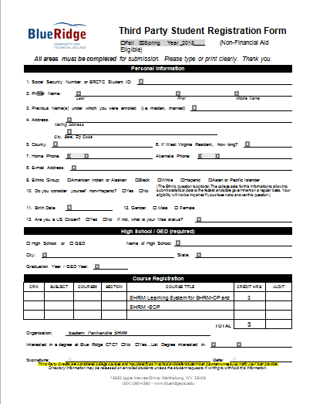

Slide 9
March Sponsor

Slide 10
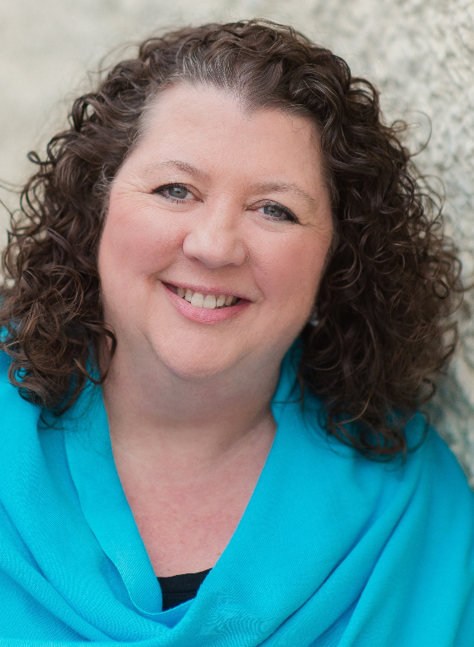
Patricia Sherwood
Matchmaker - Long & Foster Realty
Patti Sherwood is a matchmaker – she connects her clients with their dream homes, helping people find where their heart is and move to the place where their future will unfold. Serving as a local real estate authority, she provides consistent, candid communication empowering her clients to make clear, confident decisions. As a Realtor with Long & Foster, Patti specializes in finer homes in Jefferson and Berkeley Counties. She also teaches Business Ethics and Communications classes at Shepherd University. Patti has been an active member of EPSHRM for 10 years!

