Slide 1
Business updates will begin at 8:30am.If you’re joining us now, feel free to chat amongst the group, check some email, or refill that coffee cup ☺

Slide 2
Taking Talent Development Beyond the Norm Presented by Dr. Wendy Anson
March 10th, 2021

Slide 3
Board of Directors – 2021
President: Jesse Sites, SHRM-SCP
President Elect: Courtney Carroll, SHRM-CP, GCDF
Treasurer: Wanda Bonfili
Secretary: Lesley Hower, PHR, SHRM-CP
Past President & Certification Chair: Harvey Ashworth, SPHR, SHRM-SCP
College Relations Chair: Pat Hubbard
Communications Chair: OPEN
Membership Chair: Sabby Aldaya Lickey, SHRM-SCP
Member Liaison: Hanna Kenney, SHRM-CP
Workforce Readiness Chair: Susan Lewis, SHRM-CP
Legislative Chair: Raylea Harvey, CEBs
Programming Co-Chair: Hadley Ward, PHR, SHRM-CP
Programming Co-Chair: Jessica McIntosh, aPHR

Slide 4
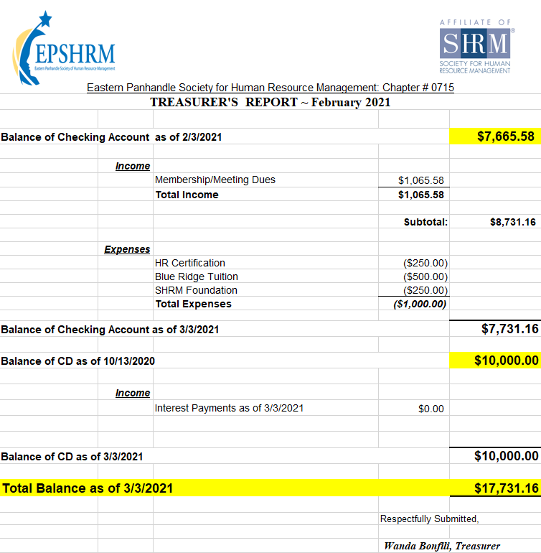
Treasurer’s Report

Slide 5
March Legislative Updates
VA Issues Permanent COVID Standards: https://www.shrm.org/ResourcesAndTools/legal-and-compliance/state-and-local-updates/Pages/Virginia-Issues-Permanent-COVID-19-Standard.aspx
SHRM Advocacy- The Pro Act: To join our advocacy efforts regarding the PRO Act and contact your representative with one click, text NOTOPRO to 52886 or visit SHRM’s Advocacy Website. https://www.congress.gov/bill/117th-congress/house-bill/842
The American Rescue Plan Act of 2021: https://www.congress.gov/bill/117th-congress/house-bill/1319/actions

Slide 6
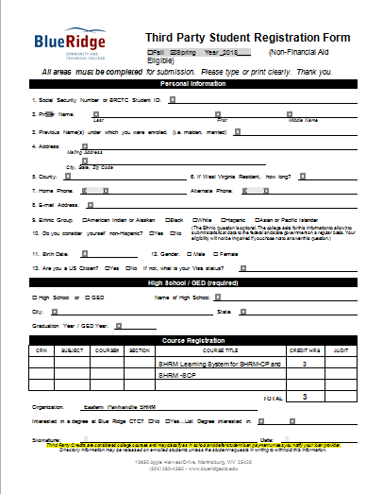

Slide 7
Upcoming Monthly Meetings
April 14th, 8:00am – Communication/Leadership presented by Sarah Fletcher
November 10th, 8:00am – HR Technology & Analytics Part 2 presented by Erica Young
Notes:
Sarah Chick Fil A Leadership Director

Slide 8
Annual Leadership Development Conference – May 21st, 8:30am
"SOMETHING GREATER IS ALWAYS POSSIBLE"
With Devin Henderson
What would you do and who would you be if you believed anything was possible for you? Join seasoned speaker and performer Devin Henderson for an unforgettable experience of entertainment meets inspiration. Part magic & mentalism show, part inspirational keynote, take a break from the worries of the day while breaking free of your perceived limits, as you discover the mindset and practices to realize your greatness like never before.
"GREATNESS AWAITS: FROM POSSIBLE TO PROBABLE"
With Judson Laipply
Recognizing your potential is an essential step on the road to greatness. Understanding the vast power held within yourself and then learning how to implement that to unlock your greatness is nothing short of a superpower; and every one of us has it. Everyone struggles but not everyone is able to navigate through those struggles to achieve greatness. Nothing great ever happened without struggle. Learn to embrace that struggle and then the “how to” that allows you to influence your life and take your possible to probable.
Notes:
Sarah Chick Fil A Leadership Director

Slide 11
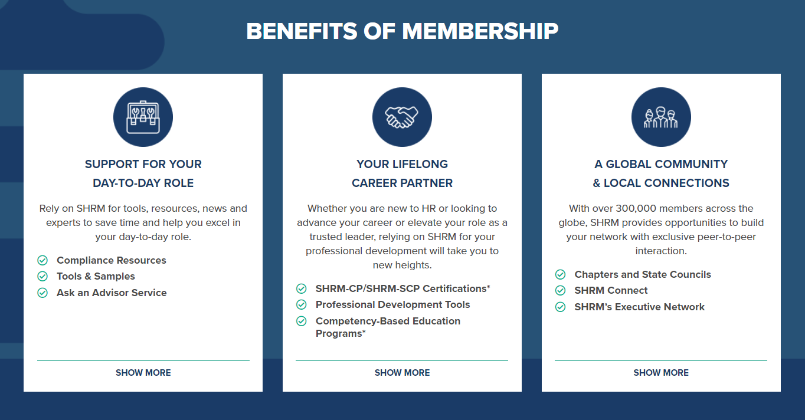

Slide 14
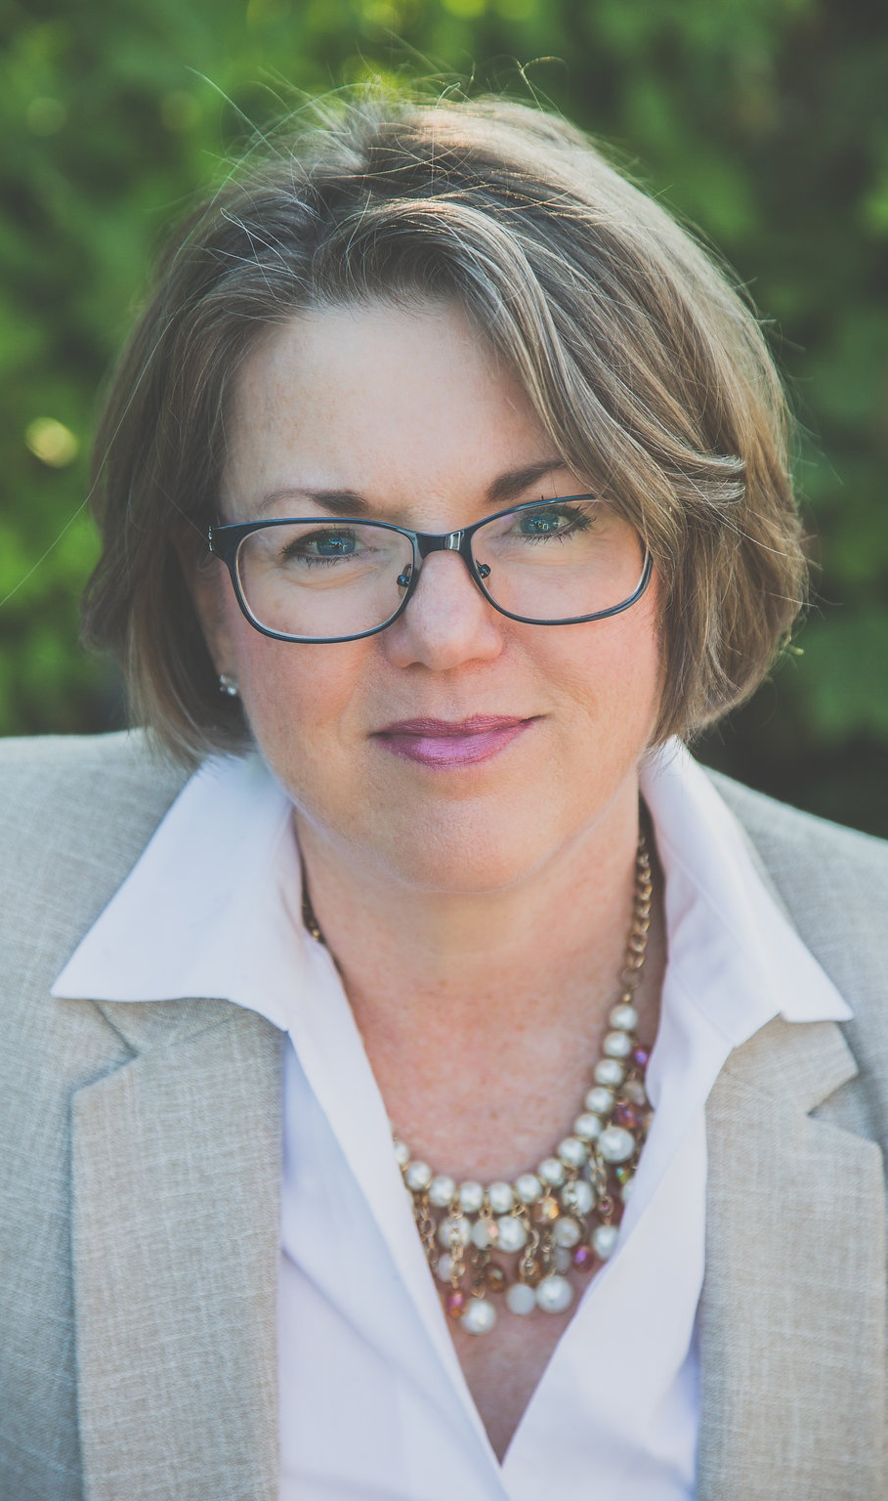
Taking Talent Development Beyond the Norm Presented by Dr. Wendy Anson
Notes:
Dr. Wendy Anson worked as an internal consultant for more than 25 years before launching her own consulting, training, and coaching company, Engaged CTC LLC, in 2018. Dr. Anson has consulted with small organizations and universities on change initiatives, compensation models, and policy reviews. She has provided training on a variety of topics both in person and online. As a Certified Professional Coach, she has documented over 750 coaching working with executives and high potential leaders. Dr. Anson uses research-based techniques from the field of positive psychology that have been demonstrated to help clients achieve their unique goals.
Dr. Anson has a PhD in Industrial & Organizational Psychology from Capella University and a Master’s in Education Human Resource Development from George Washington University. She holds a Senior Certified Professional (SPC) certification from the Society for Human Resource Management and a Senior Professional in Human Resources (SPRH) certification from the Human Resource Certification Institute. Dr. Anson is a member of the International Coaching Federation, the Society of Human Resource Management, and the World at Work.

