Slide 1
The Common Good in HRM Presented by Andrew Miller
March 11th, 2020

Slide 2
Board of Directors – 2020
President: Jesse Sites, SHRM-CP
President Elect: OPEN
Treasurer: Wanda Bonfili
Secretary: Lesley Hower, PHR, SHRM-CP
Past President & Certification Chair: Harvey Ashworth, SPHR, SHRM-SCP
College Relations Chair: Pat Hubbard
Communications Chair: OPEN
Membership Chair: OPEN
Member Liaison: Hanna Kenney, SHRM-CP
Workforce Readiness Chair: Courtney Carroll, SHRM-CP, GCDF
Legislative Chair: Raylea Harvey
Programming Co-Chair: Hadley Ward, PHR, SHRM-CP
Programming Co-Chair: Jessica McIntosh, aPHR

Slide 3
Volunteer Opportunities
Communications Chair - primary responsibilities
sets up online meeting and event registrations
works with partner organizations to share relevant communications (e.g.., Blue Ridge CTC's SHRM-CP/SCP prep course)
copyedits meeting presentation documents
updates ep.shrm.org website
takes/posts photos
Membership Chair - primary responsibilities
maintains membership database
sends membership due notices
reconciles memberships once per month, prior to meetings
works with treasurer on event/meeting/membership payments

Slide 4
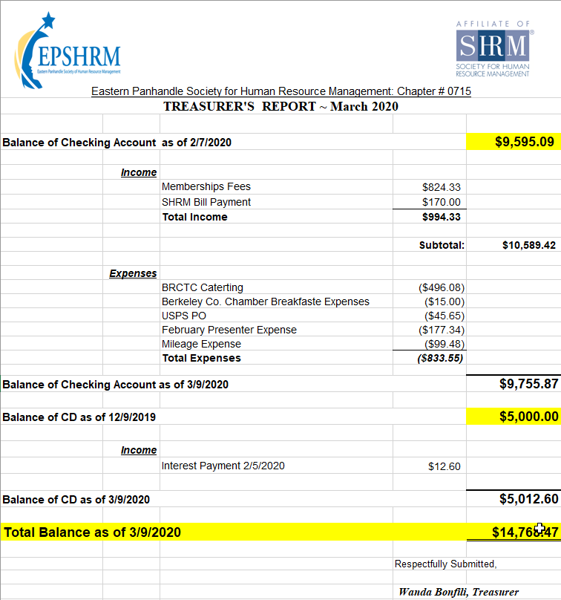
Treasurer’s Report

Slide 5
March Legislative Updates
New Definition of “Joint Employer”: https://www.shrm.org/ResourcesAndTools/legal-and-compliance/employment-law/Pages/NLRB-defines-joint-employer.aspx
Pro Act: https://www.uschamber.com/article/pro-act-introduced-house
The A-Team: SHRM Advocacy@work: http://www.advocacy.shrm.org/about
Notes:
Synopsis:
Each month I try to report on Legal Rulings or Legislative Bills that have been signed into law that would impact the world of HR. I also like to provide resources that you can use on a day to day setting that will help navigate some of the complexities in our ever-changing world.
1. "The IRS will not grant an additional 30-day extension beyond this deadline," and if an employer submits a request for a 30-day extension to furnish these forms, "the IRS will not respond to that request since it is now moot," according to compliance firm Hub International. Even with the automatic extension, "the IRS specifically encouraged employers and other coverage providers to send the forms to employees and individuals as soon as possible."
2. Regular Rate: Under the Fair Labor Standards Act, non-exempt employees must receive one and one half times their regular rate of pay for all hours worked over forty in a work week. On December 16, 2019, the United States Department of Labor (“DOL”) released the final rule updating the regulations that govern how the regular rate is calculated. The new rule is intended to provide additional guidance and address certain types of compensation that have become more common since the regulations were initially implemented. The new rule took effect January 15, 2020.
3. SECURE Act:
Allow unaffiliated employees to offer their workers a 401(k) through a multiple employer plan (MEP), with eased compliance requirements compared to current MEPs.
Delay required retirement distributions from 401(k) plans to age 72, up from age 70 1/2.
Allow automatic-enrollment safe-harbor 401(k) plans to increase the cap on automatically raising payroll contributions
Create a 401(k) safe harbor from liability for offering in-plan annuities.
Reduce annual testing requirements on "frozen" defined-benefit pension plans closed to new hires.
SECURE Act Passage
The Setting Every Community Up for Retirement Enhancement (SECURE) Act, passed by the House in May, contains several compliance changes for 401(k)-type defined contribution plans and to defined-benefit pension plans. The SECURE Act would, among other changes:
Increase the business tax credit for plan startup costs to make setting up 401(k) plans more affordable for small businesses.
Allow unaffiliated employees to offer their workers a 401(k) through a multiple employer plan (MEP), with eased compliance requirements compared to current MEPs.
Delay required retirement distributions from 401(k) plans to age 72, up from age 70 1/2.
Allow automatic-enrollment safe-harbor 401(k) plans to increase the cap on automatically raising payroll contributions.
Create a 401(k) safe harbor from liability for offering in-plan annuities.
Reduce annual testing requirements on "frozen" defined-benefit pension plans closed to new hires.
Most of the SECURE Act's provisions won't take effect until January 2021.
"This legislation will help hard-working Americans prepare for a financially secure future by incentivizing small businesses to set up employer-sponsored retirement plans," said SHRM Chief of Staff Emily M. Dickens, who oversees SHRM Government Affairs.
"Among the many valuable elements of the SECURE Act is a measure that would address a glitch in the nondiscrimination rules affecting participants in frozen pension plans," said Lynn Dudley, senior vice president for global retirement and compensation policy at the American Benefits Council, which represents benefit plan sponsors. "Hundreds of thousands of participants could lose future pension benefits as of Jan. 1, 2020, without a legislative fix."

Slide 6
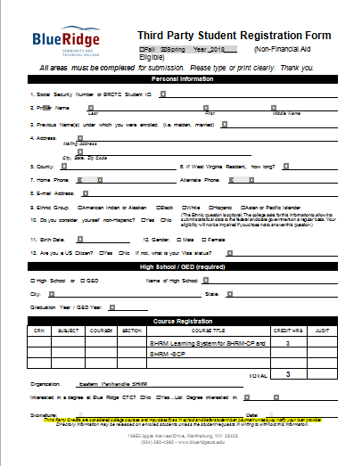

Slide 7
Upcoming Events
April Meeting – Domestic Violence and the Workplace, Katy Spriggs
May – Leadership Conference

Slide 9
Monthly Corporate Sponsor

Slide 10
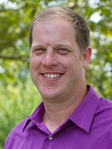
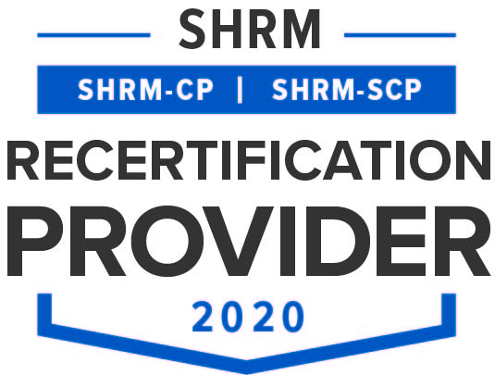
The Common Good in HRM Presented by Andrew Miller

Slide 11
Andrew Miller
Andrew Miller is the Director of Organizational Leadership Studies graduate programs and Instructor at Eastern Mennonite University. He has an interest in working with students and leaders towards self-understanding and personal formation as a foundation for organizational leadership and development. He draws upon his diverse background in strategic leadership studies, economics, and theology as a grounding for this process. His current research work focuses on motivation and leadership in the Gig economy and workplace leader-follower relationships. Before beginning at EMU in the fall of 2012, he served as Southeast Asia Representative for Mennonite Central Committee (MCC) supervising and facilitating strategic development in the Cambodia, Laos, Myanmar, and Vietnam country programs and advising local partners on strategic development. He is captivated by creation and consumption of Cambodian and Southeast Asian cuisine.

