Slide 1
A Culture of Belonging Presented by Becky Mathis-Stump
January 12th, 2021

Slide 2
Board of Directors – 2021
President: Jesse Sites, SHRM-CP
President Elect: Courtney Carroll, SHRM-CP, GCDF
Treasurer: Wanda Bonfili
Secretary: Lesley Hower, PHR, SHRM-CP
Past President & Certification Chair: Harvey Ashworth, SPHR, SHRM-SCP
College Relations Chair: Pat Hubbard
Communications Chair: OPEN
Membership Chair: Sabby Aldaya Lickey, SHRM-SCP
Member Liaison: Hanna Kenney, SHRM-CP
Workforce Readiness Chair: OPEN
Legislative Chair: Raylea Harvey, CEBs
Programming Co-Chair: Hadley Ward, PHR, SHRM-CP
Programming Co-Chair: Jessica McIntosh, aPHR

Slide 3
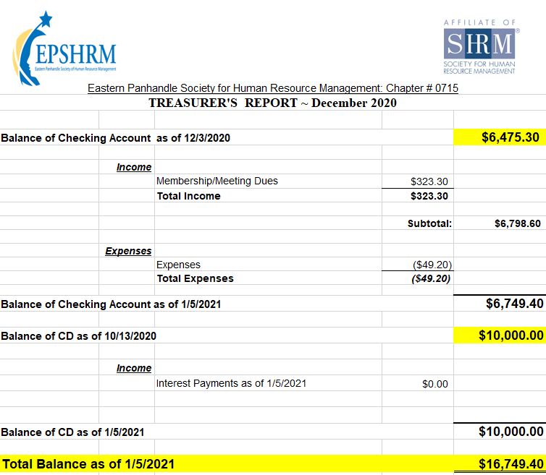
Treasurer’s Report

Slide 4
January Legislative Updates
Families First Coronavirus Response Act (FFCRA) expired?: https://www.dol.gov/agencies/whd/pandemic/ffcra-questions
Consolidated Appropriations Act, 2021 (CAA): https://www.shrm.org/resourcesandtools/hr-topics/benefits/pages/appropriations-act-permits-midyear-fsa-elections-and-unlimited-carryover-amounts-through-2021.aspx
Requiring COVID-19 Vaccine?: https://www.shrm.org/resourcesandtools/legal-and-compliance/employment-law/pages/coronavirus-mandatory-vaccinations.aspx
Second Stimulus: https://www.irs.gov/coronavirus/get-my-payment

Slide 5
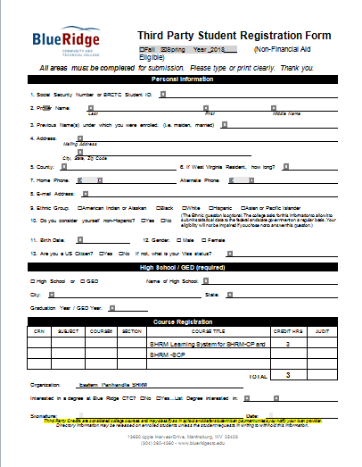

Slide 7
Notes:
January: As we embark on a brand new year, SHRM shares their top considerations for HR in 2021 to help build better workplaces and a better world during January’s episode of Tune in Tuesday!

Slide 9
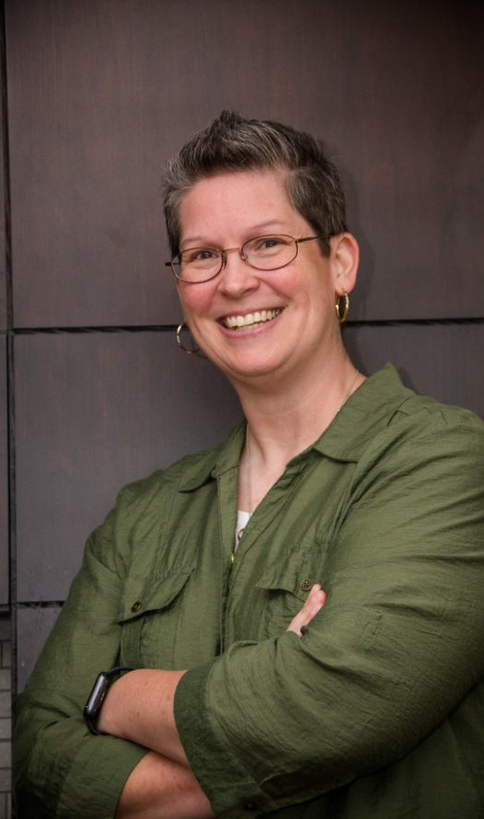
A Culture Of Belonging Presented by Becky Mathis-Stump
Notes:
Rebekah D. Mathis-Stump (Becky) is the Chief Operating Officer of Ethos Leadership Group, LLC. She has a rich background in leadership, strategic analysis and planning, organizational development, governance, and communication.
Becky earned a life membership in The Order of the Barristers, a national honor society recognizing excellence in oral advocacy, while completing a doctorate of jurisprudence at West Virginia University College of Law.
Becky is married to West Virginia native, Jeff Stump, and spends a good portion of her free time with him – golfing or cheering on the Mountaineers.

