Slide 1

Overview of the
Americans with Disabilities Act and the ADA Ammendments Act

Slide 2
Presented By:
Karen Goss
Assistant Director
Mid-Atlantic ADA Center
kgoss@transcen.org
301-217-0124 v/tty

Slide 3
ADA = Civil Rights

Slide 4
What is the ADA?
Americans with Disabilities Act, passed in 1990
Federal CIVIL RIGHTS legislation that says it is illegal to discriminate against people with disabilities in employment, state and local government services, private businesses, telecommunications and transportation
Goal: The full inclusion of people with disabilities in all aspects of American society
Notes:
4

Slide 5
Why was the ADA needed?
Think back to before 1990…
There were fewer curb cuts
Many businesses were not accessible
People with disabilities were rarely seen in advertisements and TV shows
Interpreters were rarely used at public events
People with disabilities were excluded from many activities due to barriers
Notes:
Can you think of other examples of things that have changed?

Slide 6

In summary: Legislative timeline
1964—Civil Rights Act (did not include disability)
1968—Architectural Barriers Act (ABA)
1973—Rehabilitation Act (amended 1998—Section 508)
1975—Individuals with Disabilities in Education Act (IDEA)
1976—Higher Education Act Amendment (to include students with disabilities)
1986—Air Carrier Access Act
1988—Fair Housing Amendments Act
1990—Americans with Disabilities Act (ADA)
2008—ADA Amendments Act signed into law

Slide 7

Who is “covered” (must comply with ) the ADA
Entities with 15 or more employees
Public (government) agencies regardless of whether they receive federal assistance
Privately operated commercial entities (for example, private schools and colleges, banks, restaurants, theaters, hotels, private transportation, supermarkets, shopping malls, museums, recreational facilities, sports arenas, medical, legal and insurance offices)
Exempt: Private clubs and religious organizations

Slide 8

The ADA (1990)
  ADA disability definition
  based on the 1973 Rehabilitation Act
  An individual who has a physical or mental impairment that substantially limits one or more major life activities
  An individual who has a record of such an impairment
  An individual who is regarded as having such an impairment

Slide 9

Five Titles of the ADA
Title I. Employment
Prohibits disability discrimination in all employment processes
Title 2. Accessibility in public entities
Physical and program accessibility in state/local govt. entities
Title 3. Accessibility in businesses
Physical and program accessibility in restaurants, hotels, stores, places of business
Title 4. Telecommunications
Telephone and communications systems for the public
Title 5. Miscellaneous
Protection from retaliation

Slide 10
What is the ADAAA?
Americans with Disabilities Act Amendments Act (ADAAA) 2008
Overall purpose -- “To restore the intent and protections of the Americans with Disabilities Act of 1990”
Effective January 1, 2009
Regulations effective as of May 24, 2011

Slide 11

So why was the ADAAA passed?
U. S. Supreme Court rulings narrowed the definition of disability such that:
Focus of attention more on whether the individual has a disability instead of on the alleged discrimination event
The Supreme Court’s decisions construed the term “disability” too narrowly resulting in fewer individuals included under its protections
The EEOC’s current regulation defining “substantially limits” as “significantly restricted” expresses too high a standard and is inconsistent with Congressional intent

Slide 12
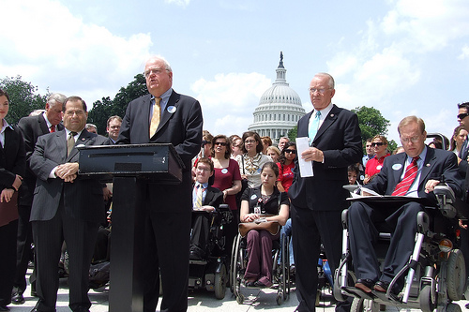
How did the ADAAA change the definition of disability?
Restored the definition (and protection) to the original intent of Congress in 1990
Definition itself did not change
Interpretation of the phrases in definition changed
    Mitigating measures
    Episodic conditions
    Some impairments considered disability without extensive analysis
    Broadened protections under “Regarded as”

Slide 13
Remember this definition?
The ADA (1990)
  ADA disability definition
  based on the 1973 Rehabilitation Act
  An individual who has a physical or mental impairment that substantially limits one or more major life activities
  An individual who has a record of such an impairment
  An individual who is regarded as having such an impairment

Slide 14
Expanded Definition of Disability under the ADAAA
Now impairment need not prevent, significantly or severely restrict the performance of a major life activity.
Now, disability “shall be construed in favor of broad coverage “ and “ should not require extensive analysis"

Slide 15
Major Goals of New Legislation
To restore the ADA’s broad protections as intended by Congress
To reject the Supreme Court’s view that “disability” should be determined taking into consideration the effects of mitigating measures
To reject the Supreme Court’s holding that the ADA requires a “demanding standard” for establishing coverage and requires that an impairment “severely restrict” major life activities

Slide 16
Statutory Changes to
Definition of “Disability”
“Substantially limited” redefined
Major life activities include “major bodily functions”
Effects of mitigating measures (other than ordinary eyeglasses or contact lenses) cannot be considered in determining “disability”
Impairment that is episodic or in remission is a disability if it would be “substantially limiting” when active

Slide 17
Examples of Impairments That Will
“Consistently Meet the Definition of Disability”
Due to lower substantially limits standard, new mitigating measures rule, inclusion of major bodily functions as major life activities, and new episodic/in remission rule for some types of impairments, “the individualized assessment of the limitations on a person can be conducted quickly and easily” and they will “consistently meet the definition of disability”
Examples include deafness, blindness, intellectual disability, partially or completely missing limbs, mobility impairments requiring use of a wheelchair, autism, cancer, cerebral palsy, diabetes, epilepsy, HIV/AIDS, multiple sclerosis, muscular dystrophy, major depression, bipolar disorder, post-traumatic stress disorder, obsessive-compulsive disorder, and schizophrenia

Slide 18
Examples of Impairments that May Be
Disabling for Some Individuals But Not For Others
Impairments such as asthma, back and leg impairments, carpal tunnel syndrome, and learning disabilities
May require somewhat more analysis to determine whether they are substantially limiting for a particular individual
Level of analysis still should not be extensive

Slide 19
Examples of Impairments that
Usually Will Not Be Disabilities
Temporary, non-chronic impairments of short duration with little or no residual effects are usually not disabilities:
the common cold, seasonal or common influenza, a sprained joint, minor and non-chronic gastrointestinal disorders, or a broken bone that is expected to heal completely

Slide 20
Major Life Activities
Write down 5 different activities that you did this morning that involve a major life activity.
hint : seeing and hearing are major life activities.

Slide 21
Major Life Activities
These are basic activities that the average person in the general population can perform with little or no difficulty.
Caring for Oneself
Performing Manual Tasks
Seeing
Hearing
Eating
Sleeping
Walking
Standing
Lifting
Bending

Slide 22
Major Life Activities continued
Thinking
Communicating
Sitting
Reaching
Interacting with Others
Working
Breathing
Learning
Reading
Concentrating
Thinking
Speaking

Slide 23
Under the ADAAA, 'major life activities' is expanded to include "major bodily functions."
Brain
Circulatory
Cardiovascular systems
Neurological
Immune system
Normal cell growth
Digestive
Bowel
Bladder

Slide 24
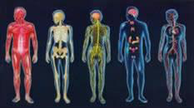
Major Bodily Functions continued
Respiratory
Endocrine
Lymphatic
Musculoskeletal
Special sense organs and skin
Genitourinary
Reproductive functions

Slide 25
New Standard
Episodic Disabilities:
epilepsy
hypertension
multiple sclerosis
asthma
diabetes
major depression
bipolar disorder
schizophrenia
cancer
Considered a disability even in remission, if when active would be substantially limiting

Slide 26
Mitigating Measure
Any device, measure, or medication that reduces the effects of the disability

Slide 27
Mitigating Measures
Positive effects of mitigating measures (except for ordinary eyeglasses and contact lenses) are ignored in determining whether an impairment is substantially limiting.
Notes:
The Sutton trilogy was a series of three Supreme Court decisions that required the consideration of mitigating measures before determining whether someone had a disability or not. These decisions significantly limited the number of people who were considered disabled under the ADA.

Slide 28
The Americans with Disabilities Act
Title I: Employment
Title II: State and Local Gov’t
Title III: Private Business
Title IV: Telecommunications
Title V: Miscellaneous

Slide 29

ADA Title I - Employment
An employer may not discriminate against an employee on the basis of disability in any aspect of the employment relationship.

Slide 30
ADA Title I - Employment
The activities covered include:
  Outreach, Application Process, Testing
  Interviewing, Hiring, Assignments
  Evaluation, Discipline, Medical Examinations
  Compensation, Promotion, On-the-Job Training
  Layoff/Recall, Termination, Leave
  Benefits of employment e.g., health insurance

Slide 31

Title I ensures that qualified individuals with disabilities:
Have comparable access to the employment process
Are afforded an interactive process to determine reasonable accommodation
Are provided access to all benefits of employment including access to related services (e.g., gym, transportation)

Slide 32
Qualified Individual with a Disability
A qualified individual with a disability means one who satisfies the requisite skill, experience, education, and other job-related requirements of the position such individual holds or desires, and who:
    with or without reasonable accommodation can perform the essential functions of such position.

Slide 33

Title I Enforcement
File a complaint with the EEOC
Other Options:
  File a complaint with the state or local Human Relations Agency
  Alternative Dispute Resolution
Notes:
33

Slide 34

Title II
State and Local Governments

Slide 35

General Requirements
State and local government must provide full program access to people with disabilities.

Slide 36
Title II: Program Access
Programs accessible “when viewed in their entirety”
ADA does NOT give special privileges or entitlements for people with disabilities – it’s about equality!
Each state program should insure everyone can access all facets of the program
Reasonable Modifications to insure programs accessible

Slide 37
Who is Covered by Title II?
Every type of state and local government entity, including:
    all types of state agencies
    counties
    municipalities and cities
    executive, legislative, and judicial branches of state and local government

Slide 38
General Requirements
A public entity must reasonably modify its policies, practices, or procedures to avoid discrimination.

Slide 39

Title III
Public Accommodations

Slide 40
Title III: Public Accommodations
Places of public accommodation may not deny people with disabilities goods or services.

Slide 41

Public Accommodations
Public accommodations are private entities that own, lease, lease to, or operate a place of public accommodation.
A facility operated by a private entity whose operations affect commerce and that falls within at least one of twelve categories.

Slide 42
Title III Requirements:
Effective Communication
Businesses must to take steps to provide “auxiliary aids or services” (exchange written notes, provide sign language interpreter services, Braille materials, etc.) when necessary to communicate effectively with customers with vision, hearing and speech disabilities
If a specific communication aid or method would be an undue burden or fundamental alteration, a business must provide an effective alternative, if there is one

Slide 43
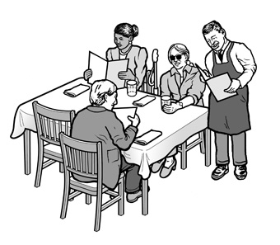
What are some accommodations that restaurants could make for:
A customer who has a visual disability?
A customer who is Deaf?
A customer who uses a wheelchair?

Slide 44
Title III Requirements:
Physical Access
Architectural accessibility
  For new facilities – built after March 15, 2012 must meet the 2010 standards
Readily achievable barrier removal
  In existing facilities

Slide 45
Question:
What are some examples of readily
achievable barrier removal?

Slide 46
Possible Answers
Widening a door
Installing grab bars
Building a ramp
Changing round door knobs to lever handles
Reducing the pressure to open a door
Rearranging furnishings / equipment

Slide 47
Alternatives to Barrier Removal
If barrier removal is not readily achievable, public accommodations must make goods and services available through readily achievable alternative methods

Slide 48
Examples: Alternatives
Service at other accessible locations
Home delivery
Door bell to request service
Moveable chairs to provide access where fixed seating is not accessible
Signage to alert patrons of alternatives

Slide 49
Religious organizations are exempt from Title III
Churches, mosques, synagogues and all of their activities, even if they are open to the public, do not have obligations under Title III.

Slide 50
Available Tax Write-Offs
50% TAX CREDIT for Small Business ($1 million gross income OR less than 30 employees)
Tax Deductions for Larger Businesses
Capital Improvements Need Not Be Depreciated

Slide 51


Title II & III Enforcement
File a complaint with the Department of Justice or Department of Transportation
Private lawsuits
Alternative Dispute Resolution including mediation

Slide 52

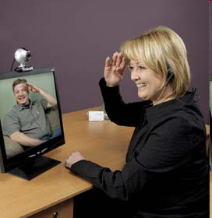

Title IV: Telecommunications
Requires that all telecommunications companies in the U.S. take steps to ensure functionally equivalent services for consumers with disabilities.

Slide 53

Title IV: Telecommunications
Federal Communications Commission is the enforcement agency for Title IV

Slide 54
Title V: Miscellaneous
Some of these items include:
Coverage of Congress by the ADA
Recovery of legal fees
Prohibition of coercing, threatening or retaliating
Requirements for historic properties
The role of federal agencies enforcing the ADA and providing technical assistance

Slide 55
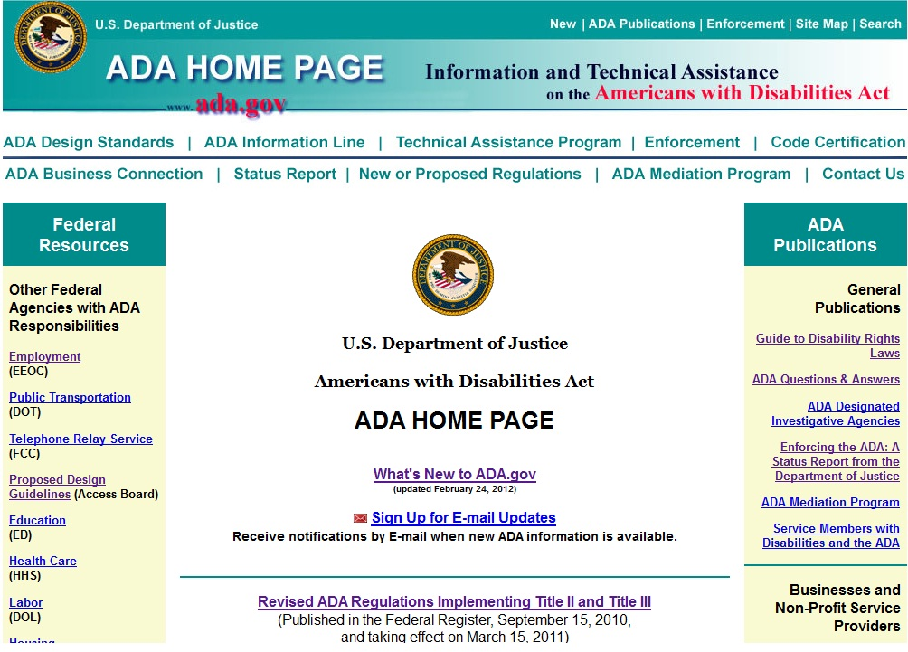
U.S. Department of Justice http://www.ada.gov

Slide 56
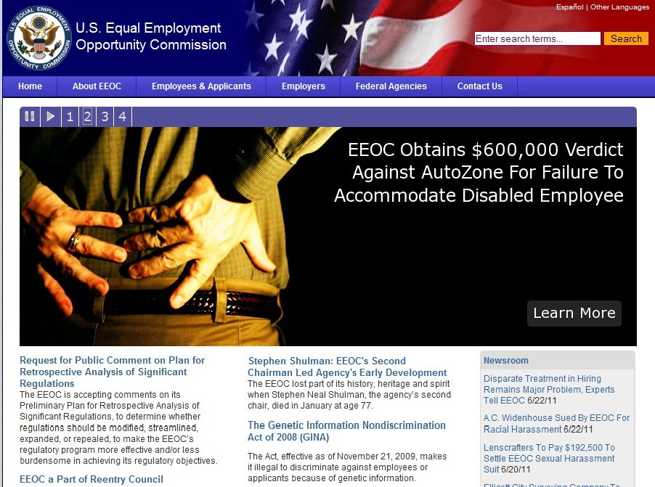
Equal Employment Opportunity Commission
http://www.eeoc.gov

Slide 57

Job Accommodation Network
http://www.askjan.org

Slide 58
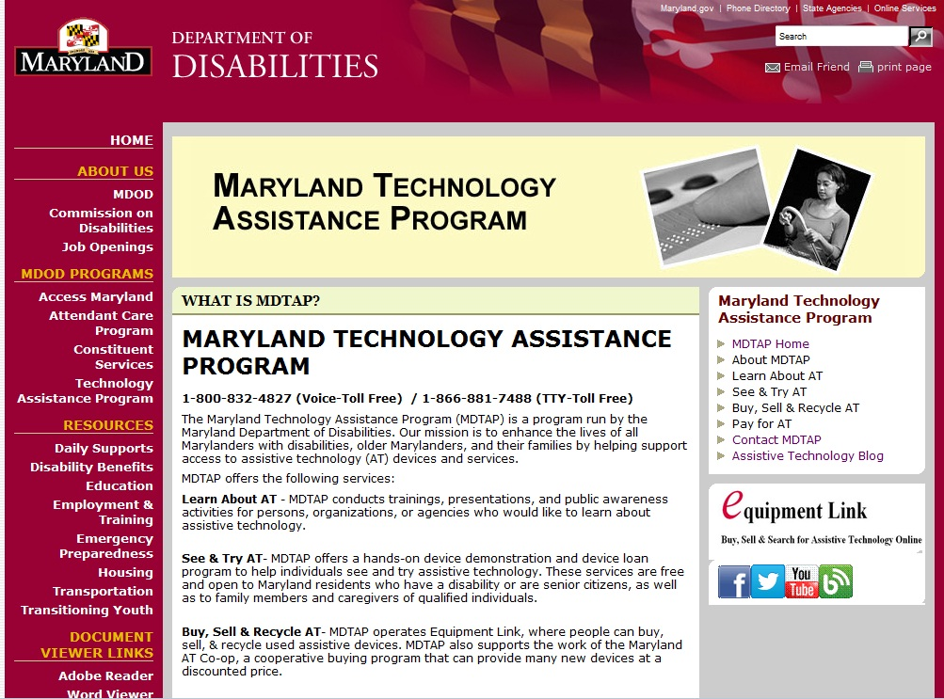
MDTAP
Maryland Technology Assistance Program
Learn about Assistive Technology
See and Try Assistive Technology
Buy, Sell & Recycle Assistive Technology
http://www.mdtap.org
1-800-832-4827 (Voice-Toll Free)
1-866-881-7488 (TTY-Toll Free)

Slide 59
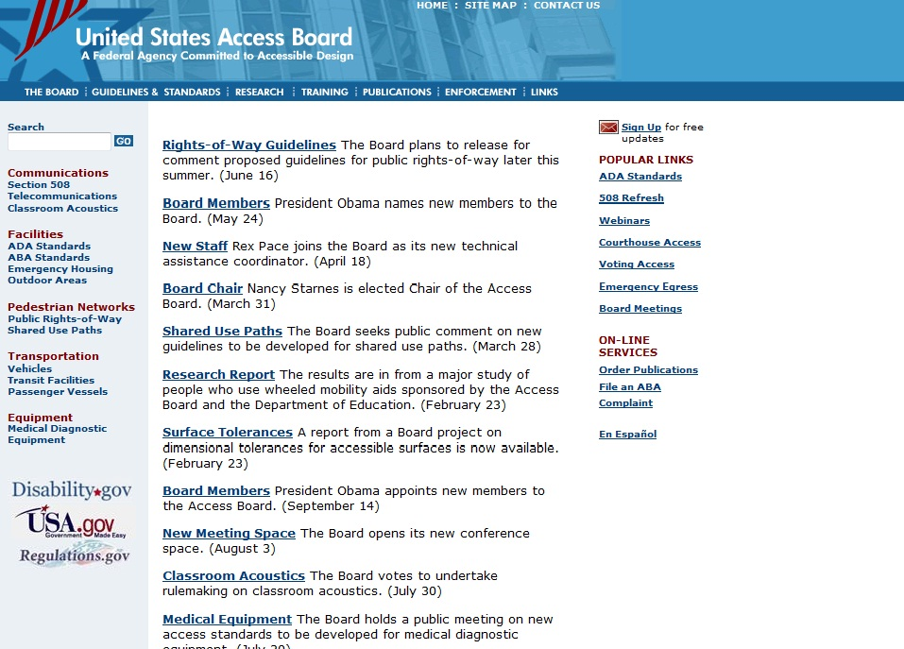
United States Access Board
http://www.access-board.gov

Slide 60

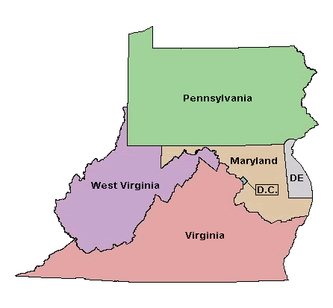
1 of 10 Regional Centers Providing:
Information
Guidance
Materials
Newsletter/E-Bulletin
Training
Toll-free phone number:
800-949-4232 V/TTY
Website: www.ADAinfo.org
60
Notes:
60

Slide 61
Questions?

