Slide 1
Social Media & Professional Development
Presented by the APUS Social Media Team
Madeline Roberts & Rachel A. Adler

Slide 2
Contact Us!
Madeline Roberts
mroberts@apus.edu
Connect on LinkedIn
Follow on Twitter
Rachel Adler
radler@apus.edu
Connect on LinkedIn
Follow on Twitter

Slide 3
Agenda
Using social media as an HR professional
Recruiting candidates
Promoting your place of work
Policing employees
Creating a personal brand
Twitter
LinkedIn
Instagram
Looking Forward in 2015

Slide 4
Why We Use Social Media
Communication
Building relationships
Reputation management
Corporate social responsibility
Customer service
Information
Entertainment

Slide 5
Platforms
LinkedIn
Professional network connecting 65+ million members from 170 industries
Twitter
Microblogging platform with messages in 140 characters or less
Facebook
Social networking site with more than 400 million users
Intended to connect friends, family, business associates
Used by companies to connect with customers
Instagram
Image-based platform
200 million monthly active users
Used by individuals and brands alike

Slide 6
Recruiting: Know Your Audience
Job seekers and recruiters use the same platforms but to a different degree

Slide 7
Recruiting: Where to Post Openings
Company-owned channels
LinkedIn Company Page – Careers tab
Facebook Page
Twitter
Google+
Personal networks
Share with your personal social network of friends and family
Use hashtags – broad & niche
#jobsearch #hiring #ITjobs
#jobopening #consulting #dcjobs

Slide 8
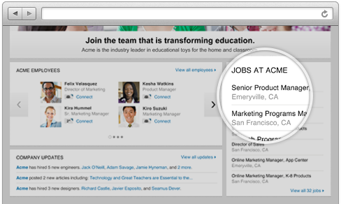
Recruiting: Finding & Vetting Candidates
LinkedIn Recruiter
Powerful search capabilities
Contact candidates through InMail
Track & manage talent to hire now or in the future
Twitter Searches & Chats
Participate in chats (ongoing or create your own)
Follow hashtags used by job seekers
#hireme #needajob #resume
#unemployed #MBA #jobhunt
Facebook Directory
Search pages, groups, users

Slide 9
Apps for Recruiters & Job Seekers
Jobr – browse for jobs & connect with employers
Poacht – “covert job search for the currently employed”
Cuts sourcing time by 40% and cost to hire by 75%
Poachable – find currently employed candidates
SpringRole – referral-based
Switch – for jobs in Tech field
TheLadders Recruiter – built to save time by showing relevant candidates & making it easy to connect
Notes:
These are just a few of the apps that job seekers and recruiters have at their disposal.

Slide 10
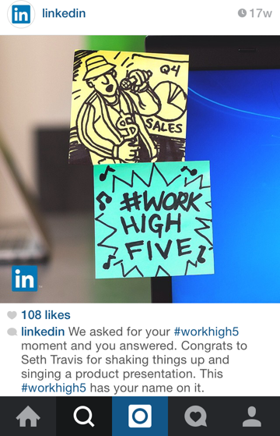
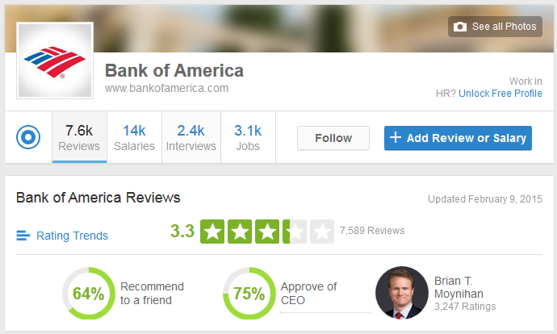
Great Place to Work
Attract potential employees by showing company culture
LinkedIn Company Page
Instagram – show behind-the-scenes pics, corporate life
Reviews on Glassdoor

Slide 11
Social Media & Current Employees
Understand National Labor Relations Board rules
Develop internal Social Media Policy
Set forth expectations
Outline escalation plan
Communicate the policy
Share internally
Train employees

Slide 12
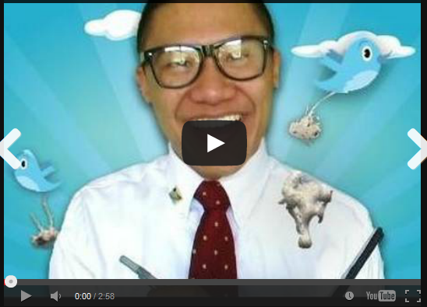
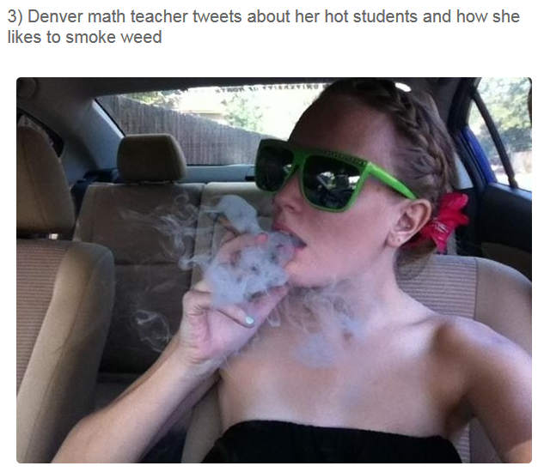
Job offer extended from Cisco. This tweet resulted in the offer being rescinded.
CPK employee Tweeted about restaurant’s uniforms. Managers contacted & he was fired.
Notes:
These are some of the “worst case” examples of poor social media use by potential or current employees.

Slide 13
Creating a Personal Brand
Audiences tend to trust people more than corporations
What are your goals?
Gain awareness (be visible)
Build trust (be consistent)
Earn loyalty (be valuable)
Three steps
Discover who you are
Create your identity
Make it visible
“Your brand is what people say about you when you’re not in the room.”
Jeff Bezos, founder & CEO Amazon.com

Slide 14
Using Twitter to Build Your Brand

Slide 15
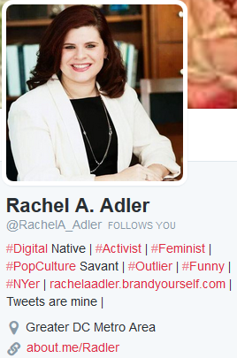
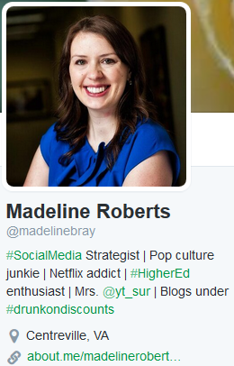
Build Your Profile
professional picture
Handle that makes sense
160 characters
use # and @

Slide 16
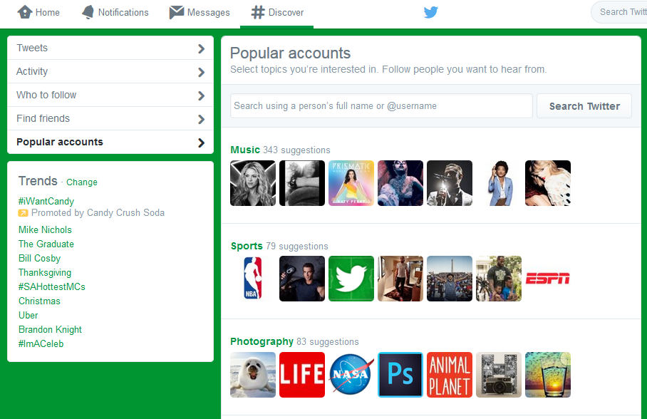
Who to Follow

Slide 17
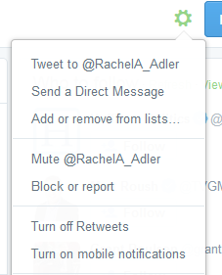
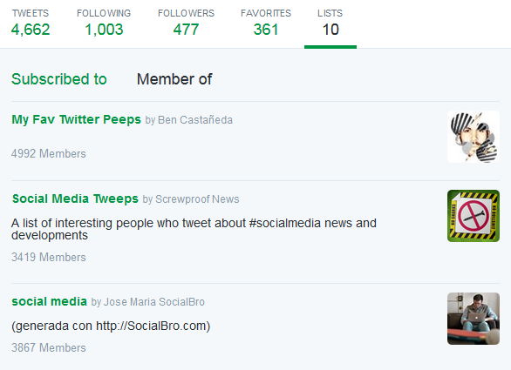
Create a List
Lists are curated groups of Twitter users – create your own or subscribe to ones created by others
For reading tweets, not tweeting to that specific group

Slide 18
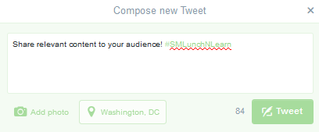
How to Tweet & RT
You have a 140 Characters (Includes text, spaces, images & web URLS)
Twitter will count the characters for you
If you go over the limit, try using abbreviations or rephrasing some of your sentences
Links & images take up 20 characters
Twitter's retweet feature allows you to repost other people's tweets so your followers can read them too

Slide 19
Twitter Shorthand
RT – Retweet
MT – Modified Tweet
# - Hashtag
@ - Tweet directed to specific user
.@ - Tweet directed to specific user that your followers can see

Slide 20
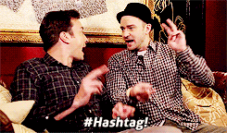
What is a Hashtag?
Word or phrase beginning with a # symbol with no spaces or punctuation: #tbt #dcjobs #GRAMMYs #entrepreneur
Hashtags group conversations about topics making them easier to find, follow, and join
Extend your own brand and distribute your content to certain interests and groups

Slide 21
What & When to Tweet
What?
Look at trending topics
Mix of professional & personal
Source attribution
When?
Depends on your audience and geographic location
Live tweet events or TV shows
Participate in Twitter chats
Schedule it!

Slide 22
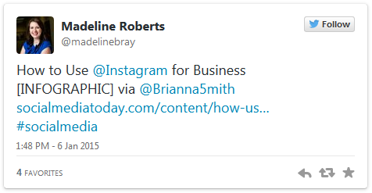
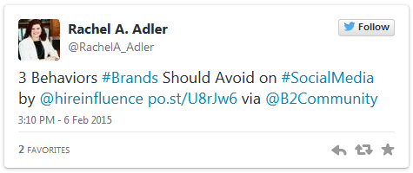
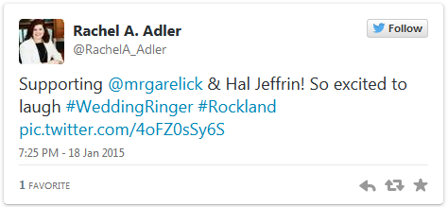
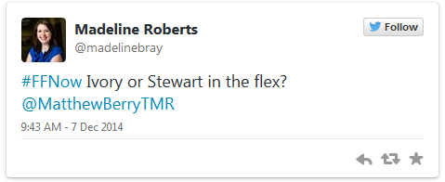
Variety of Content
Notes:
Twitter is not just for posting about your company or industry – show your true self with a mix of professional and personal tweets.

Slide 23
Twitter Tools
Publishers
Tweetdeck
Hootsuite
Buffer
IFTTT (if this then that) – triggered actions, not just for Twitter
Analytics
SocialBro
Twitonomy
Content Discovery
Klout – curates articles based on your interests, allows you to schedule and improves your social influence
Nuzzel – discover what your friends are reading

Slide 24
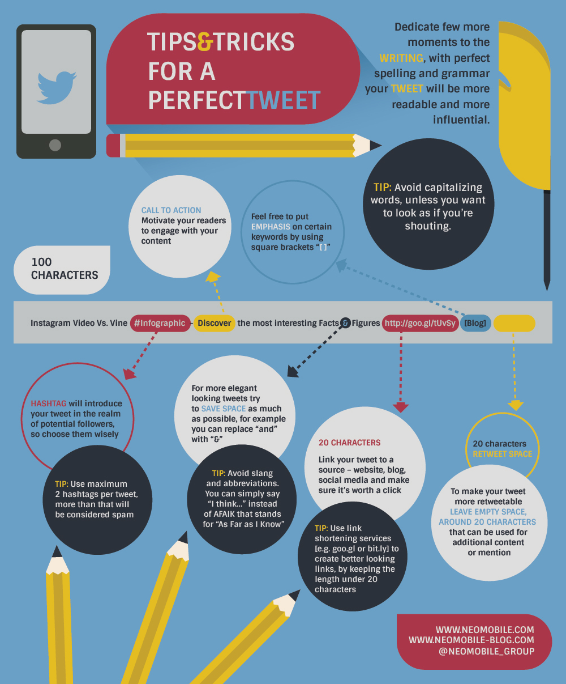

Slide 25
Branding Yourself on LinkedIn

Slide 26
Complete Your Profile
Professional photo
Descriptive headline
Experience, education, certifications
Organizations, volunteer work
Publications (articles, videos, photography)

Slide 27
LinkedIn Profile Checklist
Photo: It doesn’t have to be fancy. Wear a nice shirt and don’t forget to smile. It is more inviting.
Headline: Tell people what you’re excited about now & the awe-inspiring things you want to do in the future.
Summary: Describe what motivates you, what you’re skilled at, and what’s next. As well as your contact information.
Experience: List the jobs you held, even if they were part-time, along with what you accomplished at each. Even include photos, writes ups or videos from your work or of your work.
Recommendations: Ask managers, peers & co-workers who've worked with you closely to write a recommendation. This give extra authority to your strengths & skills. *Don’t forget to all give out recommendations this expands your network & your credibility as well.*
Education: Starting with college, list all the educational experiences you've had - including summer programs or year abroad.
Courses: List the classes that show off the skills & interests you're most excited about.
Volunteer Experiences & Causes: Even if you weren't paid for a job, be sure to list it. Admissions officers and employers often see volunteer experience as just as valuable as paid work.
Skills & Expertise: Add at least 5 key skills - and then your connections can endorse you for the things you're best at. Think of this as your personal SEO (search engine optimization).
Honors & awards: If you earned a prize, don’t be shy. Let the world know about it!
Projects: Whether you led a team assignment or built an app or website on your own, talk about what you did & how you did it.
Notes:
http://www.thesocialmediahat.com/article/ultimate-guide-perfect-linkedin-profile

Slide 28
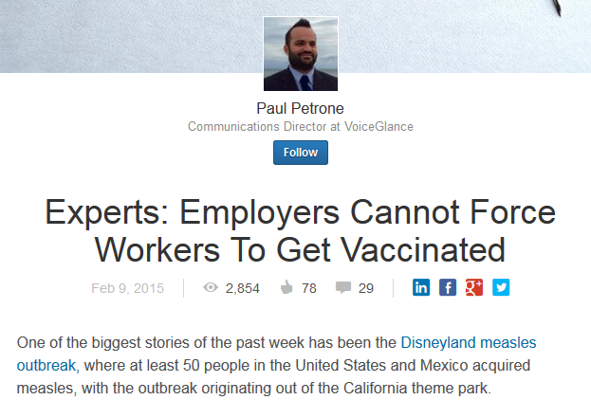
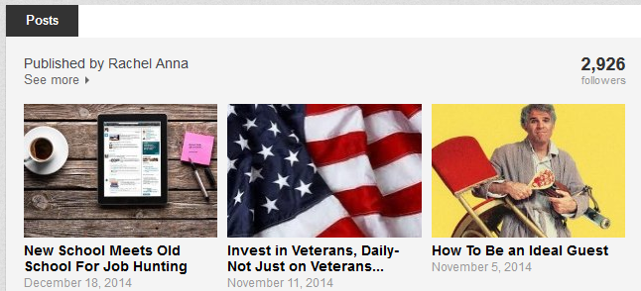
LinkedIn Publishing
Way for members to contribute professional insight
Long-form content becomes part of your profile
Searchable on and off LinkedIn
Added to Pulse section (if content is relevant)
For more information on how to get started please see SlideShare.

Slide 29
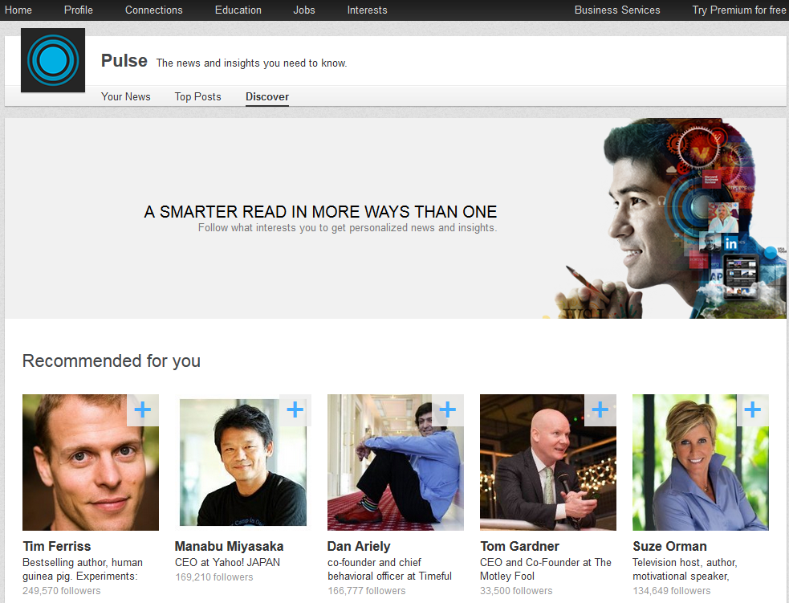
Make Connections & Find News
Join groups based on your…
Area
Industry
Interests
Start and join discussions
Use Pulse to find news
Comment
Share with your network

Slide 30
What is Instagram?
Free smartphone app used to capture and share the world’s moments
Fast, beautiful & fun way to share your life with friends through a series of pictures and videos

Slide 31
Why Use Instagram?
Consumer change
Consumer behavior and shift towards visual content
80% of the brain is dedicated to visual processing
Content is King
Instagram allows you to create and publish content easily
Source content
Get influencers and locals (including photographers) to help build your content bank by introducing your own #hashtag
Republish content (and give credit) to your content creators (when they use your # or give you approval)
Highly engaged community
Notes:
EVERY DAY
•60 million photos are uploaded
•84.4 million comments are posted
•1.6 billion likes on photos
Source: http://www.slideshare.net/homehelper/visual-creative-thinking-1260733 & http://www.socialmedianews.com.au/social-media-statistics-australia-february-2014/

Slide 32
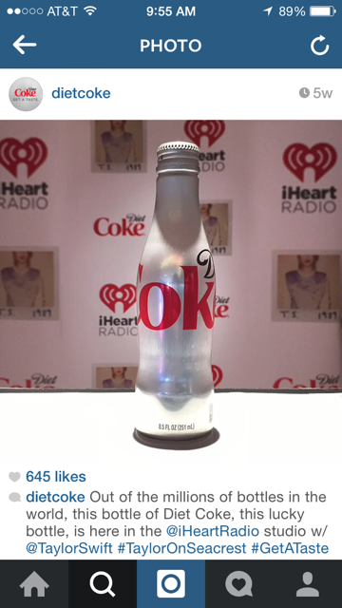
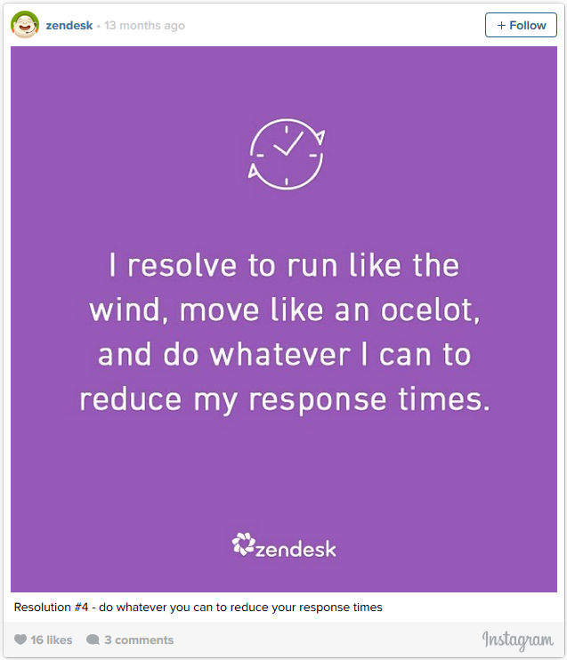
Taking People With You
Instagram is great for showing a moment or a snapshot
Great Instagram accounts take their followers with them…
On the road
Behind the scenes
Sneak peaks into new products or events
Think Instagram is just for younger consumer audiences? These B2B brands can make you think again.

Slide 33
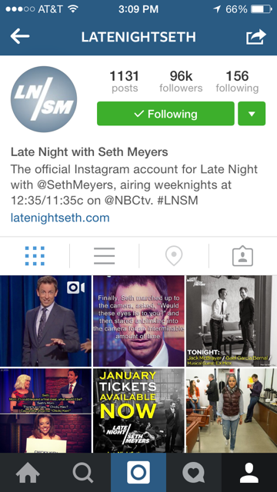
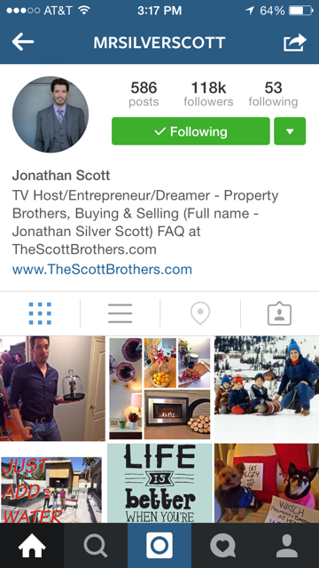
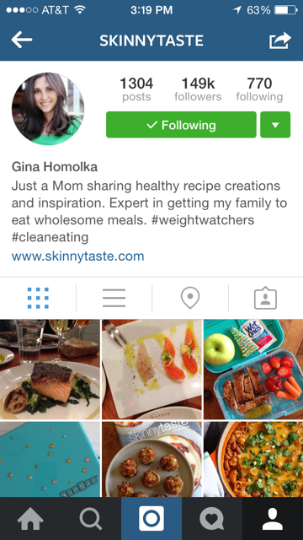
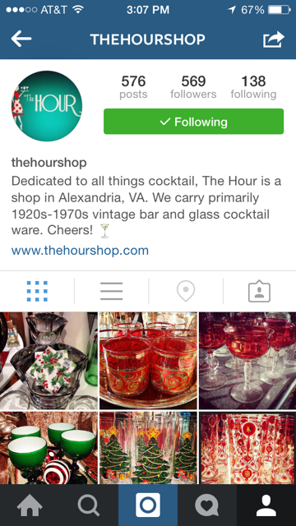
Who’s on Instagram?
TV Shows
On-air Personalities
Bloggers
Local Businesses

Slide 34
Using Instagram
Newsfeed → just like Facebook where you’ll find images from the instagrammers you follow
Explore → find instagrammers and topics using #hashtags
Take a pic or video, upload an existing image or video file
Your notifications → See who’s followed, liked or commented on your pics
Your profile → See your bio, followers, who you’re following, your pics & pics you’re tagged in

Slide 35
Hashtag = Content Distribution
Use ones relevant to your destination (research in www.iconosquare.com )
Add popular hashtags to relevant images to grow audience & engagement
#qotd
#instagood
#photooftheday
Add a unique hashtag to source content and build a community
Communicate your hashtag in your profile
#CalmYourFarm → too many hashtags or ones that don’t make sense will be ignored (especially in the 1st comment)
Notes:
Source: http://blog.viralheat.com/2013/09/12/instagram-for-business/

Slide 36
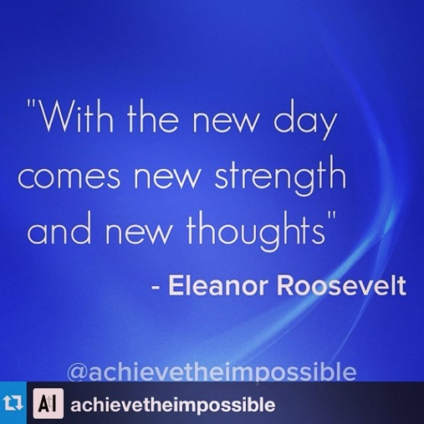
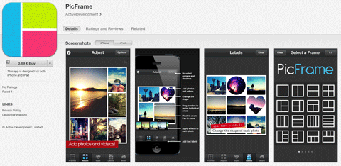
Instagram Extras
Repost
Snapseed
PicStitch/PicFrame
Hyperlapse
TimeHop
Top hashtags & users

Slide 37
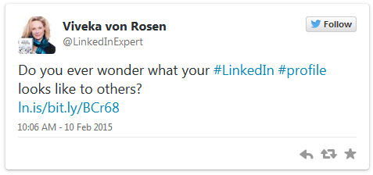
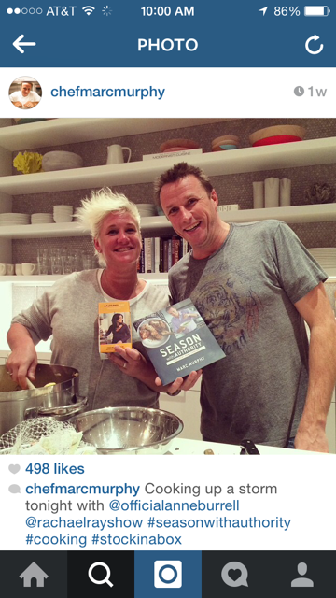
Before You Post
Is it valuable?
Does it fit within my personal brand?
Did I include source attribution?
Did I add relevant hashtags?

Slide 38
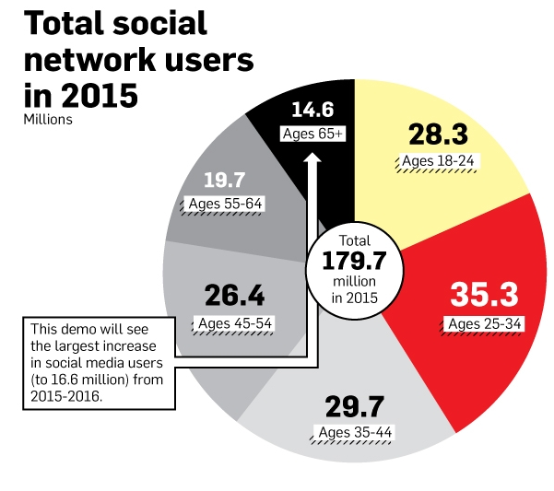
Who's Really Using Facebook, Twitter, Pinterest, Tumblr and Instagram in 2015
What to look forward to in 2015:
Facebook at Work
The rise of video (YouTube, Vine, SnapChat, Yik Yak etc.)
Privacy
Data Analytics
Beyond the Resume
Passive Candidates- Open to New Opportunities
LinkedIn University Pages
LinkedIn Hiring Trend 2015

Slide 39
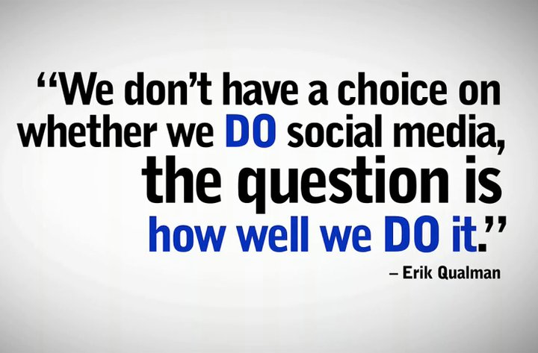
Summary
Social media can be used for…
Finding and researching candidates
Promoting your company
Monitoring employee activities
Personal branding is a way to…
Establish credibility
Grow your network
Attract opportunities

