Slide 1
April 10th, 2019
The Family and Medical Leave Act (FMLA)
presented by attorney:
J. Tyler Mayhew, Esq.
of Bowles Rice LLP.
Established 2007

Slide 2
Board of Directors – 2019
President: Harvey Ashworth, SHRM-SCP
President Elect: Jesse Sites, SHRM-CP
Treasurer: Lori Turner, SHRM-CP, transitioning to Courtney Carroll
Secretary: Lesley Hower, PHR, SHRM-CP
Past President & Certification Chair: Justin Ruble, SPHR, SHRM-SCP
College Relations Chair: Pat Hubbard
Membership & Communications Chair: JiJi Russell, SHRM-CP
Member Liaison: Hanna Kenney, SHRM-CP
Workforce Readiness Chair: Courtney Carroll, SHRM-CP, GCDF
Legislative Chair: Raylea Harvey
Programming Co-Chair: Hadley Ward, PHR, SHRM-CP
Programming Co-Chair: Jessica McIntosh, aPHR

Slide 3
SAVE THE DATE

Slide 4
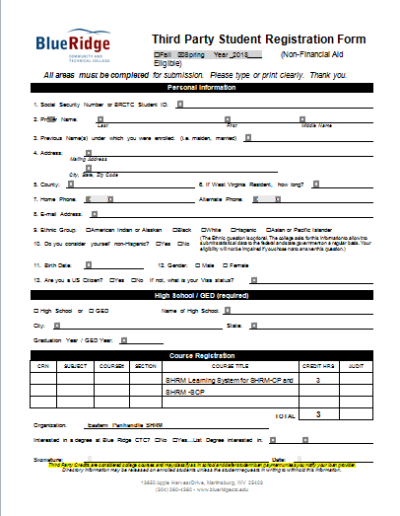

Slide 5
Corporate Sponsor
Bowles Rice LLP
ATTORNEYS AT LAW
101 West Queen Street
Martinsburg, West Virginia, 25403

Slide 6
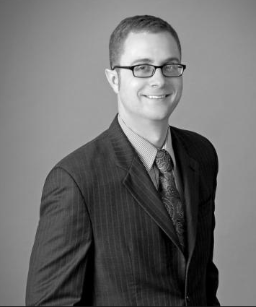
J. Tyler Mayhew, Esq.
of Bowles Rice LLP.
Tyler Mayhew focuses his practice on labor and employment law, commercial litigation, and appellate litigation. Mayhew advises employers on human resources and compliance matters, and employment policies.

